Slide 1
Online Engagement
Stan Garfield
August 11, 2016

Slide 2
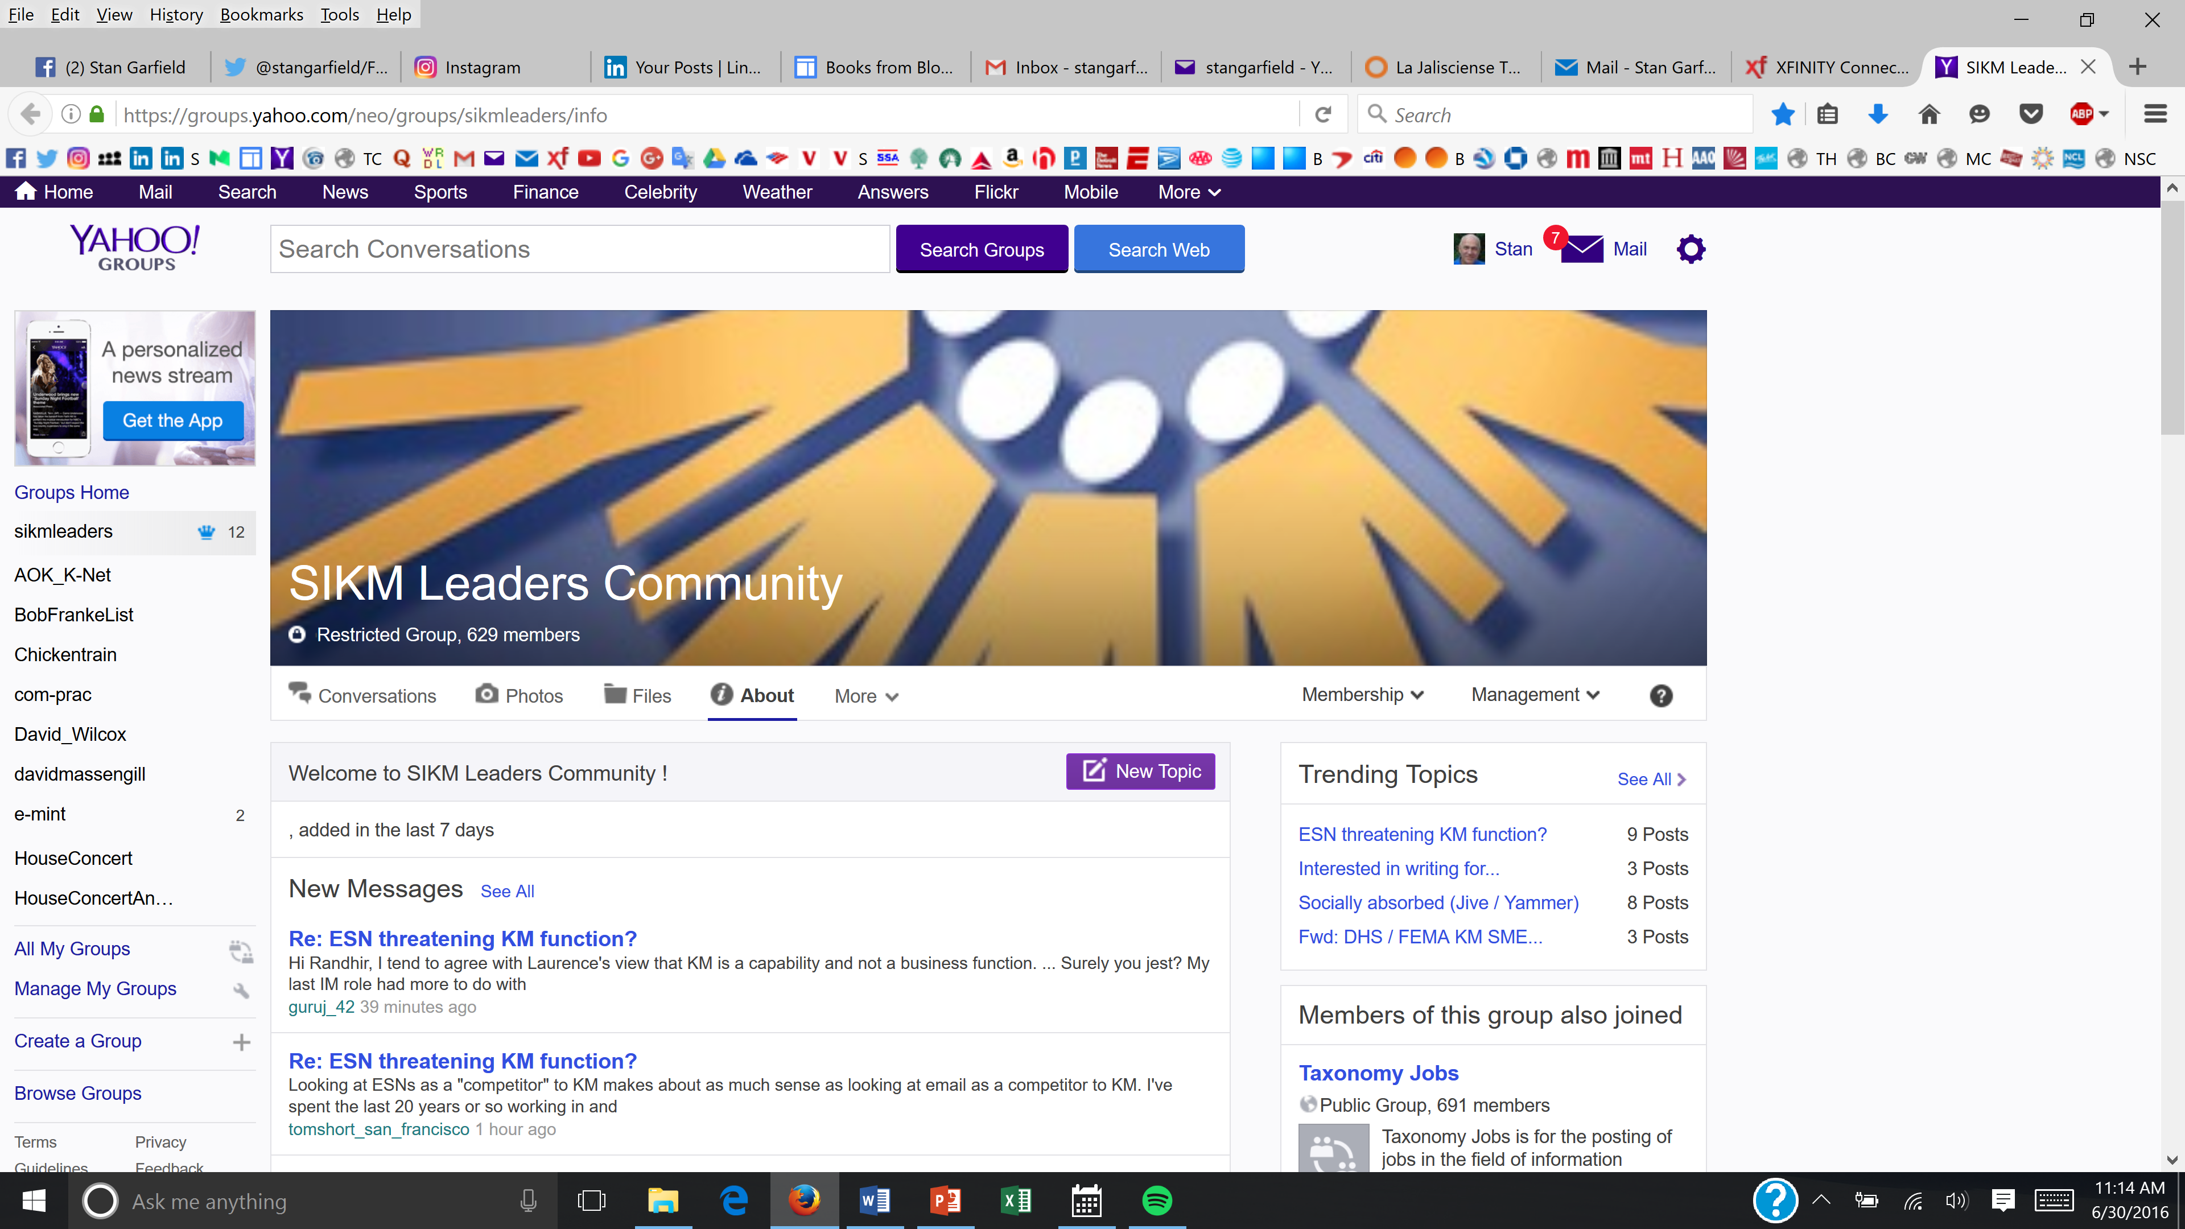
Communities
Communities are groups of people who share a:
Specialty
Passion
Interest
Role
Concern
Set of problems
Community members deepen their understanding of the topic by:
Interacting
Asking/answering questions
Sharing their knowledge
Reusing good ideas
Solving problems
Developing new ideas
Fundamentals for a community
Subject: A specialty or role
Members: Interested people
Interaction: Calls, discussions
Leaders: People passionate about the subject
Enthusiasm: Motivation to engage and spend time
2

Slide 3
1. Carefully choose the community topic
Make ‘em SMILE
Subject: A specialty to learn and/or collaborate about
Members: People interested in the subject
Interaction: Meetings, calls, and discussions
Leaders: People passionate about the subject who are dedicated to creating, building, and sustaining a community
Enthusiasm: Motivation to engage and spend time collaborating and/or learning about the subject
Avoid redundancy
Narrowing either by geography or function should be discouraged
Local chapters can be created as subsets of larger communities
Suggest that overlapping communities with similar topics be combined, either directly or with one as a subset of the other
Avoid having too narrow a scope
Start with the broadest feasible topics, and narrow down as needed
Spin off narrower sub-topics only when a high volume of discussion or communication makes it necessary
Challenge those with a niche topic to prove that it warrants its own community

Slide 4
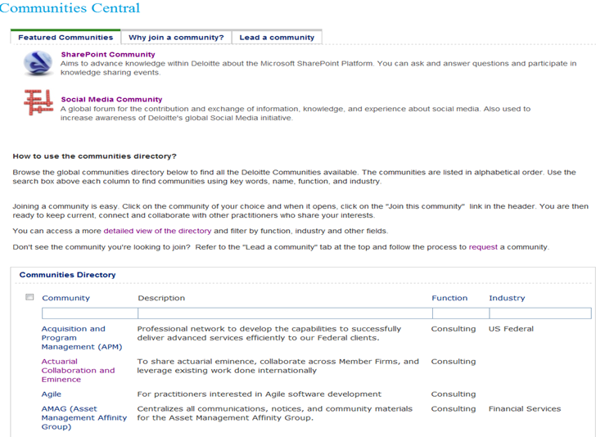
2. Publicize
Look for all existing distribution lists of people interested in your community’s topic – use these lists to invite people to join your community
Look for related communities, calls, and sites you can use to promote your community – ask permission to do so, and then post, present, or send a brief invitation
Ask well-connected people to forward your announcement memo to their distribution lists, social networks, and communities
Write and submit articles to existing newsletters that reach your target audience
Use social networking tools such as microblogging to inform possible members about your community
Ask the leaders of relevant organizations to send a one-time message to all of their people
Ensure that your community is included in the master community directory
Request that links to your community site be added on all relevant web sites
Offer an incentive to join, e.g., a member will be chosen at random or the 100th member will receive an iPad or equivalent gift
Search personal profiles for people with relevant interests and/or expertise, and invite them to join

Slide 5
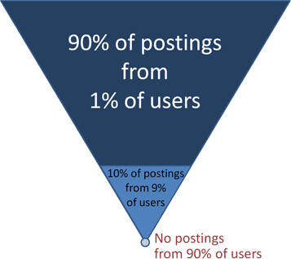
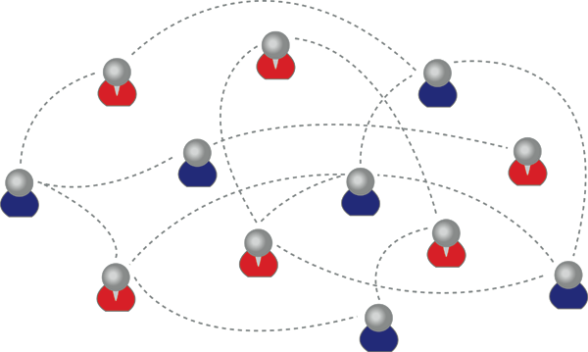
3. Increase membership
Communities need a critical mass of members
You usually need at least 50 members
100 is a better target
Only about 10% of the members will be active
Invite people to join who are part of existing networks
Existing teams that practice in the community's specialty
Existing distribution lists of people interested in the topic
Use Social Network Analysis to identify people who may not be part of a formal community
Regularly suggest to those with questions or interest in your topic that they
Join your community
Use its tools
Attract members by word of mouth
Create communities for which potential members want to be included in discussions, meetings, and other interactions
Make it so they don't want to miss out on what is going on

Slide 6
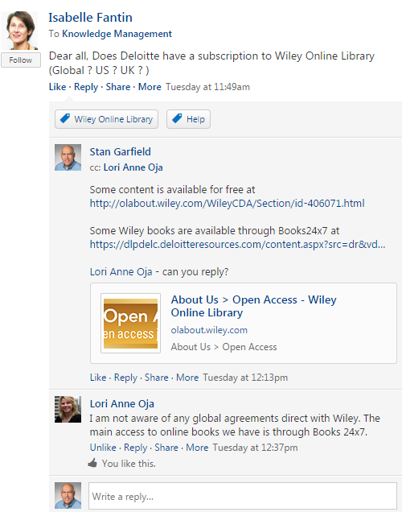
4. Post and reply in threaded discussion board/ESN group
Lay the foundation
Enable posting and replying by email
Seed the discussion board with example posts
Recruit other key community members to also post and reply
Set clear expectations for the community threaded discussion board
Members should subscribe by RSS or email
If a member posts a question, make sure that it gets a response within 48 hours
If your community has a regular call, leverage the discussion board as a means of continuing the conversation, or providing resources covered on the call
Set a calendar reminder to post every week
Summary of a community event
Useful link – save these in a list and share one each week
Thought-provoking topic to stimulate discussion
Redirect relevant discussions taking place in
Email exchanges
Distribution lists
Other collaboration channels or communities
If questions are asked via email that the entire community can benefit from, ask the requestor to post in the discussion board and reply there

Slide 7
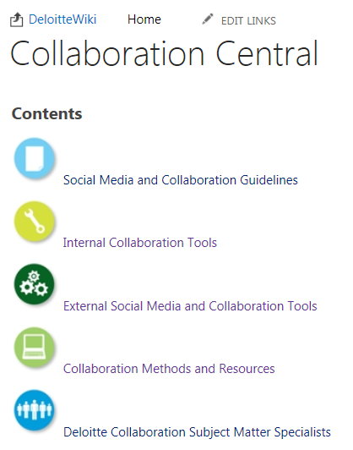
5. Use blog, newsletter, wiki
Blog – chronological archive
Announcements
Newsletters
Recurring communications which lend themselves to lists and archives
Newsletter – one page, every month
Stay in communication with members
Remind about calls
Link to key information – reuse content already produced
Recent discussion board threads
Blog posts of interest
Recently-edited wiki pages
Wiki – collaborative editing
Meeting agenda
Position paper
Self-maintained list of resources

Slide 8
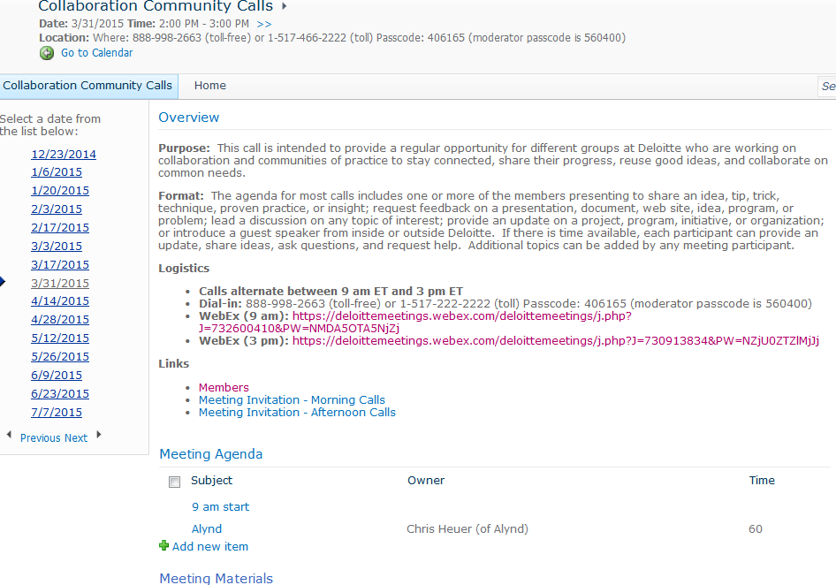
6. Schedule and host events
Types
Regular conference calls
Occasional face-to-face meetings
Training sessions
Purpose
stay connected
share progress
reuse good ideas
collaborate on common needs
Activities
Share an idea, tip, trick, technique, proven practice, or insight
Request feedback on a presentation, document, web site, idea, program, or problem
Lead a discussion on any topic of interest
Provide an update on a project, program, initiative, or organization
Speaker (community member or invited guest)
Ideas
Themed-call, where multiple speakers discuss the same subject
Post agenda ahead of time using events calendar, agenda pages, uploaded presentations
Send reminder message
Prime the pump prior to the call by asking others to ask questions or share their thoughts

Slide 9
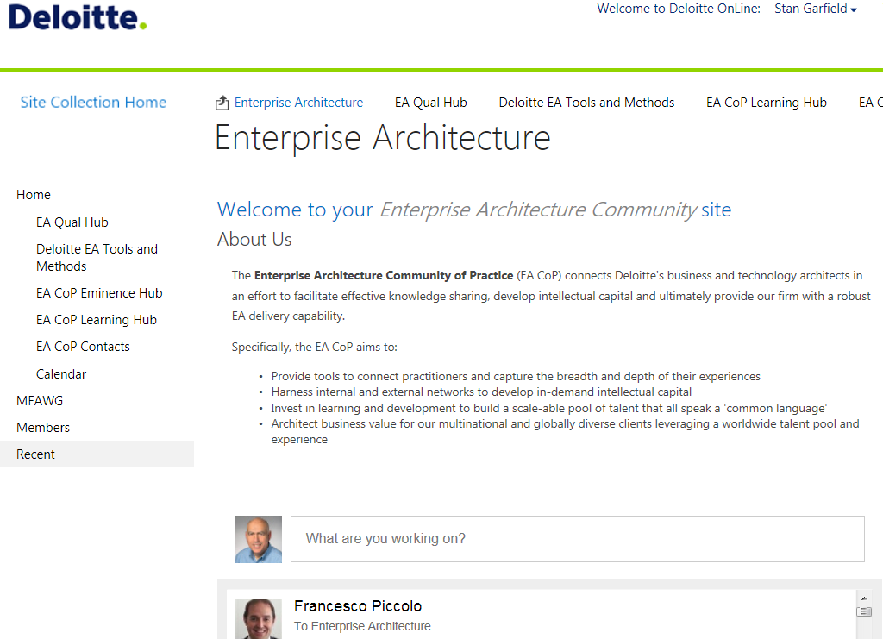
7. Provide useful content
Review and refresh content on a regular basis
Communicate changes in the newsletter
Solicit content contributions from your membership
You don’t have to produce all of the content yourself
Let members know specifically what is needed
Recognize contributors publicly in the newsletter
Ask for content submissions to:
Newsletter
Blog
Wiki
Site
Discussion board
ESN group

Slide 10
8. Tell members how they should participate
Become a SPACE cowboy
Subscribe: Get email or RSS and regularly read a threaded discussion board
Post: Start a new thread or reply in a threaded discussion board
Attend: Participate in community events
Contribute: Submit content to the community newsletter, blog, wiki, or site
Engage: Ask a question, make a comment, or give a presentation

Slide 11
And tell them how to use communities: SAFARIS
Share a link. “Here is a link to the latest Forrester report.”
Ask a question. “Has anyone encountered this problem before, and if so, how was it solved?”
Find a resource. “Looking for a specialist in welfare benefits to help in a project.”
Answer a post. “Here are links to three relevant documents in the knowledge database.”
Recognize a colleague. “Thanks to John Smith for helping solve a difficult problem.”
Inform about your activities. “Working on a new wellness initiative.”
Suggest an idea. “I think we should invite Nobel laureates to attend our recognition event.”

Slide 12
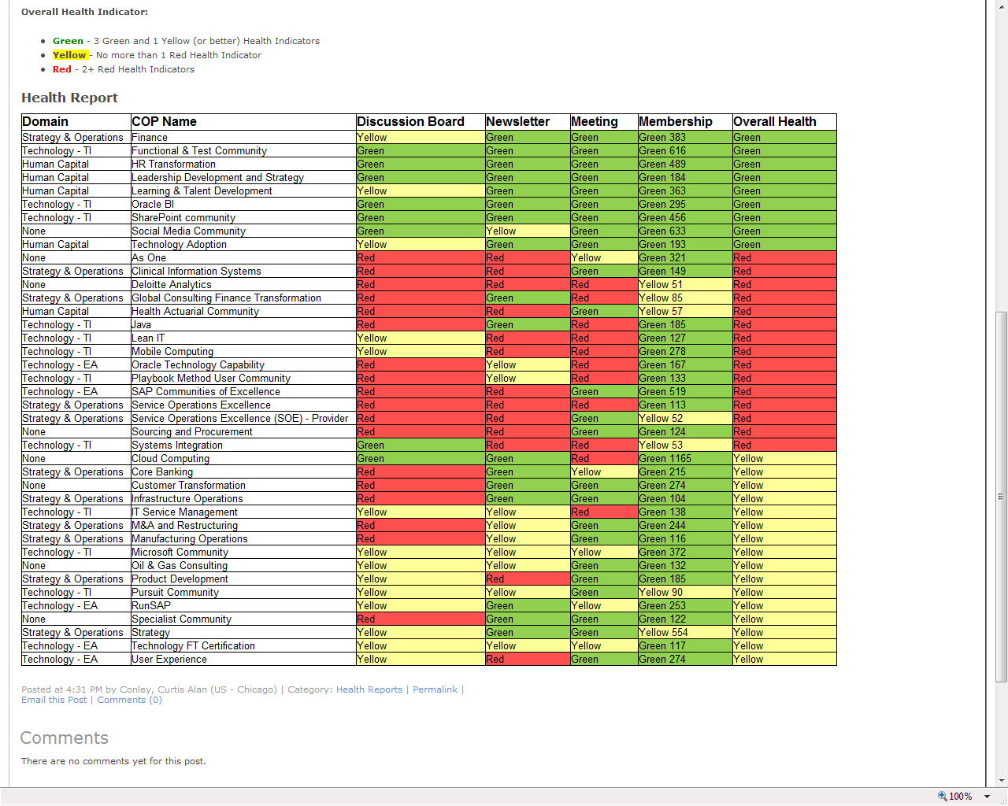
9. Set goals and measure progress
Go Green!
At least one discussion board post, reply, and new thread per week
At least one newsletter or blog post per month
At least one conference call, webinar, or face-to-face meeting per quarter
At least 100 members and increasing over time
At least 10 members participating in each event

Slide 13
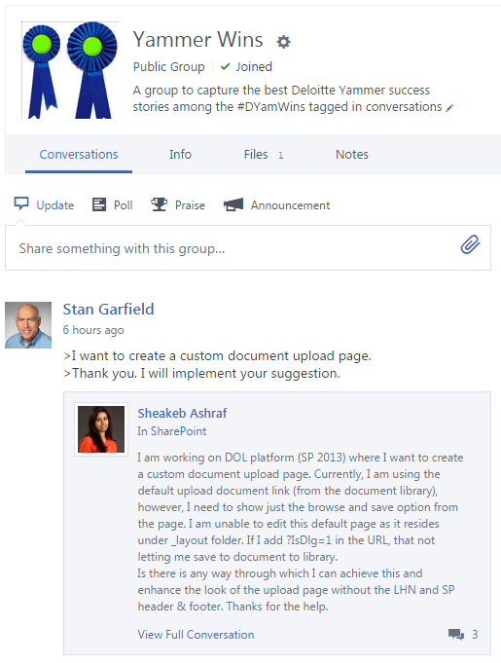
10. Solicit, find, and publicize success stories
Solicit from community members
Mine discussion threads
Publicize in the blog and newsletter
Testimonials by community members on the value of participation
Stories about the usefulness of the community
Posts thanking other members for their help

Slide 14
Components
Training
Documentation
Communications
Content
User interface
Virtual meeting rooms
Threaded discussions
Blogs
Wikis
Podcasts
Videos
Incentive points tracking
Notes:
23

Slide 15
1. Training

Slide 16
2. Documentation

Slide 17
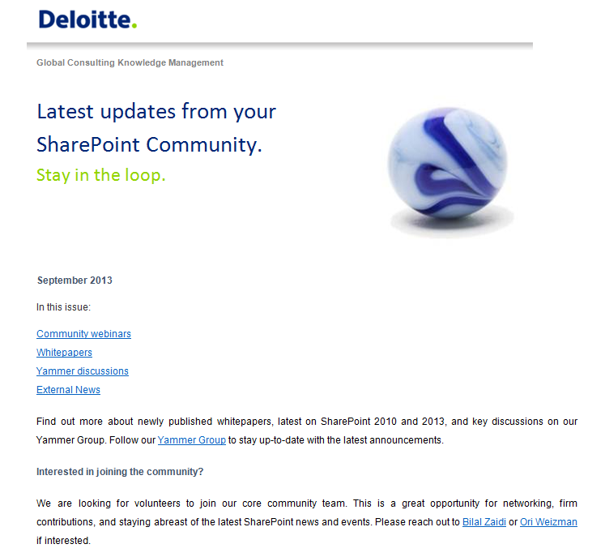
3. Communications

Slide 18
4. Content

Slide 19
5. User Interface

Slide 20
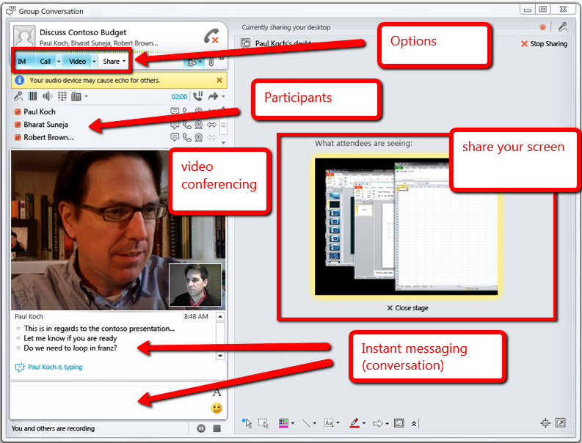
6. Virtual Meeting Room

Slide 21
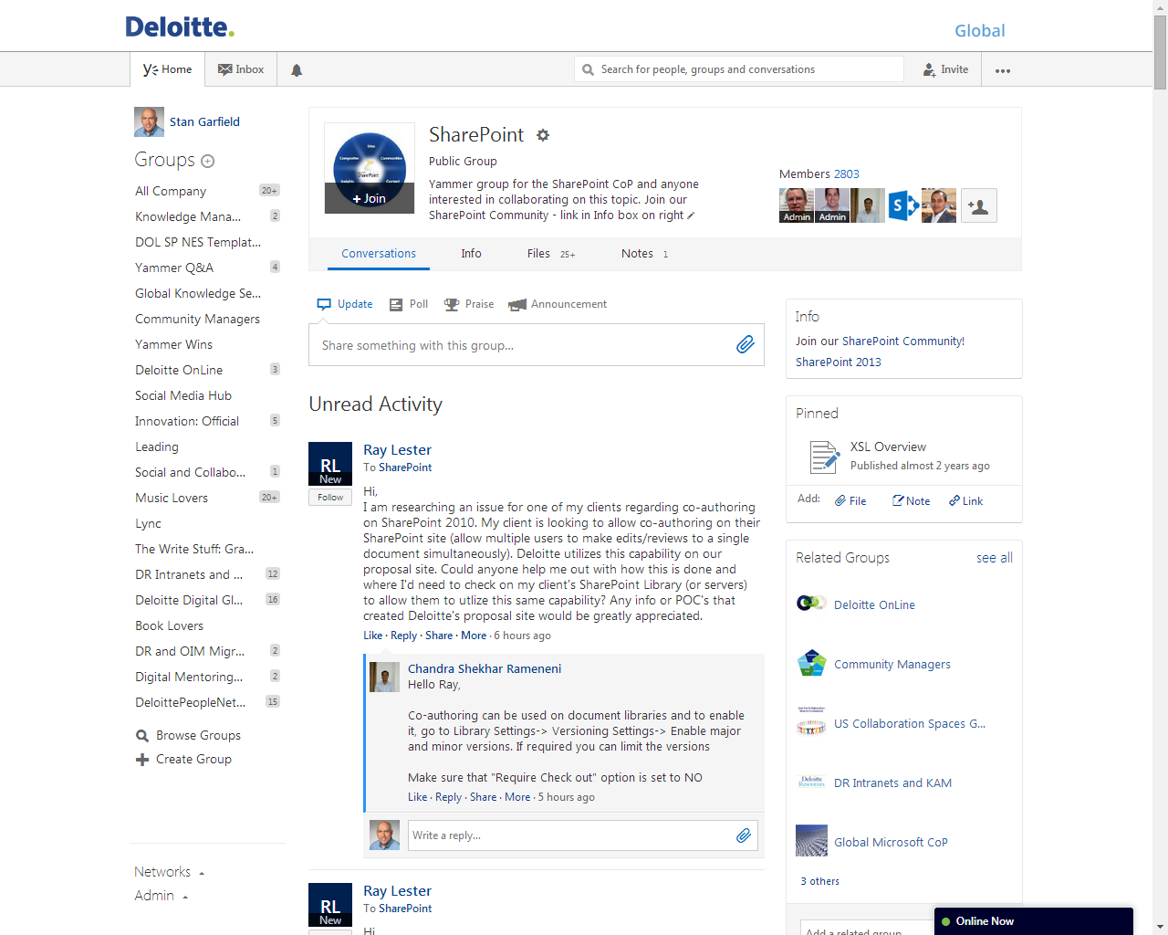
7. Threaded Discussion

Slide 22
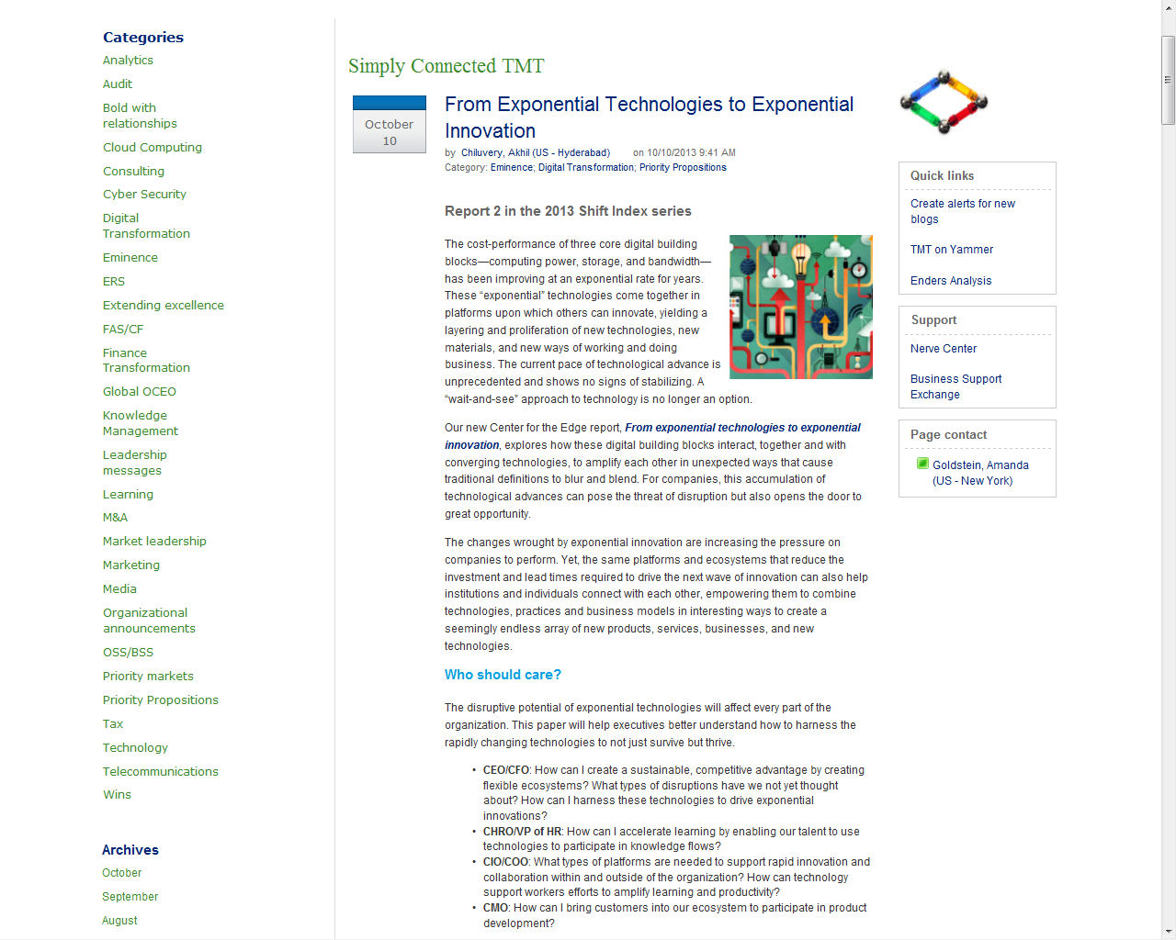
8. Blog

Slide 23
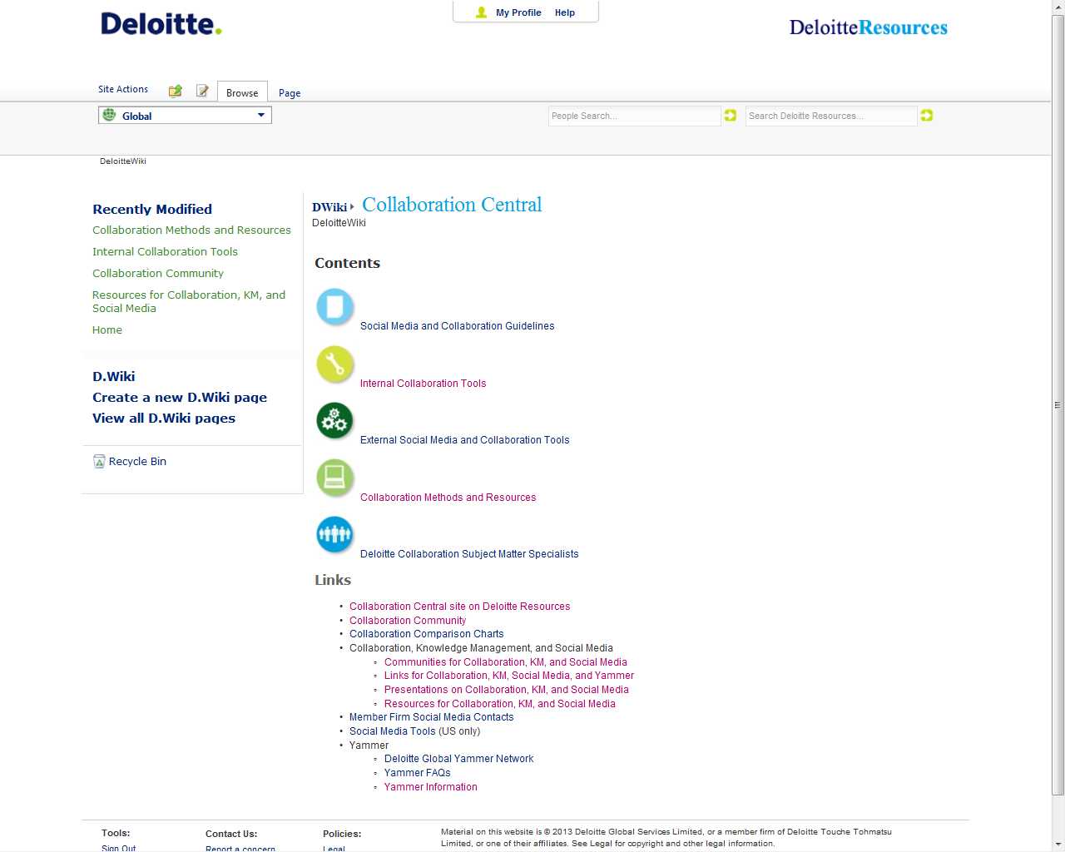
9. Wiki

Slide 24
10. Podcast

Slide 25
11. Video

Slide 26
12. Incentive Points Tracking
Source: HP

Slide 27
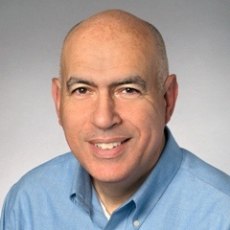
For additional information
Join the SIKM Leaders CoP http://tech.groups.yahoo.com/group/sikmleaders/
Twitter @stangarfield
Site http://sites.google.com/site/stangarfield/
Posts about communities of practice https://plus.google.com/110005283908695811857/posts/2gjHeKRTP8N
Gaining Buy-in for KM (chapter author)
Stan Garfield
Implementing a Successful KM Program (author)
Successful Knowledge Leadership:
Principles and Practice
(chapter author) The Modern Knowledge Leader:
A Results-Oriented Approach

Slide 28
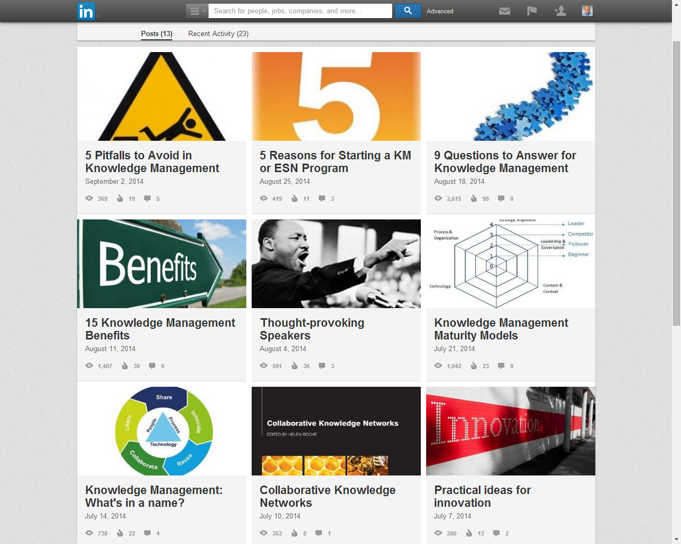
LinkedIn Posts https://www.linkedin.com/today/author/2500783

