Slide 1
Recurrent Monitoring
Results from an Interim Monitoring Survey in Ethiopia
Tim Frankenberger
TANGO International
October 27, 2015

Slide 2
Background
The Pastoralist Areas Resilience Improvement and Market Expansion (PRIME) project, funded under the United States government’s Feed the Future initiative, was launched in October 2012 in one of the most shock-prone areas of the world, the dry lands of Ethiopia.
A key objective of the project is to enhance the resilience of households to shocks. In particular, it aims to enable households to withstand and recover from the recurrent climate-related shocks—mainly drought—to which they are subjected.
The analysis presented is being undertaken as part of an impact evaluation (IE) whose goal is to determine whether the PRIME project has a positive impact on households’ resilience to shocks and, thus, on well-being outcomes including poverty, food security, and children’s nutritional status.

Slide 4
Background
The PRIME IE was launched with a baseline survey undertaken in two zones of the project area, Borena and Jijiga, in November/December 2013.
In addition, two Interim Monitoring Surveys (IMS) are being carried out in order to capture real-time household and community responses to any actual shocks that might occur during a project’s five-year implementation period.
IMSs would be launched after “trigger indicators” being monitored reach shock levels.

Slide 5
Resilience Measurement
Need for High (and appropriate) Frequency Data
To be sensitive to resilience dynamics, data should be collected with a degree of frequency to map out the trajectory of well-being over time.
Collecting data more frequently will reveal path dependencies of well-being states with special reference to shock exposure.
Observations of a consistent upward trajectory may reflect a resilience pathway even in cases where acceptable levels of food security or poverty have not been reached.
Intervention Planning and Trajectories
Insights gained from data on how well-being shifts up and down over time in the face of shocks could help to identify optimal points of entry for launching an intervention.

Slide 6
Methods
A quantitative questionnaire was administered to a representative sample of a panel of households (430) selected from among a baseline of households (3200). Starting in October 2014, data were collected from 17 kebeles on a monthly basis for 6 rounds through March 2015. This was done to determine how households were coping with shocks.
Qualitative data collection, including focus group discussions and key informant interviews, also took place in each round.

Slide 7
Research Questions
(1) What downstream impacts of the shock did households experience and how did the incidence of these impacts evolve over the IMS period?
(2) What coping strategies did households employ to deal with the shock? Do these change over time?
(3) How did households’ food security change over the shock period? Which types of households were able to maintain their food security in the face of the shock, i.e., which were resilient to its impacts?

Slide 8
Research Questions
(4) How did the severity of exposure to the shock affect households’ ability to recover from it?
(5) Did households’ resilience capacities before the onset of the shock help protect them from its negative impacts?
(6) Did households’ resilience capacities before the onset of the shock prevent them from using negative coping strategies that undermine their future resilience to shocks?

Slide 9
Main Objective
Providing real-time data collected during an actual shock in progress, the IMS presents a unique opportunity to understand how, in a time of increasing climatic variability throughout the world, climate shocks affect households, their responses, and whether their resilience capacity can help them recover.

Slide 10
Monitoring Shocks
Understanding how different types of shocks affect household and community well-being is fundamental to designing appropriate resilience-building programs.
Collecting data on shocks and stressors and understanding their relationships with well-being is therefore an essential element of resilience measurement.

Slide 11
Evolution of the Drought and its Downstream Effects
The study used external data sources to map out the progression of the 2014-15 drought in the two PRIME IE areas.
The data sources include FEWS NET Food Security Outlook publications, PRIME trigger indicator data, rainfall classifications provided by the Ethiopian government, and satellite remote sensing data from the African Flood and Drought Monitor (AFDM).
In both areas, the drought unfolded in two waves roughly corresponding to March-September 2014 (between the PRIME baseline survey and IMS Round 1) and October 2014-April 2015 (between IMS Rounds 1 and 6).

Slide 12
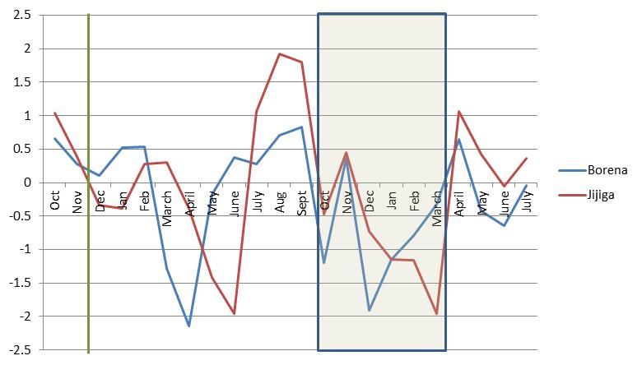
Rainfall deviation from norm in Borena and Jijiga, October 2013-July 2015

Slide 13
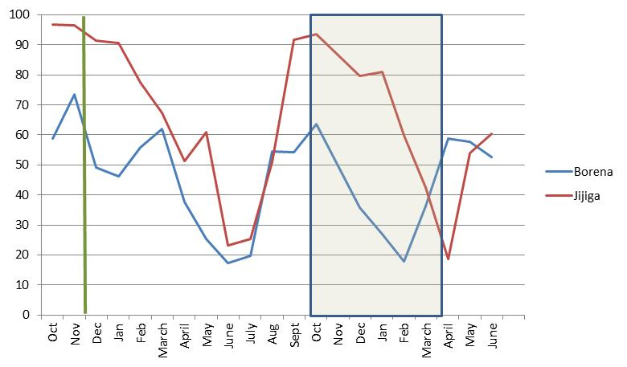
Soil moisture percentage of norm in Borena and Jijiga, October 2013-July 2015¹

Slide 14
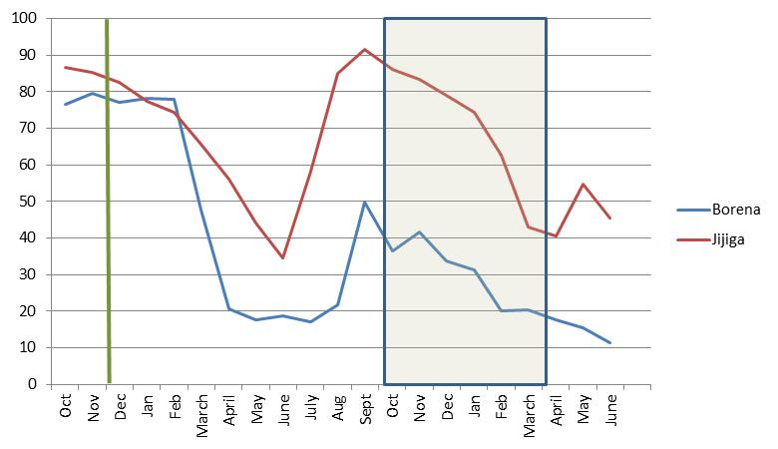
Normalized difference vegetation index percentile in Borena and Jijiga, October 2013-July 2015

Slide 15
Evolution of the Drought and Downstream Effects
During the initial wave of the drought, the first rains (Ganna in Borena, Diraa in Jijiga) failed in the regions, leading to abnormal precipitous drops in soil moisture and vegetation coverage.
Critical water and pasture shortages ensued, followed by unusual mobility patterns among pastoralists, a deterioration of livestock body conditions, and crop failures.
Cereals prices sharply increased and livestock prices fell, leading to a livestock-to-cereal terms of trade far below normal in markets, to the detriment of pastoralists.
Many areas in both regions were elevated to Priority 1 Nutrition Hotspot status by the Ethiopian government as malnutrition cases increased.

Slide 16
Evolution of the Drought and Downstream Effects
The second wave of the drought evolved differently in Borena than in Jijiga.
In Borena, the second rains, the Hagaya rains, failed. Thus the region experienced successive below-average rainy seasons.
The lack of water and pasture reached critical levels, desperate livestock movements both within Ethiopia and cross-border ensued, and local crop production failed, necessitating cereal imports from other areas in Ethiopia.
Conflict also increased between tribes over access to pasture and water.
Many households were dependent on humanitarian assistance to meet their food needs, and malnutrition continued to rise.

Slide 17
Evolution of the Drought and Downstream Effects
In Jijiga the second rainy season, the Karan rains, followed a near-normal pattern, improving water and pasture availability.
FEWS NET and the PRIME trigger indicators reported that water and pasture availability had returned to normal, there was a normal harvest, and households’ access to food was stabilizing.
However, remote sensing satellite data show that these favorable conditions were the beginning of a sharp drop-off in soil moisture and vegetation coverage below the norm over the post-Karan dry season.
Overall, Borena faced more severe drought conditions over the two drought waves, but this additional climate shock put households in Jijiga under further stress.

Slide 18
Evolution of the Drought and Downstream Effects
With respect to downstream drought impacts, the quantitative data reveal that those most commonly felt by households in Borena were livestock or crop disease, food price inflation, and increases in the prices of inputs.
Those most commonly felt in Jijiga, where agro-pastoralism and non-pastoralism are more common, were livestock or crop disease, food price inflation, and a “very bad harvest.”
The IMS data confirm that the downstream effect of the drought on prices was very strong in both areas. After food price inflation, the most common economic shocks experienced were: decreases in the prices of livestock, increases in the prices of agricultural inputs, drops in the prices of products sold, and lack of demand for products sold.

Slide 19
Evolution of the Drought and Downstream Effects
There has been a noticeable increase in conflict-related shocks since the baseline, including theft of crops and livestock, and in deaths of household members, the ultimate negative impact.
The qualitative data provide a rich source of detailed information on how households experienced these downstream impacts as well as others, including reduced access to fodder and water, cattle raids, and illness due to exposure to polluted water.

Slide 20
Household Response: Coping Strategies for Dealing with the Drought
Households were using both positive and negative responses.
Reducing food consumption, a negative coping strategy, was used by almost all households and is a strong indication that the drought and its downstream impacts were exacerbating food insecurity in both regions.
It can explain why 50 percent of households planned to rely on some type of humanitarian assistance (food aid or cash) at some time over the IMS period.
The use of other negative coping strategies that undermine future resilience to shocks, for example, taking children out of school and selling productive assets, increased in the last two rounds of the IMS when drought conditions were getting worse.

Slide 21
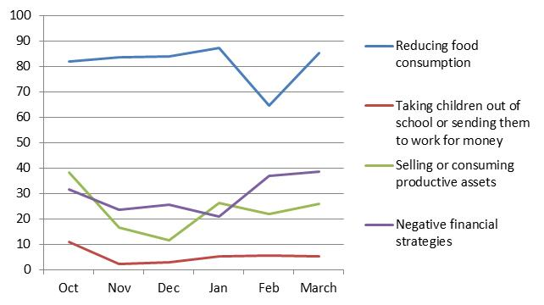
Trends in the use of negative coping strategies over the IMS period

Slide 22
Household Response: Coping Strategies for Dealing with the Drought
A very common positive coping strategy was to rely on assistance from friends and relatives, including receiving money for food and borrowing money.
The qualitative data concur that people’s reliance on social capital to get them through the drought period was critical.
However, it was only a reliable coping strategy in the early months of the survey, because over time social capital was eroded.
As the downstream impacts of the drought began to accumulate, there was a steady erosion of social support making it harder for better-off households and community leaders to support those in need.

Slide 23
Household Response: Coping Strategies for Dealing with the Drought
As the food security situation deteriorated over time, more households in Borena were taking children out of school to migrate with the animals, to work to support the family, or to live with relatives.
This response can negatively affect the long-term human capital of a household and degrade its opportunities to escape from poverty and food insecurity in the future.
In Borena, the governance systems in communities were starting to be negatively affected because community leaders were migrating to distant locations in search of water and pasture, making it more difficult to hold clan meetings.
It is at these meetings that support is mobilized for the poor. Other traditional ritual ceremonies where food redistribution takes place were also neglected.

Slide 24
Household Response: Coping Strategies for Dealing with the Drought
In Jijiga, indications that coping abilities were becoming strained as the drought progressed included reports of quarrels between spouses over food shortages, sometimes leading to divorces.
Patterns of migration where males of households leave for long periods of time seeking water and pasture for livestock can lead to stressful conditions for families.
Children, women, and the elderly are often more negatively affected by the drought and its downstream impacts because they are the ones who remain behind in the villages.

Slide 25
Household Food Security and Resilience in the Face of the Drought
Resilience to the drought is measured using two indicators:
The change in food security over the drought period
An indicator of whether households were able to maintain or increase their food security over the period.
The IMS data show that changes in food security over time differ for Borena and Jijiga. In Borena, food security was lower in all IMS rounds than it was at baseline, indicating a decline in the average households’ food security over time.
In Jijiga, food security was higher in all IMS rounds compared to the baseline. This indicates a greater resilience to both waves of the drought than that in Borena.

Slide 26
Household Food Security and Resilience in the Face of the Drought
The qualitative data from both regions on households’ experiences of food and livelihood insecurity during the second drought wave highlight common conditions of economic hardship and simply not having enough food to eat.
Children and women felt special burdens. Children were taken out of school due to the need to use funds to buy foods that previously were used for schooling expenses.
Children, the main consumers of milk, saw a reduction or complete stoppage in their milk consumption.
Women were finding it difficult to feed children and other family members and perform their domestic chores due to the disruption caused by the drought.
Further, women’s income generating activities, such as retail sales, were disrupted, reducing their incomes and money available for food.

Slide 27
Household Food Security and Resilience in the Face of the Drought
Overall, only about one-third of households were resilient to the first wave of the drought, 26 percent in Borena and 48 percent in Jijiga.
Pastoralists were less likely to be resilient than agro-pastoralists, and agro-pastoralists were less likely to be resilient than non-pastoralists (different risk environments).

Slide 28
The Relationship between Household Resilience, Drought Exposure and Pre-drought Resilience Capacity
Resilience capacity is measured using indicators of its three dimensions—absorptive capacity, adaptive capacity, and transformative capacity.
Regression analysis confirms that the more severely a household was exposed to the drought, the less likely it was to recover from it, that is, the less resilient it was.
The analysis suggests that households’ absorptive capacity had a positive impact on their resilience to the drought In Borena.
This result is strongly robust to the measure of shock exposure employed, whether based on agro-climatic conditions or households’ own perceptions of their exposure to the drought.

Slide 29
The Relationship between Household Resilience, Drought Exposure and Pre-drought Resilience Capacity
The analysis found no impact of absorptive capacity on resilience to the drought in Jijiga, perhaps due to the combination of lower drought exposure and low pre-drought absorptive capacity in the region.
While the evidence is not as strong for adaptive capacity and transformative capacity, the analysis is suggestive that they do play a role in supporting households’ resilience to shocks, as well.

Slide 30
The Relationship between Household Resilience, Drought Exposure and Pre-drought Resilience Capacity
Specific factors supporting households’ resilience capacities that contributed to their resilience to the drought
Bonding and Bridging Social Capital
Access to informal safety nets
Human capital (education and skills)
Access to financial services
Access to markets
Access to communal resources

Slide 31
Does Resilience Capacity Prevent the Use of Negative Coping Strategies
Four types of coping strategies are explored:
Reducing food consumption
Selling or consuming productive assets
Employing negative financial strategies (taking out a loan from a money lender or purchasing food on credit)
Employing negative strategies related to the care of children (taking children out of school and/or sending them to work for money).
For Borena, regression analysis provides evidence that all three dimensions of resilience capacities helped to prevent households from reducing their food consumption as a response to the drought.

Slide 32
Does Resilience Capacity Prevent the Use of Negative Coping Strategies
Additionally, in Borena, adaptive and transformative capacity helped to prevent households from depleting their productive assets.
Transformative capacity helped prevent them from undermining the human capital of their children by taking them out of school or sending them to work for money.
The analysis suggests that resilience capacity had less of a preventative effect in Jijiga than in Borena at the time of IMS Round 1.

Slide 33
Does Resilience Capacity Prevent the Use of Negative Coping Strategies
When looking at the use of coping strategies over the entire six-month IMS period (a period in which the second drought wave was in full progress), the analysis found strong evidence that both adaptive and transformative capacity helped to prevent households from taking their children out of school and/or sending them to work for money in both regions.
Absorptive capacity helped to prevent households from employing negative financial strategies in Borena.
Adaptive capacity helped to prevent them from reducing their food consumption in Jijiga.

Slide 34
Conclusion
The majority of households in the PRIME IE area were not able to maintain their food security in the face of the drought, that is, they were not resilient in the face of the drought.
Their absorptive, adaptive, and transformative capacities did buffer them from the shock.
But, for most households, these capacities were not enough to maintain their food security and prevent them from employing negative coping strategies that undermine their ability to manage future shocks and stressors.
Any future interventions should be focused on both strengthening resilience capacities to manage shocks and timely social protection interventions that are carried out over a long enough period and appropriately targeted to protect households from the most severe drought impacts.

