Slide 1
Share Fairs: Guidance and Lessons Learned
Sarah V. Harlan, Learning Director
Knowledge for Health (K4Health) Project
Notes:
Good afternoon everyone. My name is Sarah Harlan and I’m the Learning Director with the Knowledge for Health Project at the Center for Communication Programs. I lead audience engagement and partnership activities for the K4Health Project.
I will start us off with an overview of Share Fairs and our new Share Fair Guide that K4Health has just published – and then I’ll go over specific examples of past share fairs. This will give you an overview of some of the material in our Share Fair Guide. We should have time for questions at the end, but feel free to speak up if you have questions as I go along.

Slide 2
Outline of Presentation
Share Fair Guide – overview
What is a Share Fair?
Planning your own Share Fair
Agenda, Logistics, Presentations, Post event
Examples of Share Fairs
GHKC KM Share Fair
East Africa Share Fair
ICMM Share Fair
Notes:
There has been a lot of interest in the KM world for events like share fairs and we wanted to put together our own guide so we can offer some tools and some lessons learned from our own experiences putting together these events. We hope that in sharing our experience with Share Fairs that you will be able to put on your own event or take elements into other types of meetings you may hold.

Slide 3
New K4Health Share Fair Guide
https://www.k4health.org/resources/how-hold-successful-share-fair
Step-by-step guide for planning and hosting your own share fair
Tools and templates to use in planning, implementing, and evaluating a share fair
Examples from K4Health’s experience hosting share fairs

Slide 4
What is a Share Fair?
Participatory events focused on a single topic that involve discussion and sharing¹
The aim of these events is to provide participants with opportunities to share experiences and learn new skills
¹http://ictkm.cgiar.org/what-we-do/share-fair/
Notes:
Here are the basic definitions of a Share Fair, but the term is used often very loosely and really applies to event that is about the idea of sharing and centered around a specific topic or idea. These can be as flashy as structured and large as a 200 person Washington, DC meeting to a small luncheon with people from your organization. The real idea is about knowledge exchange and sharing.

Slide 5
Why Hold a Share Fair?
Great opportunity for people working in the same field (or on the same project/topic) to exchange knowledge
Sharing information (lessons learned, best practices, challenges) avoids duplication and “reinventing the wheel”
Focus on sharing tacit knowledge
Notes:
Share Fairs allow people in the same field (or project) to exchange information) and share lessons learned – they give people a structured but informal way to share how they do what they do, ask questions, share successes and challenges and even look for solutions. It can help prevent “reinventing the wheel.”
In the world of global health we are often sharing written documents and reports but they do not capture all the knowledge that is in people’s heads. They capture the explicit knowledge that’s on the surface – but that is just the tip of the iceberg and most knowledge is tacit knowledge-- intangible, invisible, first-person experience that’s under the surface. it’s hard to articulate this knowledge because includes skills and insights. But Share Fairs are great at getting to this knowledge.

Slide 6
Share Fair or Conference: What’s the difference?
 | Share Fair | Conference
Population | Specific | Diverse
Topics | Specific | Broad
Information Delivery Methods | Varied and Creative | Presentations, Panels
Content | Sharing of successes and failures | Highlighting successes
Agenda | Structured but informal | Structured and formal
Opportunity to connect with colleagues | Within the structure and format of the program | Specific networking opportunities usually during lunch or at the end of the day.
Communication | Informal and two-way | Formal and usually one-way
Notes:
Many people wonder the difference between a share fair and a regular conference. Much of the planning looks same, but the ideas around the purpose are very different. Here you can see a brief comparison of the two to help get a better feel for what a share fair is.
A conference is often broad and brings together a population on a topic such as HIV/AIDS. Within this topic there might be sub-topics and the people who attend would be from all different walks of life -- Policy makers, program managers, people living with HIV, funders, etc. The structure of the conference would be very pretty formal. There would be a lot of objectives for the conference. But in comparison, a share fair is very specific. It’s a moment in time look at a specific topic (or project) and tends to be pretty informal. People share successes AND failures – they use creative methods of sharing, and communication is two-way – rather than sitting and listening to a slew of presentations. Innovation and creativity are at all levels and connecting and networking is very important whereas a conference has networking events, but doesn’t have that main purpose.

Slide 7
Different Types of Share Fairs
Global
Broad
Medium
Specific
Local
Small
Large
Diverse
More Specific
Homogeneous
Similar
GHKC Share Fair
East Africa Share Fair
ICMM Share Fair
$25,000
$15,000
$5,000
Regional
Notes:
There can be different scopes and types of share fairs. We can get into specifics later, but basically, when you are planning, you will want to decide who your audience is, what your budget is and the purpose of the event. Here are three tiers that we defined – related to cost, involvement, location, and purpose. And I’ll give examples for each of these later.

Slide 8
Planning Your Own Share Fair
Budget
Conceptualize the event and pick a theme
Co-sponsors/ collaborators
Identify dates
Select a location
Pick a venue
Set up an action plan
Notes:
In planning a share fair, you’ll want to start this process 6 – 9 months before the event begins if possible. You will need to think about budget, concept, dates, location, etc. All of these logistics should be decided at the very beginning. The objectives of the event – conceptualizing the event – is extremely important and can help determine the event’s success. And in K4Health’s experience, we have really looked at our audience first – and then determined what they might need out of such an event – and you’ll see some examples later.
Once you’ve decided what you’d like to do, getting co-sponsors or collaborators can be the difference between having a small event and a medium event. Dates and location are really important. You don’t want to overlap important holidays or elections and you want to pick a location that is convenient for your main audience.
In these first steps, coming up with an action plan on what needs to be done will save you from forgetting basic things that need to be accomplished in the first few weeks and months of planning.

Slide 9
Developing an Agenda
Break down objectives
Draft a shell agenda
Add innovation
Leave a lot of space for connecting
Identify and contact presenters
Notes:
Developing an agenda is extremely important part of the Share Fair planning process. Throughout the agenda process, continuing to go back to the objectives to ensure you are meeting the goals you set for the meeting is extremely important. Adding sessions or presentations just to fill time is not ideal. Also, keep in mind that less is more, so less presentations and more interactive portions of your meeting is ideal.

Slide 10
Other Logistics
Save the dates
Invitations
Travel considerations
Shipping
Pre-evaluation
Plan for future correspondence with participants (CoP, Facebook Group, email)
Notes:
If you choose to send them, “Save the Date” emails should go out three to six months before the event and formal invites about a month before. You will want to be strategic about who you invite and who will help fulfill the objectives. Using a software like the ones mentioned in this slide can help with organizing invites and check-in day of the event.
Travel considerations such as visas, flights, hotel arrangements and airport transport should be thought about as soon as possible. If the country you are holding the event has a long wait for visas, you will want to get the invites out sooner and find out the guest list quicker. If you are having a local event, you may not need to worry about any of these except the venue and maybe travel reimbursement.
Shipping is also something to think about early in planning if things need to be shipped, it may need to happen well in advance if there are strict customs practices. Carrying luggage instead of shipping is also an option.
Pre and post evaluation surveys are very important to finding out if your event is successful. Sending a pre evaluation a week or two ahead of the meeting or even asking survey questions during registration can allow for participants to tell you who they are and their grasp of your topic. To allow for more explanation on particular areas of necessary. For example, if you are having a knowledge management specific event how familiar are participants with the concept and do they use it in their work? Will you need an introduction? These will help shape your presentations and ensure participants get a lot out of the share fair.

Slide 11
Coordinating Presentations
Assist with presentation development
Get final presentations in advance
Review everything
Keep presentations easily accessible
Notes:
Coordinating presentations can be no small task especially when working with multiple presenters internationally. In the East Africa Share Fair, many of the organizers had specific presentations to coordinate. They were the contact for these individual and were able to work with the presenters. It would have been extremely difficult for one of us to organize all the presentations.
If you want for presentations to be engaging and for people to not just read slides, assist in the development of the presentations. Explain to the presenters the idea of the meeting is to share and be engaging, think of creative things like asking people only to use images on slides and no words, no PowerPoint presentations, or even give each presenter a different KM approach to use when presenting. This helps presenters all be on the same place and insert a lot of creativity in what can be a long and boring fair.
If possible, get the presentations far ahead of the meeting so you can address any issues.
Have the presentations in multiple forms, internet can be unreliable, so have them locally saved and on flash drives if possible.

Slide 12
Event Logistics
Set-up
Breaks and meals
Keeping to time
Note taking
Social Media – Twitter, Live blogging
Notes:
If you are having a formal event, you will want to make sure a lot of things are timing appropriately for the event. Try to meet with the venue staff or call the caterers the night before to ensure timing is right for these things. If possible, have someone responsible for ensuring time is kept and food is ready when its time for breaks.
Keeping time is very important. Even in an event where informality is stressed, you want to make sure the schedule has a lot of time for interacting, but that presentations are not cut short or not given enough time for interaction at the end. Giving more time than is needed for activities is a great and padding between events is really important to insure people are ready for the next thing without taking away too much time.
Note taking is really important in events like these to capture the knowledge shared during the event. This should be synthesized so that participants can take it back to their organizations and have something to show for the event.

Slide 13
After the Event
Post-event evaluation
After-action review
Follow-up with participants
Thank you notes
Blogging
Event report
Notes:
In order to determine how useful the event was to your participants, a post event evaluation is a great tool. It can be an online survey or a paper one that is given before participants leave. In person paper surveys have a much better return rate than emailed internet ones, but participants may leave early and miss the evaluation. You may want a combination or to give some time before the very end to get people to fill these out.
An After action review is a technique that is great after an event like this. You can bring together the planning team and go over what worked and where improvements are needed.
We like to follow-up with participants and remind them to connect with one another and also share the report with them. We are also sure at the end of the event to send a formal thank you to all the presenters.
Blogging is a great way to capture stories and more informal recollections from the event. Your staff can do this and you can encourage participants as well. Interviewing a participant and blogging about that might be another good way to capture feelings, thoughts, and ideas from the event.

Slide 14
Global Health Knowledge Collaborative (GHKC) Knowledge Management Share Fair
Notes:
So now I’m going to give an example of a Share Fair that was more global in scope. It was the Knowledge Management Share Fair of the Global Health Knowledge Collaborative. It was held in April 2013 in Washington, DC – and led by the GHKC – which was chaired at the time by Johns Hopkins Center for Communication Programs.
We planned this in response to the GHKC’s request that we get together a group of KM specialists from across sectors – and share experiences and tools and lessons learned and reinvigorate the field of KM for global health. We also wanted to spark creativity and innovation within the GHKC – and to learn from other sectors such as agriculture and business.

Slide 15
Overall Objectives
One-day symposium of health and development KM practitioners to advance the science and practice of KM and address issues of coherence and execution
1. Connect and communicate to collectively address things we care about
2. Share examples of what works and doesn’t work
3. Build capacity and agency of knowledge workers

Slide 16
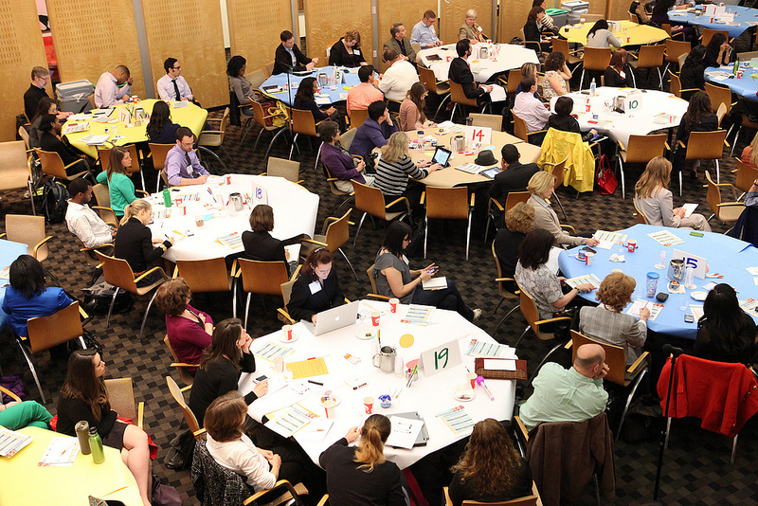
Share Fair Overview
200 participants
40 small groups, each with a host
Full-day event at FHI360 in Washington, DC
Expert facilitator
Notes:
In-between the opening and closing plenaries, and the words spoken by Stacey Young and Ellen Starbird from USAID as book-ends to the day, breakout sessions offered opportunities to look in a more intimate setting at how some of these challenges are being addressed and what we can learn from those experiences and transfer elsewhere.
We also had an exhibit hall – a “Marketplace” which provided opportunities for browsing, getting ideas from others who have made progress in incorporating KM approaches in their work, sharing their “aha moments.” And finally, smart phones were activated during the plenaries to poll the audience about a variety of matters, with instant feedback on the screen in front of us.
General format
Morning: Plenary
Afternoon: Round table (into pieces of the cycle) with pre-identified questions:
Closing plenary: Ideas of plenary bubble back to the broader
Other ways to participate:
Tables/ Kiosks: Give clear instructions on what to bring
Webinars: topics and feedback from participants
Audio/video testimonials from the field (use illuminate to record people presenting ahead of time
Video conference (for others to participate remotely)
Topics:
M&E – Framework (kick off the day)
Advocacy
Tools: Needs assessment & net mapping
mHealth (by mHealth working group)
Case studies
Strategy
Social media and KM (Social Media team)

Slide 17
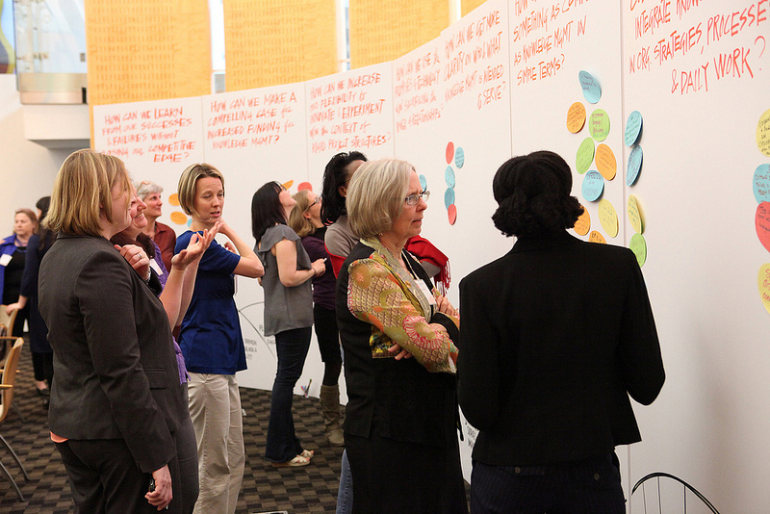
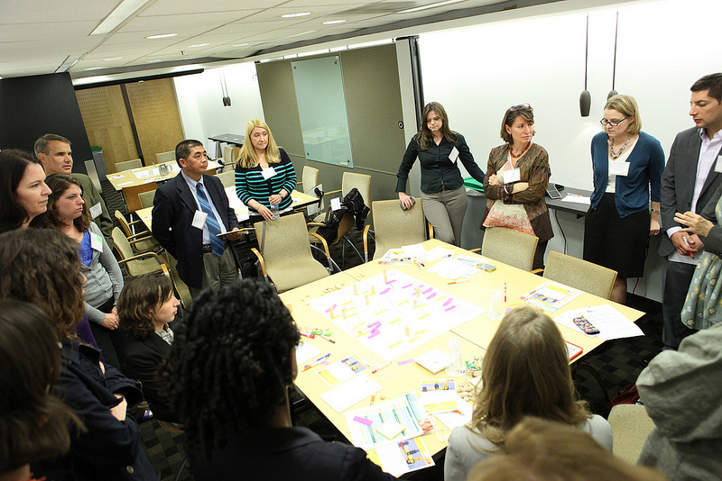
Highlights
Graphic facilitation (24X8 by http://www.thevalueweb.org/)
Knowledge Café
Marketplace (16 tools)
Breakout sessions (8 topics)
Mobile polls for instant feedback (http://www.polleverywhere.com/)
Right environment
Notes:
16 marketplaces provided opportunities for browsing, get ideas from organizations from the health and other sectors who have made progress in incorporating KM approaches in their work, generously sharing their “aha’s.”
Smart phones activated during plenaries to poll audience about a variety of matters, with instant feedback on the screen in front. ‘Who’s in the Room?’---24% private sector, 16% NGOs, 16% academia, 13% USAID or other donor
Breakout sessions: KM evaluation, in-country KM, cross-sectoral approaches to KM, Net-mapping, communities of practice, health information needs assessments, blended learning, and KM for health system strengthening. Breakout sessions didn’t have panelists or speakers. Rather, facilitators and moderators created environments rich with experience and ripe for sharing. Many K4Health tools were used as conversation starters, including:
The new Global Health eLearning Center and the K4Health Blended Learning Guide (PDF);
K4Health’s rich experience evaluating health KM programs; and
K4Health’s experience with Facebook, Twitter, and the Social Media for Global Health working group;

Slide 18
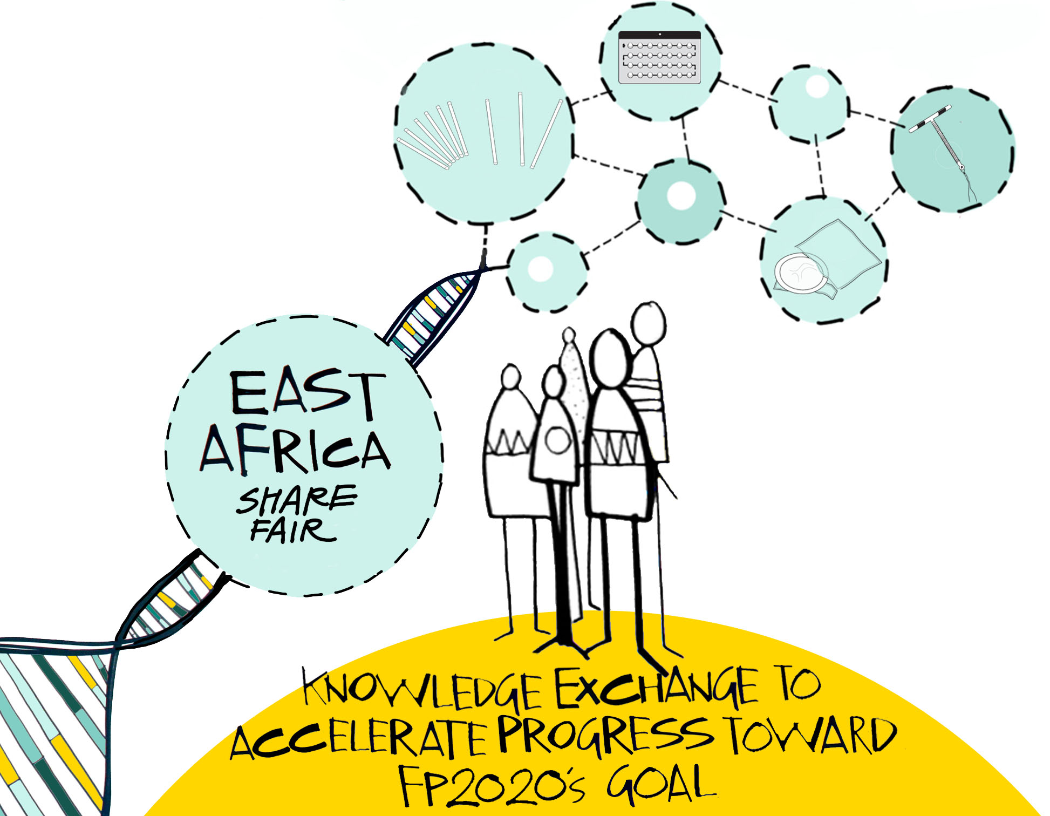
K4Health East Africa Share Fair: Knowledge Exchange to Accelerate Progress Toward FP2020’s Goal
Notes:
Arusha, Tanzania, September 2014

Slide 19
Share Fair Objectives
Demonstrate how knowledge management can enhance FP programs, and further FP2020 goal
Share examples of successful and effective FP programming in EA that have used KM
Build the capacity of FP program managers in the design, implementation and evaluation of KM for FP
Make connections with those working at the intersection of FP and KM to foster a community in the EA region

Slide 20
Share Fair Overview
49 participants from 5 countries: Zambia, Uganda, Kenya, Tanzania, US
2-day event at the Kibo Palace Hotel in Arusha, Tanzania
Audience was mainly program planners and implementers working on FP/RH activities in the region

Slide 21
Highlights
Firecracker speeches
Visual storytelling and report outs
Knowledge Café
Whiteboard video
Learning from non-FP programs
Hearing about regional initiatives
Buzz session

Slide 22
Take Aways
Based on the evaluation, participants said:
Their KM expertise greatly improved
Their knowledge of programs in the region improved
They learned new tools and approaches that can help them in their work
They enjoyed the innovative and interactive design of the event
It was a good networking opportunity
They had fun

Slide 23
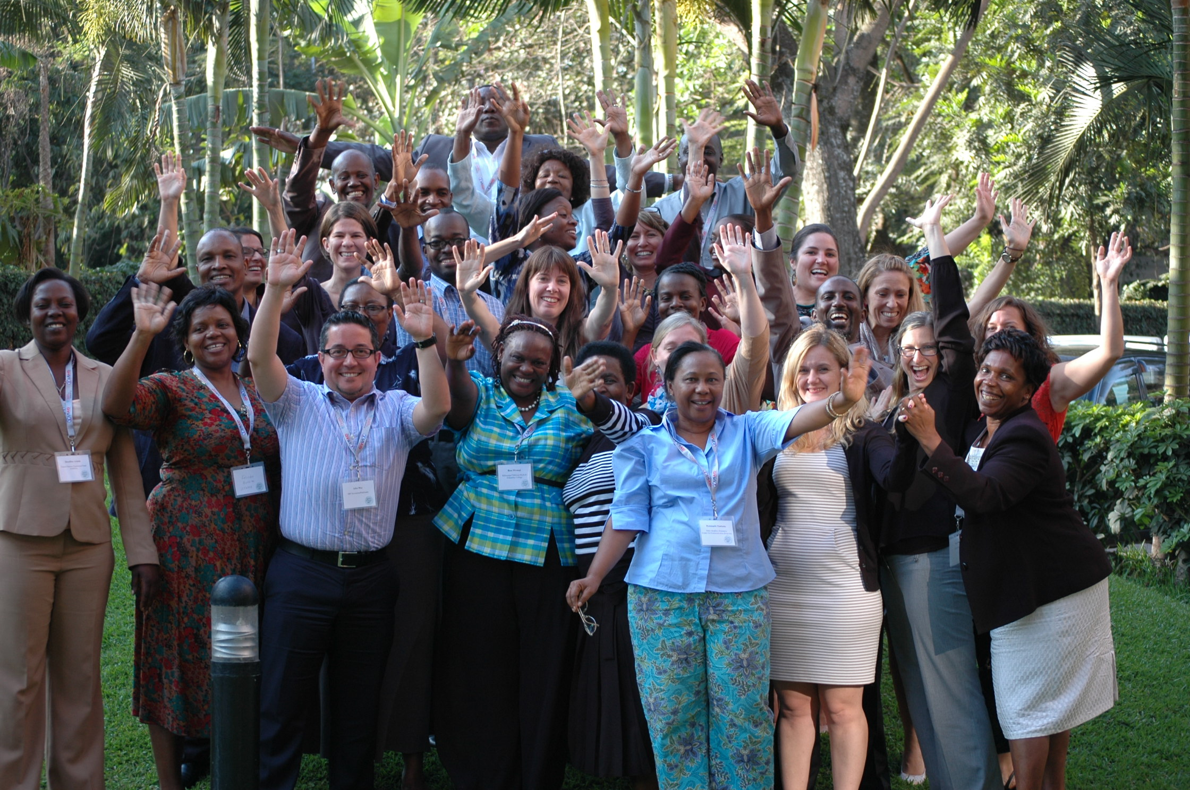
Notes:
Some participants at the share fair

Slide 24
How the “Share Fair” Method Promoted Learning Among District-Level Family Planning Stakeholders in Indonesia

Slide 25
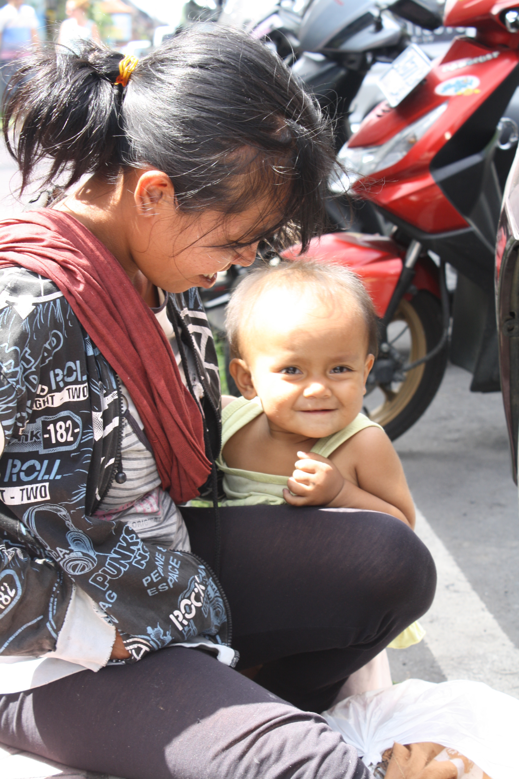
Background – Improving Contraceptive Method Mix (ICMM) Project
GOAL: To improve maternal health by improving the use of long-acting and permanent methods at the district level
Design: Operations research and advocacy project with a knowledge management component
Funding source: USAID and DFAT
Project duration: 2012 – 2016
Location: East Java (3 districts); West Nusa Tenggara (3 districts)

Slide 26
Knowledge Sharing in ICMM
Sharing is a key part of ICMM:
To translate research results into advocacy activities
To use lessons learned from the District Working Groups (DWGs) to support other DWGs
“Sharing meetings” help us find out about knowledge that is “in each other’s heads”—and use it to improve our work
Notes:
In addition to research and advocacy, sharing knowledge among the different district working groups is a key part of the ICMM project. Knowledge for Health—the mechanism that helps implement ICMM, works on “knowledge management” –which is a process of getting the right information to the right people at the right time. This meeting (as well as the two provincial-level sharing meetings ICMM held in June) is an example of us working to put this idea into practice.
As ICMM is an operations research project, we are already learning from our baseline study and our routine monitoring of service data. However, there is a lot of knowledge coming out of the district working groups as well, and this knowledge is often difficult to express in numbers or figures. This knowledge is based on our experiences—barriers, successes, and lessons learned—that are part of the day-to-day work of family planning advocacy. This is rich knowledge, and in sharing this with each other, it can spark innovation, fresh approaches, and new ways of thinking.
So for this reason, I am especially happy to see colleagues from both projects—AFP and ICMM—coming together to talk about their common experiences and challenges and discussing strategies for moving forward. Among all eleven project districts, and our partners and colleagues from the national level—we certainly have a lot to share—and a lot to learn from each other.
And beyond these meetings, I hope we can find additional ways to share experiences among the districts—we are writing up some case studies as part of ICMM, and will be launching a website in the coming weeks, so we look forward to providing support as we all keep this conversation going.
District-level advocacy progress:
District working plans being implemented
Early successes are already being seen – government commitments and collaboration/partner involvement to prioritize FP & LAPMs

Slide 27
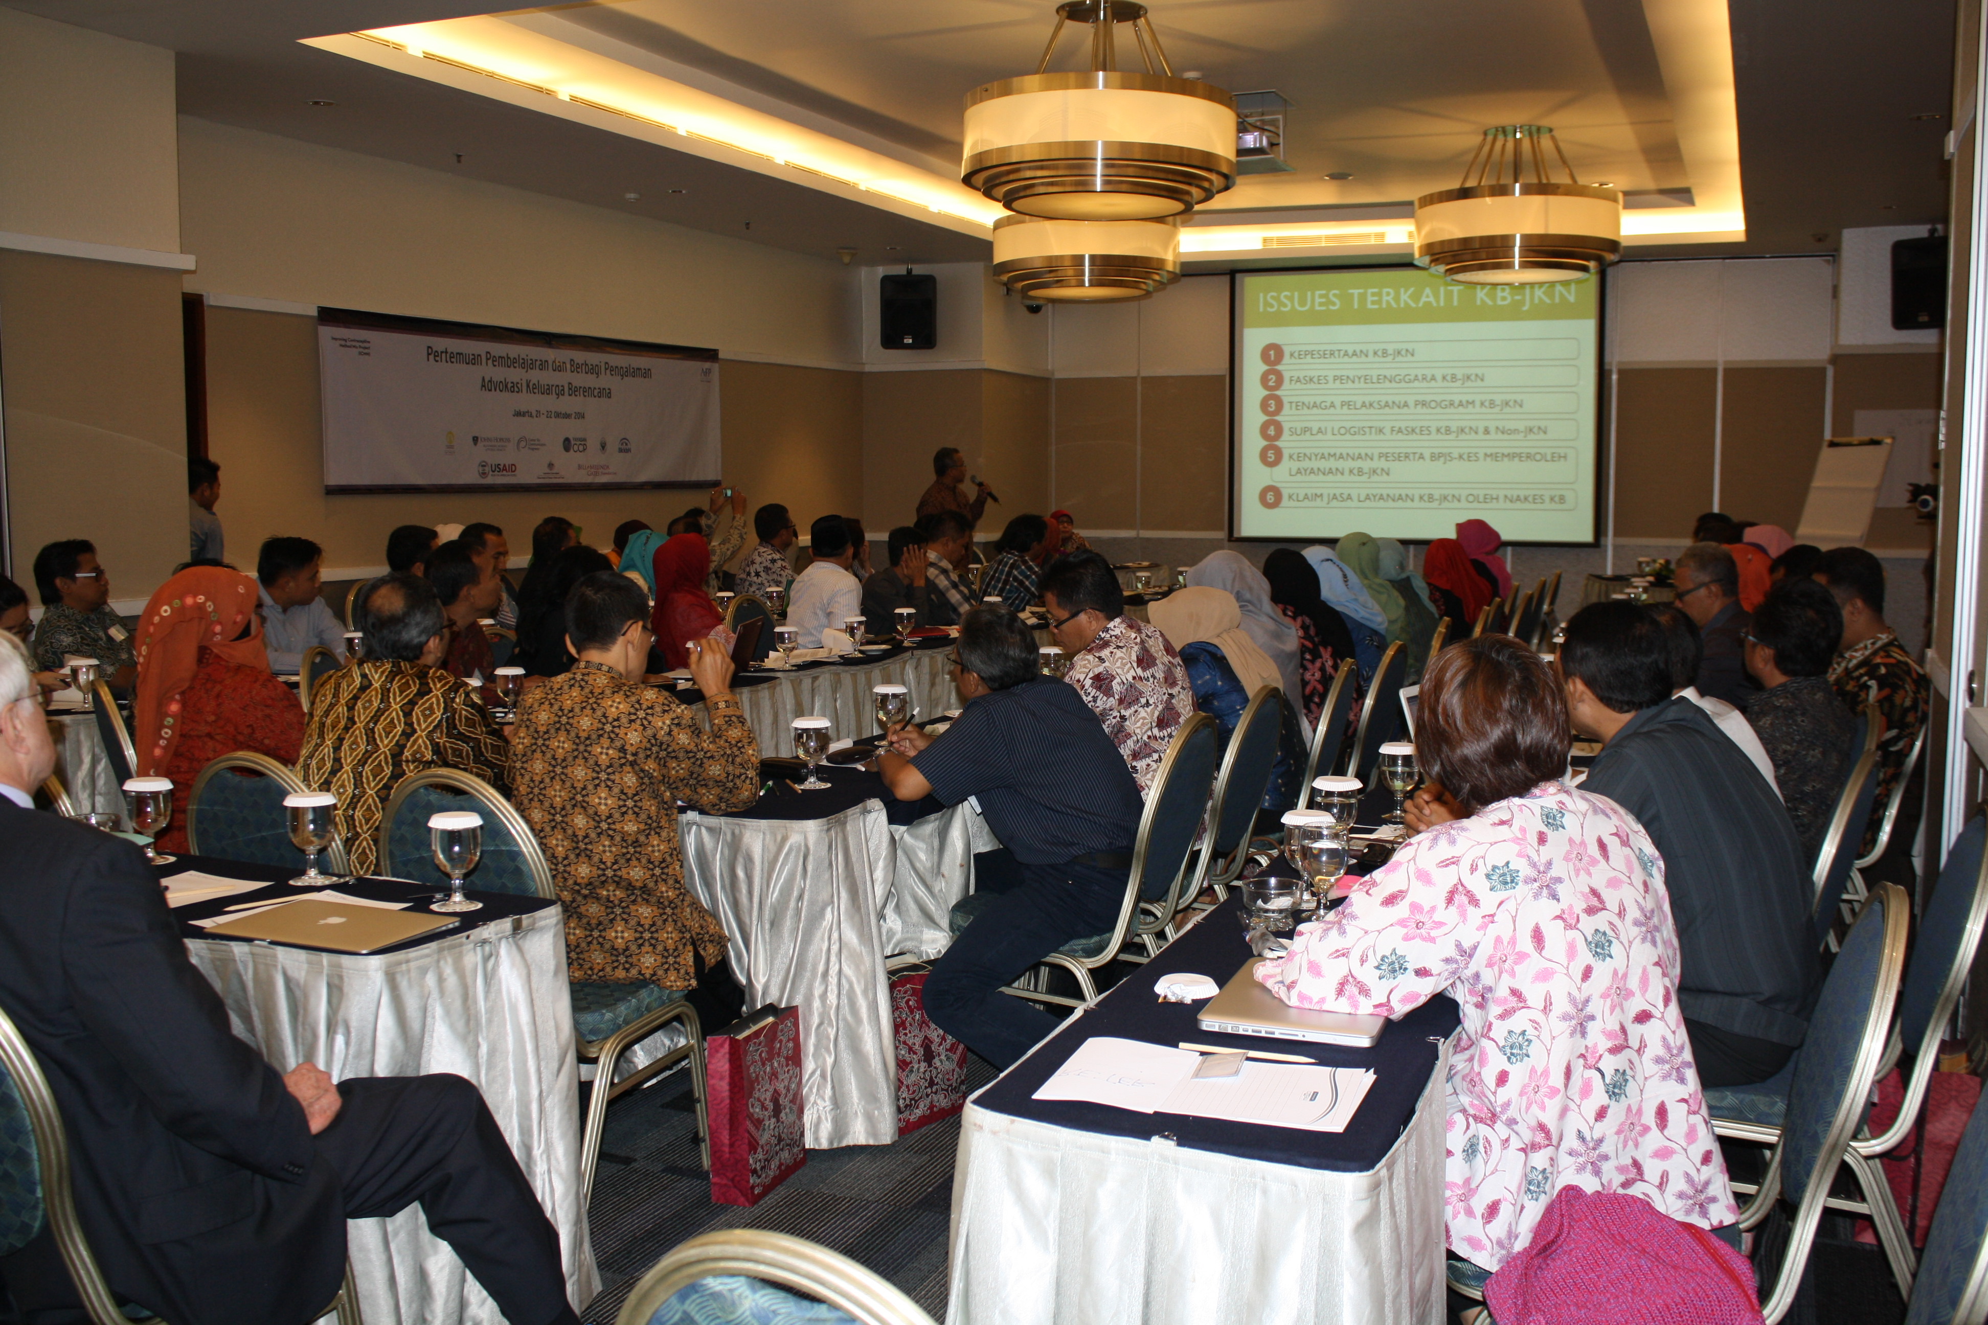
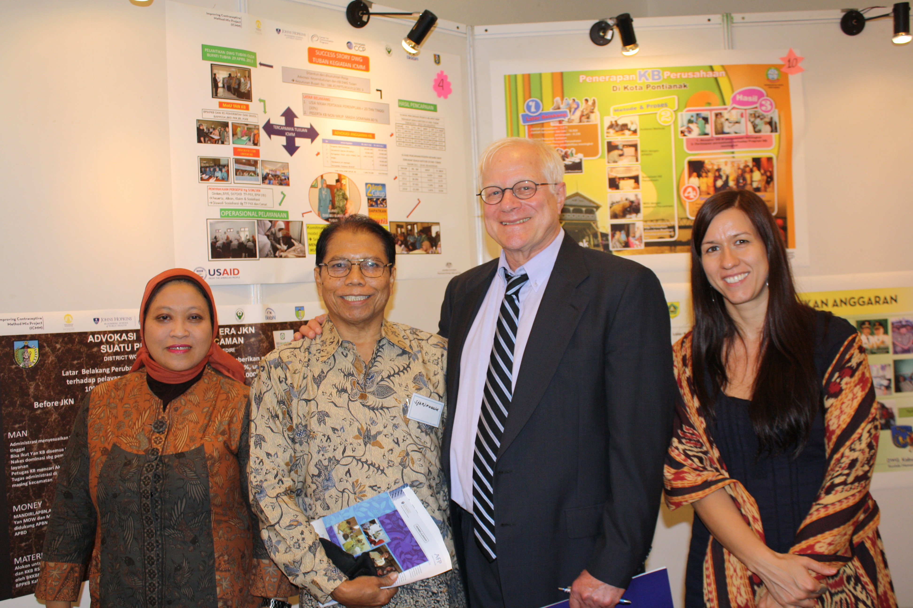
ICMM/Advance Family Planning (AFP) Sharing Meeting: Overview
Two-day meeting in Jakarta
Co-hosted by AFP and ICMM
Included DWGs from 11 districts (6 ICMM; 5 AFP)
70 participants– from district, national, and provincial levels
Theme: “Partnering to Win”

Slide 28
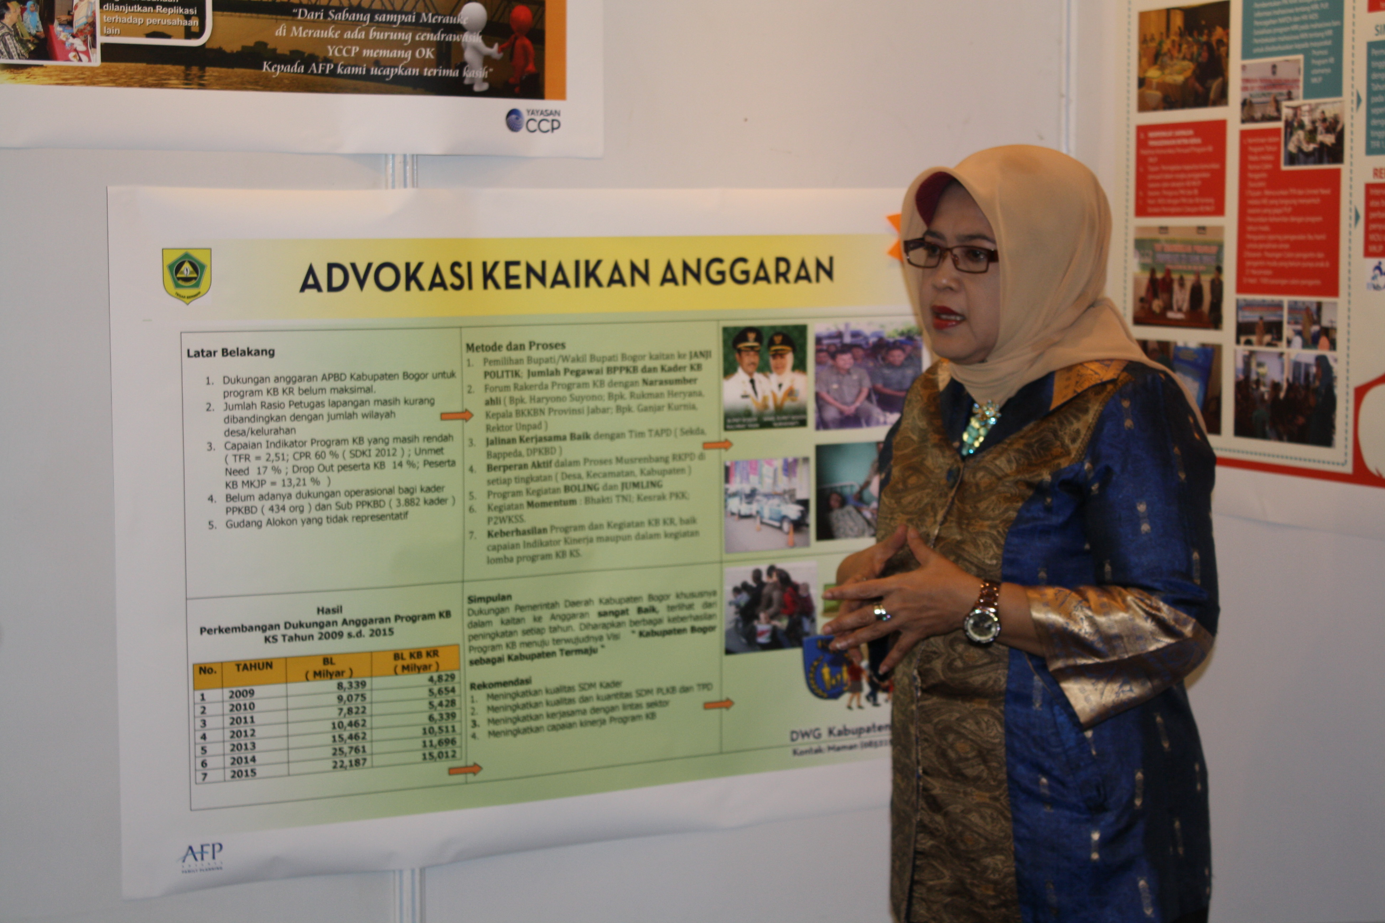
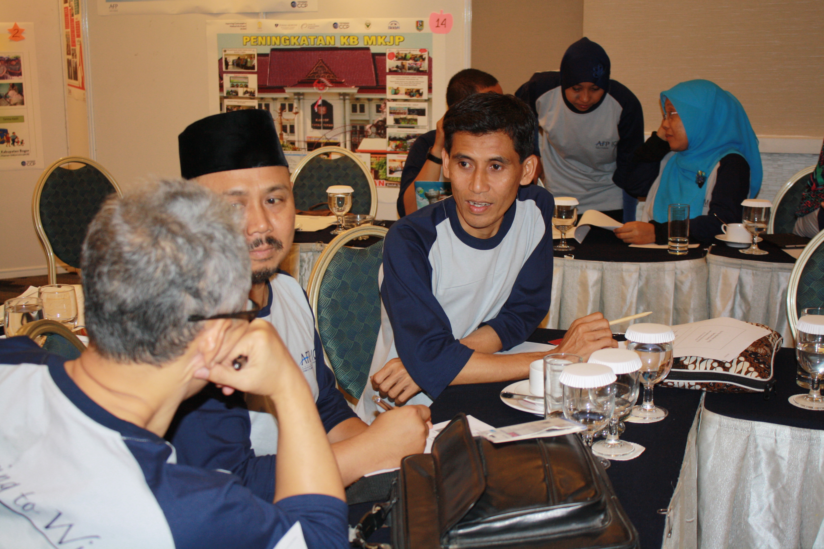
ICMM/AFP Sharing Meeting: Key agenda items
Poster presentations from DWGs (Day 1)
Overview presentations on key topics from natl stakeholders (Days 1 & 2)
Refresher of advocacy tools/guided small group sessions to work on advocacy workplans (Day 2)

Slide 29
ICMM/AFP Sharing Meeting: Feedback from participants
Keep
Change
Opportunity for DWGs to work with national/provincial stakeholders
Guided annual work plan sessions
Fun activities & posters
Collaboration between AFP & ICMM Projects
More time for questions
More time for small groups
More time for informal sharing
Have sharing meetings more often!

Slide 30
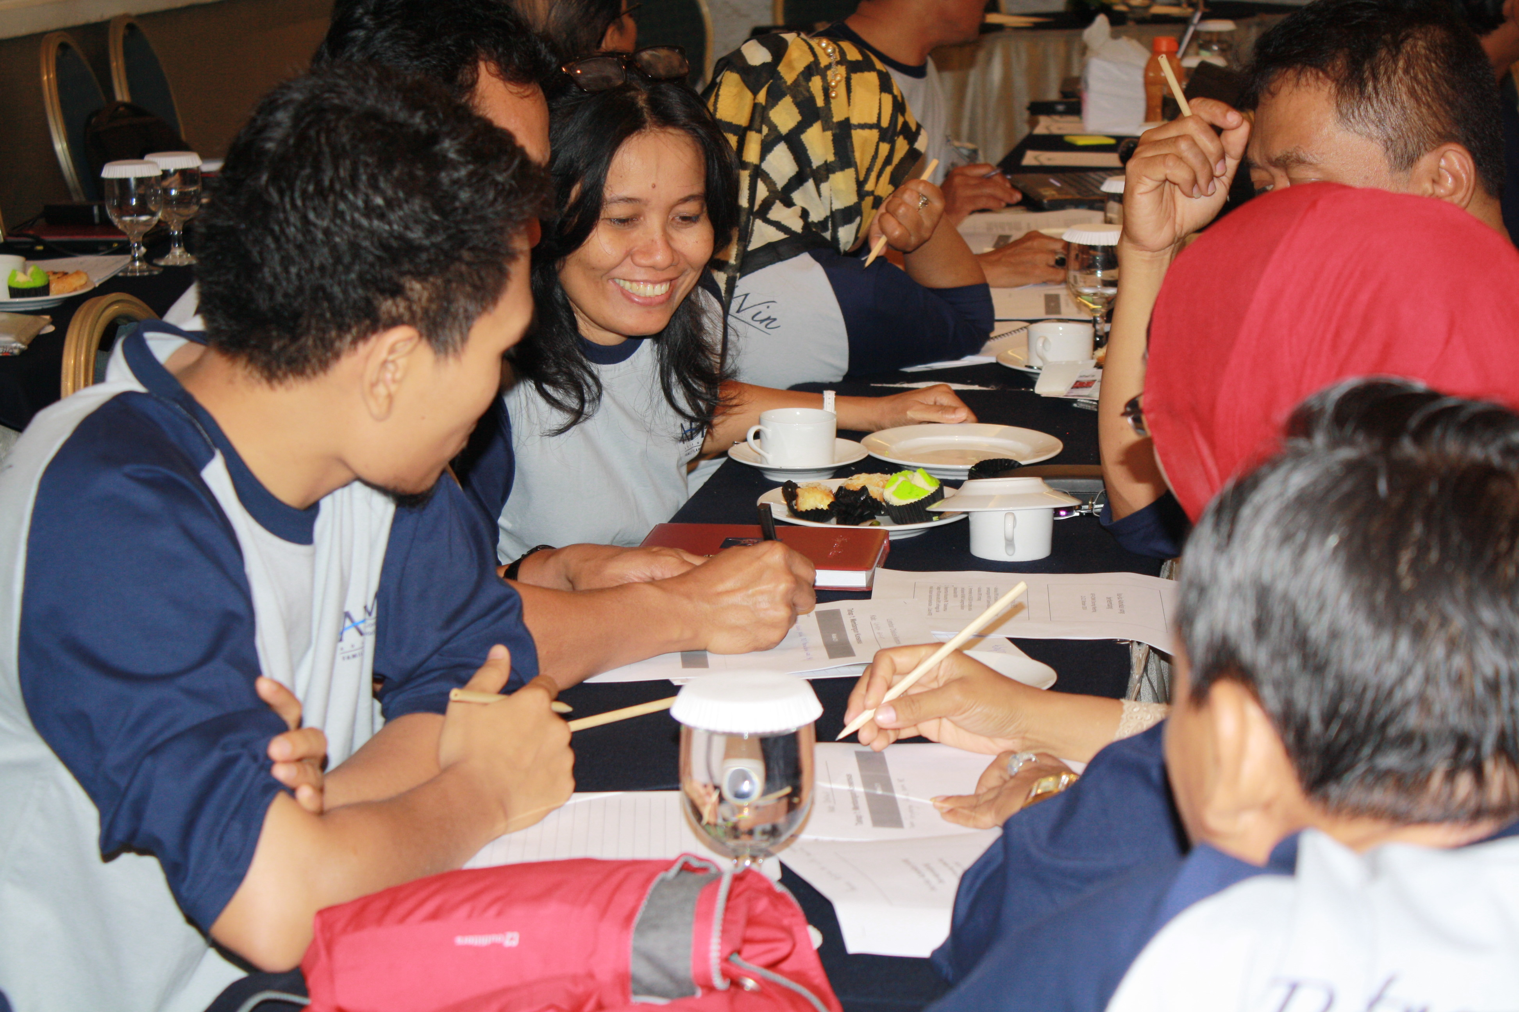
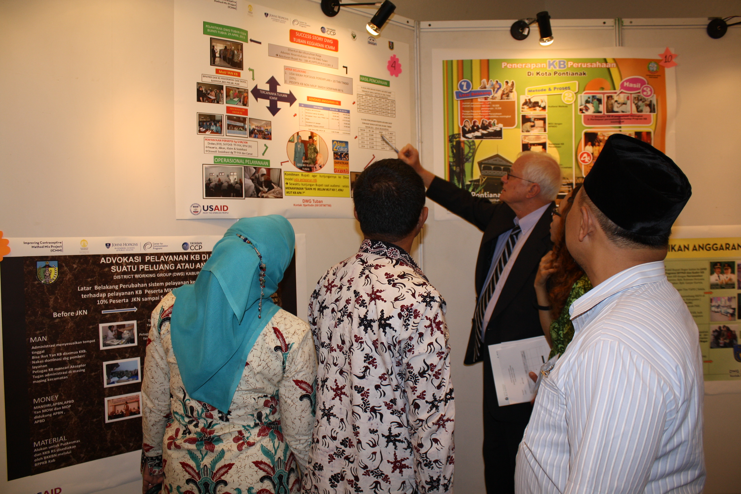
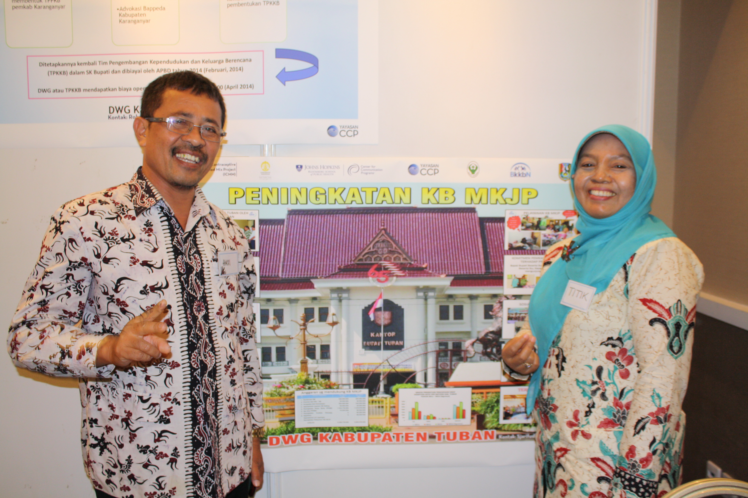
Conclusions
Meeting encouraged learning and collaboration by:
Bringing together two projects with similar challenges
Planning fun activities
Next time, we will:
Invite more “mentors” from the national level
Make working sessions longer
Offer more time for informal sharing
Notes:
This sharing meeting encouraged learning and collaboration by:
Bringing together two projects with similar challenges
Planning fun activities (for example, songs, stories, and posters)
Next time, we will improve the agenda via:
Inviting more “mentors” from the national level
Making working sessions longer
Offering more time for informal networking & sharing

Slide 31
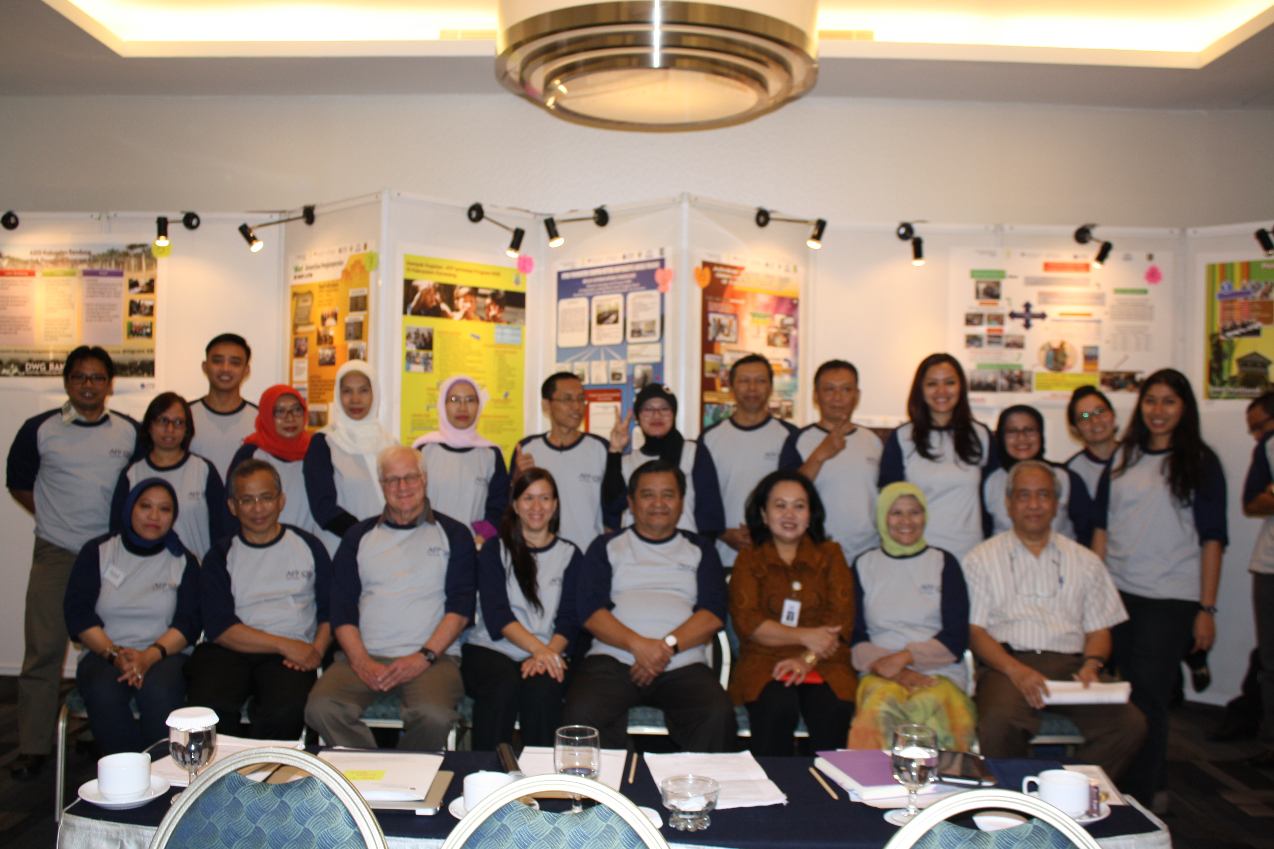
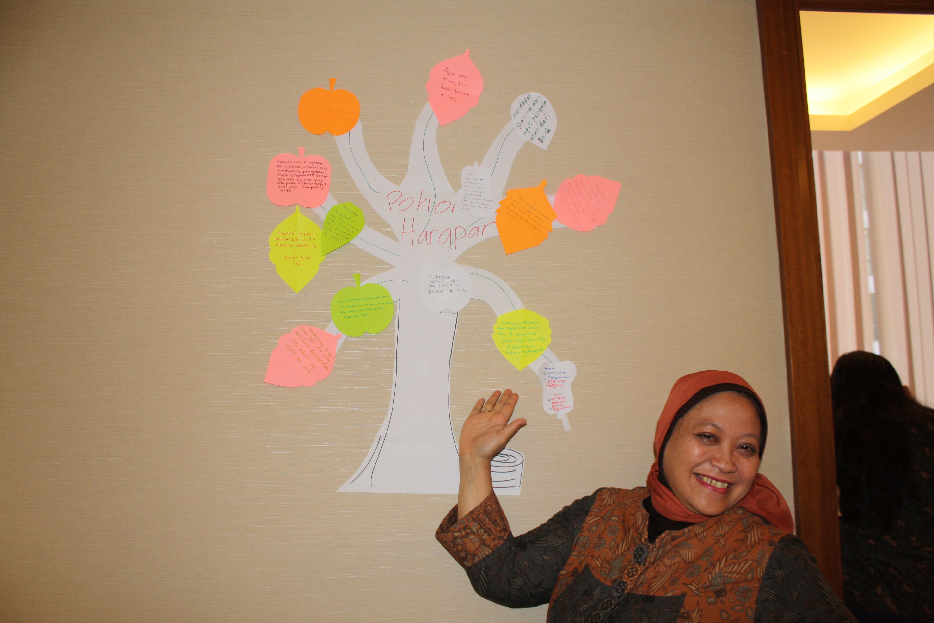
Notes:
Terima Kasih! Thank you!

Slide 32
Thank you!
Questions??
Contact:
Sarah V. Harlan, Learning Director, K4Health
Johns Hopkins Center for Communication Programs
sarah.harlan@jhu.edu
Notes:
For more information – we have reports and blogs about share fairs that I can point you to:
Report of the East Africa Share Fair (and some blogs)
Blogs from the Indonesia share fair
Report and blogs and lots of photos from the GHKC share fair

