Slide 1
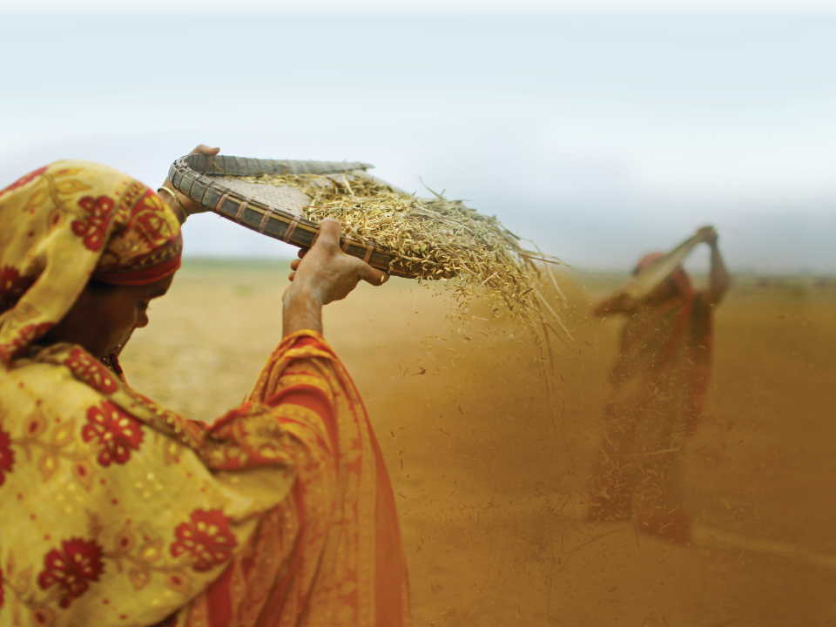


Integrating Agriculture and Nutrition in Food Aid Projects: What does each specialty need from the other?
~combined with~
Integrating Agriculture and Nutrition in Food Aid Projects:
One nutrition advisor’s perspective

Slide 2
What project agriculture staff may not know:
The “pillars” of food security and the role of the agriculture interventions in each pillar (especially “utilization”)
Why health & nutrition focus on vulnerable women and children under age two (targets); why women and children are considered the most vulnerable in the household
What is the definition of food value by a nutrition staff, as compared to an agriculture definition of food value (i.e. is potassium important?).
The basic food groups concept (i.e. balanced meal)
The Essential Nutrition Actions
How agriculture interventions can directly contribute to improving the nutritional status of women and children

Slide 3
What nutrition staff may not know about agriculture interventions:
Challenging goal: Identify solutions for common problems, such as
A lack of year round food security
Low productivity and use of resources
Focus on a limited number of crops
Identifying market opportunities
With use of the HH resource base and within the HH human resource potential and while looking at the environmental protection of the resource base (soil, water).
Key Strategies:
Strategy: Increase crop production (“yield”)
Strategy: Extend crop production season
Strategy: Diversify crop production
Strategy: Intensify the farming system
Strategy: Improve storage of harvest
Strategy: Identify marketable crops and enter the value chain

Slide 4

Target: The household…with children under age two?
UNDERLYING: RESILIENCY….EARLY WARNING…..SUSTAINABILITY
FOOD SECURITY
Indicators:
HH income
HH production
Child stunting
AVAILABILITY
ACCESSABILITY
UTILIZATION

Slide 6
What should be basic shared knowledge?

Slide 7
FOOD SECURITY PROJECTS
Targets:
1) The nutritional health of the HH income producers
Why worry about the well-being of HH income producers?
2) The nutritional health of vulnerable members (women and children) of the household
Why are some members of the HH “vulnerable”??
Why worry about the well-being of vulnerable members of the household?

Slide 8
KEY NUTRITION CONCEPTS
TO SHARE WITH AGRICULTURE SPECIALISTS
KNOW YOUR BASIC FOOD GROUPS FOR A BALANCED AND VARIED DIET
ENERGY = Staple Food
PROTECTION: Fruits and Vegetables
GROWTH: Protein
ENERGY?:
Fats Sugars
One nutrition advisor’s perspective ☺

Slide 9
MATERNAL-CHILD NUTRITION INTERVENTIONS
“FIRST 1,000 DAYS” = CONCEPTION TO AGE 2
WHY? THE WINDOW OF OPPORTUNITY
ESSENTIAL NUTRITION ACTIONS:
Good nutrition during pregnancy
Best practices in breastfeeding
Best complementary feeding practices of children ages 6 to 24 months
Micronutrients: Vitamin A, iron/folic acid, iodine

Slide 10
FOR PREGNANT WOMEN
BALANCED VARIED DIET WITH EXTRA: Why EXTRA?
  ENERGY (staple, fats)
  PROTEIN
  VITAMIN A
  IRON
Why PROTEIN, VITAMIN A and IRON?
GROWTH (pregnancy, up to age 24 months)
PROTECTION:
  High rates of vitamin A deficiency and iron-deficiency anemia
  VITAMIN A and IRON are stored in the body
  Vitamin A and eyes, lining of “gut” and “lungs”
  Iron and hemoglobin (red blood cells + oxygen)
What about ENERGY?
More staple food consumption
Fats (oils)

Slide 11
For Children age 6-24 m: F.A.D.U.A.
Small children have small stomachs
Much improvement can occur with use of staple food for complementary feeding
  Frequency of feeding
  Amount fed
  Density of the porridge (water, oil)
  Utilization (variety = protein, vitamin A & iron)
  Actively feeding child (encouraging, etc.)

Slide 12
Potential Points of Integration
Agriculture & Nutrition

Slide 13
AGRICULTURE SUPPORT FOR NUTRITION
√ Food security with staple crops; seasonal security
√ Diversified production
  √ Entering the value chain
    Teach household income management: budget to include % for animal protein foods
    Include agreements to reserve a portion of commercial crops for community availability
  √ Diversify crops for household consumption
    Include protein crops = legumes
    Include a few vegetable crops HIGH in Vitamin A and iron
    Promote consumption of “new” crops
√ Post-harvest storage
Home gardens ?? Fruit trees?? Small animals??

Slide 14
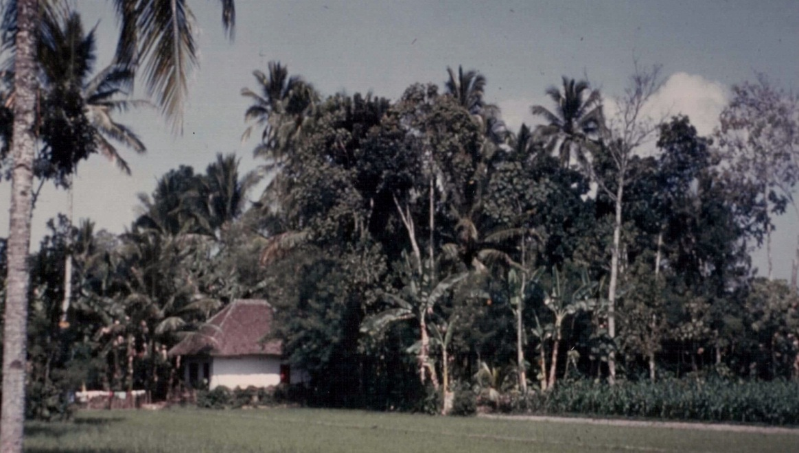
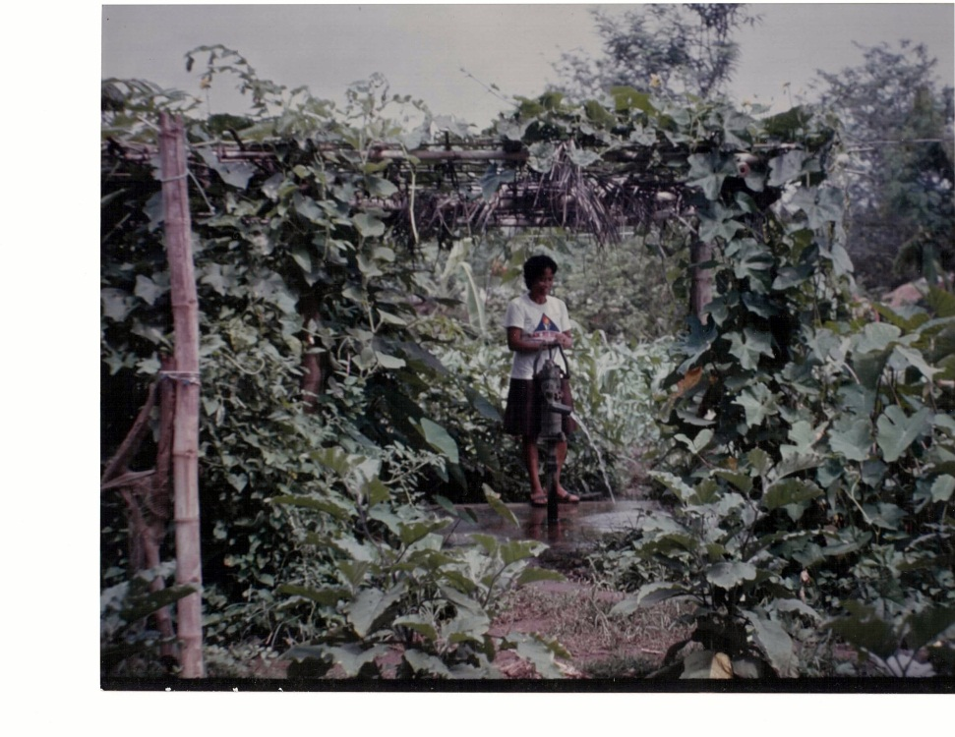
HOME GARDENS
Link between agriculture – nutrition – gender
Daily source of some first foods for baby
FRUIT TREES = sustainable source of Vitamin A but not usually available in the project’s first years
SMALL ANIMALS: Sustainability? Who cares for? What do they consume?

Slide 15
AG SPECIALIST INPUT
NUTRITION SPECIALIST INPUT
FOOD SECURITY & MATERNAL CHILD NUTRITION
OTHER SPECIALIST INPUT
POTENTIAL POINTS OF INTEGRATION
DURING THE LIFE OF A PROJECT
Seasonal food security of staple crops
Adding crops with protein (legumes)
Selecting vegetables HIGH in Vitamin A & iron
Promoting consumption of new foods
Teaching household budget management for nutrition improvement
Agreements to reserve portion of crop for community consumption
Involving PERSONS OF INFLUENCE

Slide 16
AG SPECIALIST INPUT
NUTRITION SPECIALIST INPUT
FOOD SECURITY & MATERNAL CHILD NUTRITION
OTHER SPECIALIST INPUT
POTENTIAL POINTS OF INTEGRATION DURING PROJECT DESIGN STAGE
Seasonal food security of staple crops
Adding crops with protein (legumes)
Selecting vegetables HIGH in Vitamin A & iron

Slide 17
Carrots or Pumpkins?
Pumpkin
Big seed, save seed.
Eat seed, flowers, leaves, fruit.
Weed management
Multipurpose
Traditional food
Carrot
Small seed, new seed.
Eat root only
High management
Sensitive to harvest/post harvest
Not traditional food
Is a PUMPKIN a PUMPKIN ??

Slide 18
AG SPECIALIST INPUT
NUTRITION SPECIALIST INPUT
FOOD SECURITY & MATERNAL CHILD NUTRITION
OTHER SPECIALIST INPUT
POTENTIAL POINTS OF INTEGRATION
DURING PROJECT IMPLEMENTATION
HARMONIZED MESSAGES ☺
Promoting consumption of new foods
Teaching household budget management for nutrition improvement
Agreements to reserve portion of crop for community consumption
Involving PERSONS OF INFLUENCE

Slide 19
Target: Children under age two
UNDERLYING: RESILIENCY…EARLY WARNING….SUSTAINABILITY
FOOD SECURITY
Indicators:
HH income
HH production
Child stunting
AVAILABILITY
ACCESSABILITY
UTILIZATION

