Slide 1
Graphic Refinement
[include date here]

Slide 2
TOC Process and Timeline
 | Month 1 |  |  |  | Month 2 |  |  |  | Month 3 |  |  |  |  | Month 4 |  |  |  | Month 5 |  |  |  | Month 6
WEEK | 1 | 2 | 3 | 4 | 5 | 6 | 7 | 8 | 9 | 10 | 11 | 12 | 13 | 14 | 15 | 16 | 17 | 18 | 19 | 20 | 21 | 22 | 23
Data collection and organization
Problem Tree development
TOC diagram and Complementary Documentation development
Prioritize interventions
Refine TOC graphics
Logframe transfer and select indicators
Quality and completeness review
Notes:
Modify to align to your organizational timeline.
ITERATIVE: First pass, after TOC logic check
Second pass, after intervention outputs are agreed on and output-outcome logic and sustainability checks are complete.
Final pass, in coordination with TOC checklist review—all remaining items addressed

Slide 3
Iterative
First pass, after TOC logic check
Second pass, after intervention outputs are agreed on and output-outcome logic and sustainability checks are complete.
Final pass, in coordination with TOC checklist review (all remaining items addressed)

Slide 4
General presentation
Make a separate diagram/page for each purpose, with clear links showing when logic crosses pages.
FFP requires that in addition to the detailed purpose-level diagrams, we submit a single-page summary TOC.
Notes:
FFP Activities are required to display each Purpose a distinct page; we may elect to break it down further and create a diagram for each sub-purpose.
What is most critical is that we keep the diagram reader-friendly and clearly show linkages in pathways that extend across separate Purpose pages.

Slide 5
Example: Single Page Summary Save the Children: SABAL DFSA in Nepal
Notes:
FFP-funded DFSAs must submit a single-page, summary diagram, in addition to detailed diagrams for each Purpose.
The summary page contains at minimum, the goal, the purposes, the sub-purposes, and the primary intervention outputs that are expected to catalyze change.

Slide 6
Causal pathways are easy to follow and understand
Don’t do this!
Notes:
Direction of arrows is clear.
Avoid arrows feeding into an outcome from all directions. Reading the causal logic is much easier if preconditions feed out from the top and into the bottom of the next outcome, as often as possible.

Slide 7
Causal pathways are easy to follow and understand
Direction of arrows is clear.
Avoid arrows feeding into an outcome from all directions.
Preconditions feed out from the top and into the bottom of the next outcome, as often as possible.
Use consistent shapes and colors
Use linkage shapes to limit tangled confusion
Linkage needs to be specific – not just “Linkage to Purpose 2”

Slide 8
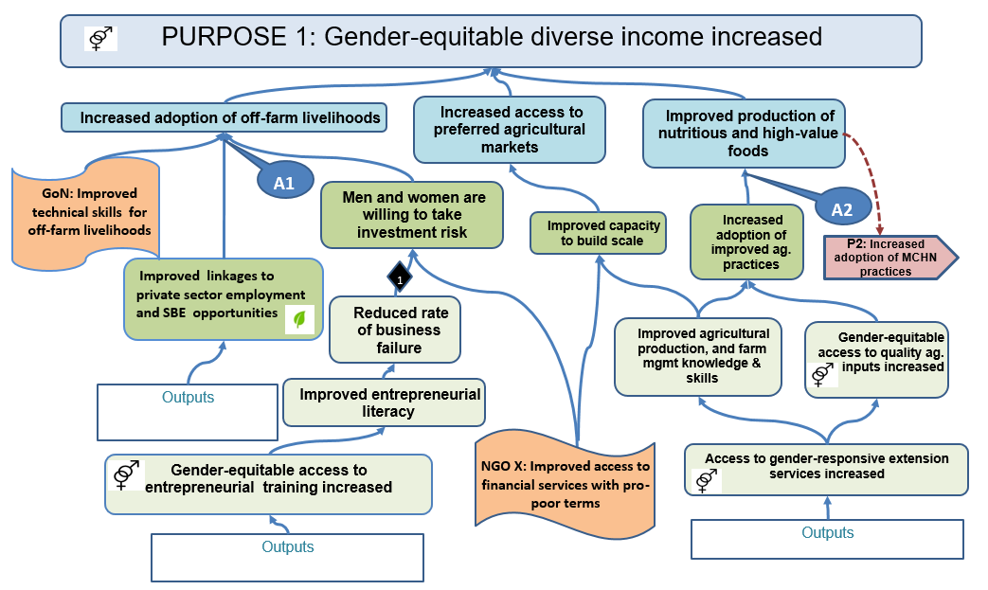
Differentiate TOC Components Use distinct colors, shapes, icons, borders, text, etc.
Notes:
Use distinct colors, shapes, borders, icons, text, and other graphic elements to differentiate TOC components and crosscutting issues.
It can be very helpful to shade each outcome level a different color. In addition to aiding communication, shading by levels makes it easier to transfer the TOC to a logframe.

Slide 9
Linking pathways across diagrams Save the Children: SABAL DFSA in Nepal
Notes:
Causal pathways that flow between TOC diagrams must be easy to follow and understand.
Some FFP partners find it helpful to use a distinct color scheme for each Purpose. The scheme applies only to the Purpose, sub-purposes, and outcomes, including cross-purpose linkages. For example, Purpose 1 might use varying shades of blue, Purpose 2 varying shades of red, and Purpose 3 varying shades of yellow. This provides an easy visual cue for demonstrating cross-purpose logic and integration.
IMPORTANT: the coding for assumptions, rationales, and external actors remains the same across all Purpose diagrams.
Facilitator: It is hard to see detail on this slide, but that is not the point of the graphic. Use this slide solely to point out how this FFP partner used varying shades of red for Purpose 3, the sub-purposes and the outcomes and how the blue and yellow linkages to Purposes 1 & 2 clearly stand out. All outcomes, sub-purposes, etc. for Purpose 1 were in varying shades of blue; all for Purpose 2, in varying shades of yellow.
Alternatively substitute one of your organizations past TOCs as an example.

Slide 10
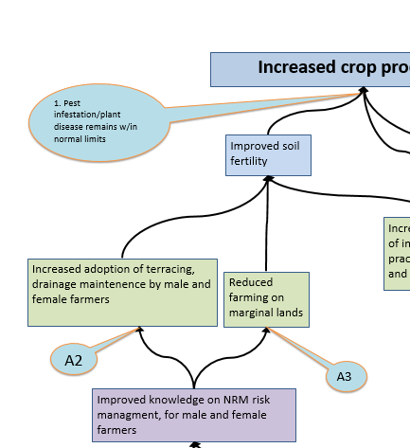
References vs. full wording
If the diagrams become too crowded, we may decide to use references versus full wording for assumptions and rationales
Notes:
If the diagrams become too crowded, we may decide to use references versus full wording for assumptions and rationales.
If we add references, the links between references in the TOC diagram(s) and the details in the complementary documentation/ TO narrative must easy to follow and the detail of the assumptions or rationales from the diagrams can be quickly and easily located in the narrative.

Slide 11
Integrating cross-cutting themes
Key words
Icons
Colors/ shades
Borders
Text
Font
Notes:
Broad rule: Don’t try to demonstrate all cross-cutting elements in the TOC. Diagrams will end up looking like a carnival and very difficult to follow.
We must agree on what to highlight depending on the context assessment and focus of the RFA.
E.g., Gender, environment, and resilience-building; OR community participation and conflict resolution.

Slide 12
Integrating cross-cutting themes: key words
Gender/age groups | Community participation | Environment
Men and women M & F youth | Inclusive | Climate change sensitive
Gender sensitive | With broad community input | Climate smart
Gender responsive | Participatory | Environmentally appropriate
Gender equitable |  | Good environmental practices

Slide 13
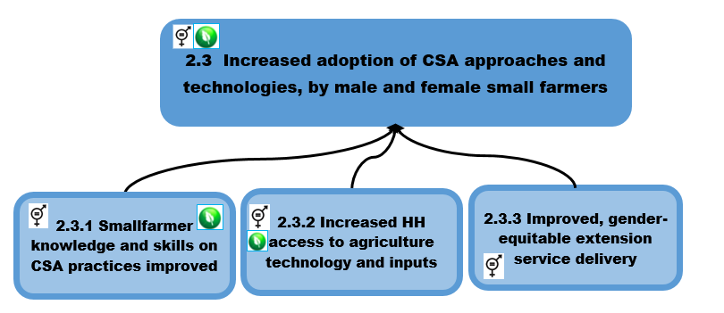
Example: Integrating cross-cutting themes (icons and key words)

Slide 14
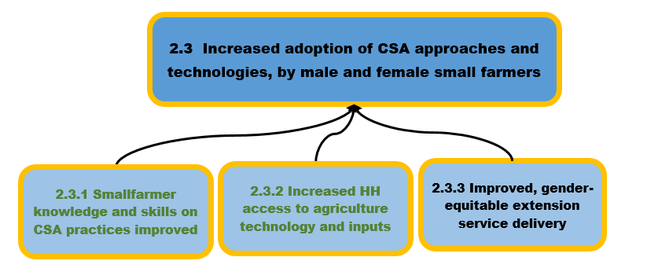
Example: Integrating cross-cutting themes (borders, fonts, and key words)
Gender = orange borders Environment = green text

Slide 15
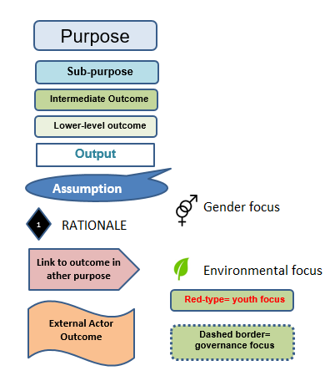
A key is required on EVERY page
Make a key for all color and shape coding and include it on every page.
These are examples only! Do what makes sense for your diagram.

Slide 16
Layering efforts of multiple actors
Notes:
Graphic demonstrates layering the efforts of multiple actors= No more isolated impact - Multiple actors working within the same geography to achieve a common goal.
Shared vision, mutually-reinforcing activities.
USAID moving from project-level attribution to a CONTRIBUTION to shared goals.

Slide 17
Layering the message
Notes:
Graphic demonstrates layering the message = Fewer technical focus silos
Nutrition messages layered in agriculture, WASH, vocational trainings, in addition to traditional MCHN activities.
GESI awareness and leadership training to lead and model farmers, local disaster management committees, youth vocational groups, etc.

Slide 18
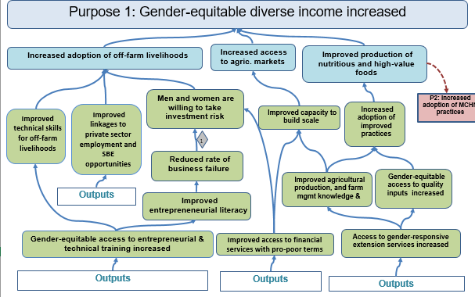
Sequencing interventions
Start Year 2/3
Start Year 1/2
Notes:
Graphic demonstrates simultaneous interventions leading into “capacity to build scale”.
Demonstrate the timing (sequencing) of interventions leading to separate outcomes. ………e.g. Entrepreneurial & tech training needs to occur, before investing time into the improved linkages to private sector.
Discuss sequencing of humanitarian assistance phasing into development assistance.

Slide 19
Sequencing interventions
Notes:
Graphic demonstrates sequencing of various interventions linked to one outcome.

Slide 20
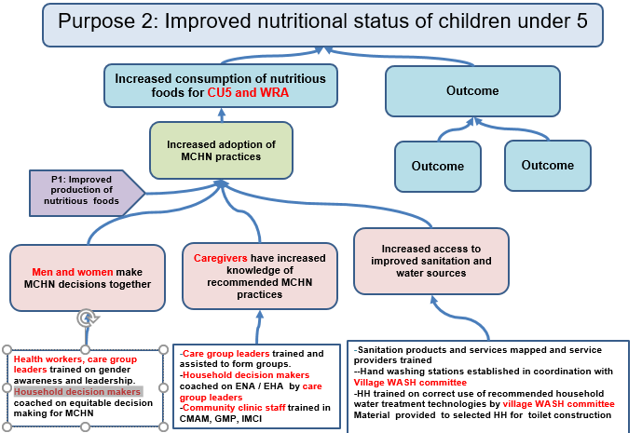
Distinct populations/sub-groups
Notes:
Different pathways for different populations
Point #27 on the checklist states, "The TOC demonstrates where and how the participation of members from the communities and sub-groups within the communities (e.g., age, livelihood group, geographic location) are critical to the TOC." tinct target groups that may be different from an outcomes’ impact group.

Slide 21
Thank you!

