Slide 1



A Data Revolution In Nutrition

Slide 2
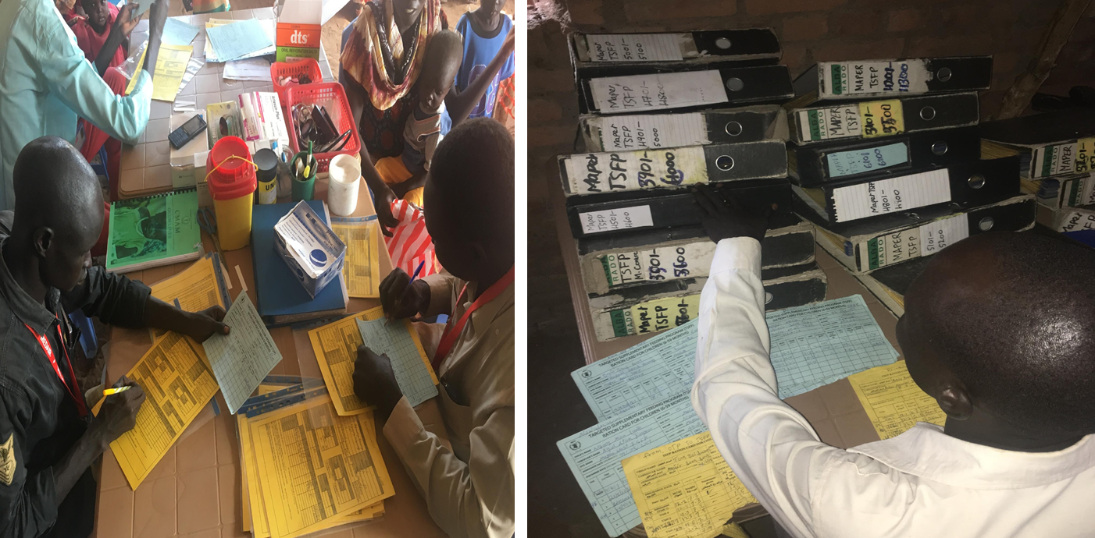
How can a data revolution improve the lives of 52 million children suffering from acute malnutrition?

Slide 3
Integrated Information Management for Programme Improvement
Transfers
Identity Management
Programme Management
WASH
SCOPE
SCOPE
CODA
CMAM
Food Security
Integrated Health
Health
HIV/TB Treatment
School Feeding
Integrated Social Safety Net
Agriculture

Slide 4
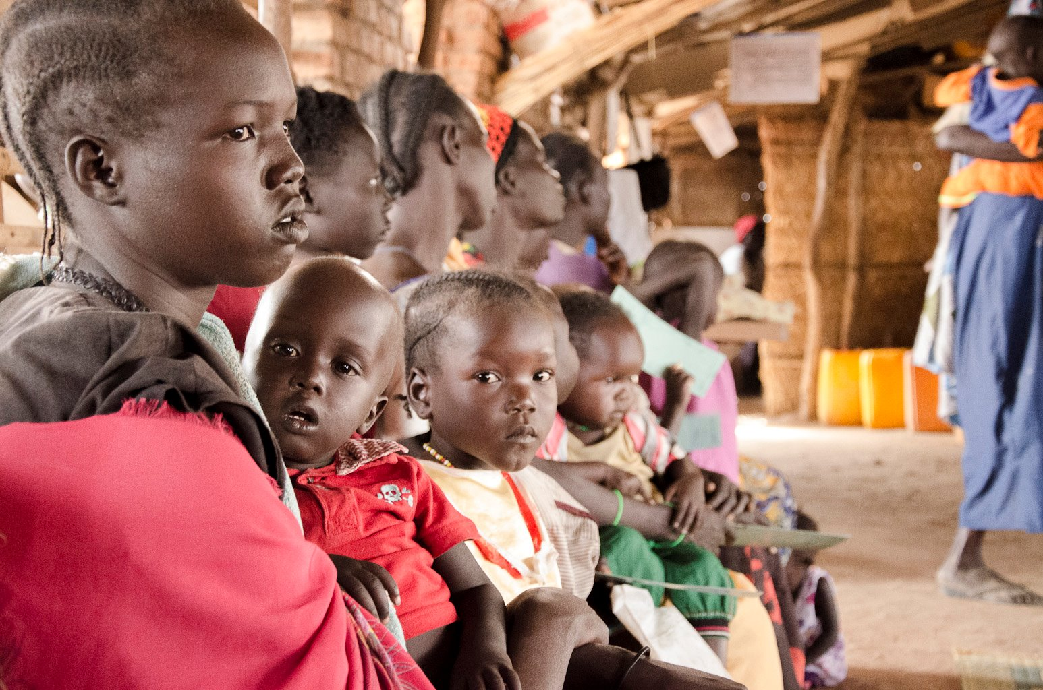
Global CMAM Challenges
Defaulters
High rates of beneficiary default reduce malnutrition recovery; hamper programme results
Referral System
Beneficiaries lost in referral system don’t receive needed treatment
Relapse
Relapse increases acute malnutrition incidence
Duplication
Coverage
Coordination
Information System
Duplication and other targeting errors increase costs and waste resources
Programme unable to reach those in need (low coverage)
Weak coordination among stakeholders stunt efforts to reduce acute malnutrition burden
Poor information systems and unreliable data exacerbate challenges and hinder programme improvement

Slide 5


SCOPE Conditional On-Demand Assistance (CODA)
Driven by CO requests to manage CMAM
Collaboration between OSN, RMT, and Innovation Accelerator
Application developed for CMAM, but flexible for other programmes
Mixes online/offline capabilities to meet programme needs and field conditions
Registration and discharge based on eligibility
Support Decision-Making for frontline workers
Biometrics recognition for de-duplication (Q3 2018)
Report generation for field managers and community health workers
Transmits reliable data in low tech environment
Near real time information for adaptive programming
Unified information system across programmes and stakeholders

Slide 6
Offline:
Improved Case Management & Community Outreach
Malnutrition Treatment

Slide 7
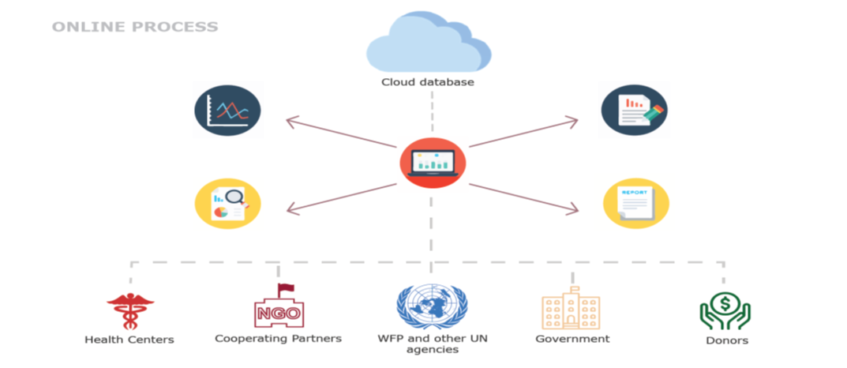
Online:
Improved Analytics for Adaptive Programme Management

Slide 8
SCOPE CODA Support to SDGs
Support to SDG 2.2: End All Forms of Malnutrition
Improved Nutritional Status of Vulnerable Populations
Improved Community Outreach
Improved Dietary Intake
Evidence Generation
Support to SDG 17.9: National Capacity for SDGs
WASH
Health
Food Security
Improved Programme Efficiency
Improved Data for Decision-Making
Strengthen Govt Nutrition Services
Improved Stakeholder Coordination
Improved Information System

Slide 9



SCOPE CODA Road Map Strategy
Scale Up & Expansion
Change Management
Research &
Development
Analysis, Evidence &
Learning

Slide 10
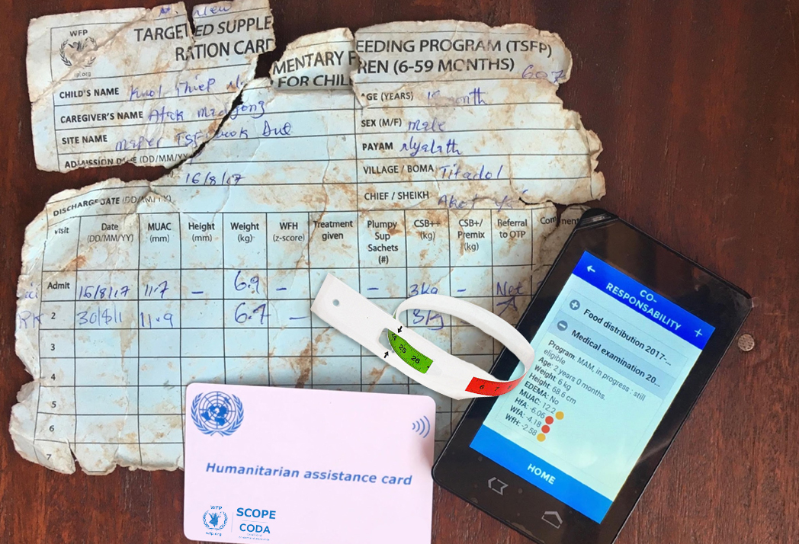
Thank You
For enquires, contact: craig.arnold@wfp.org or federico.naccarato@wfp.org

