Slide 1
Being ‘Fit for Purpose’: Perspectives on Implementing Humanitarian Public Health & WASH Actions 31st July 2019 Presentation by : Peter Nyamoko
Notes:
Notes view: 1

Slide 2
Overview of the Protracted Crisis
Humanitarian crisis in Yemen remains the worst in the world.
Estimated 80 percent of the population – 24 Million people – require some form of humanitarian or protection assistance, including 14.3 Million who are in acute need.
Severe protection risks, a nutrition crisis and interrupted schooling are the main consequences for children.

Slide 3
Overview of the Protracted Crisis
Resurgence of Cholera outbreak in 2019.
April 2017 up to July 2018- World largest cholera outbreak . Over 700,000 suspected cases and over 2,000 deaths
Floods have caused displacements in Hajja, Aden and Hodeida Governorates in 2019
Only 50 percent of health facilities are functional, but lack supplies or are manned by health workers who have not received salaries for months.

Slide 4
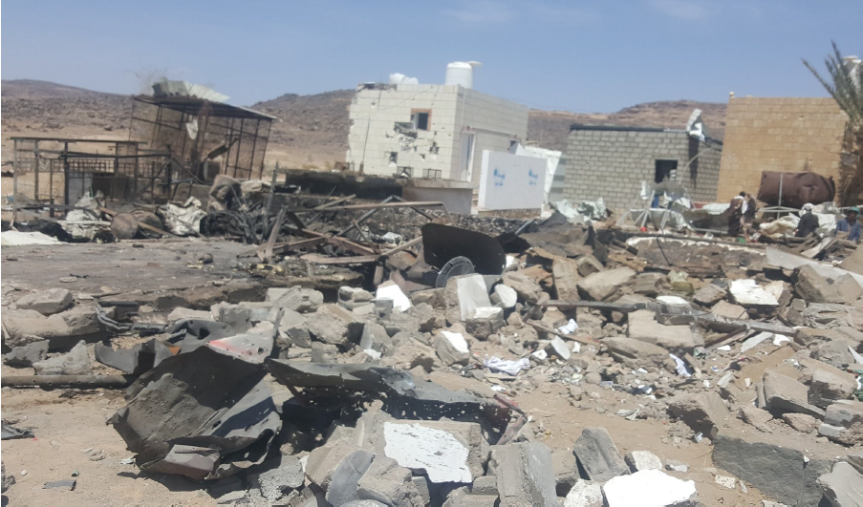
Destruction of infrastructure due to on going conflict
Kitaf Health Facility
Destroyed by airstrike on 26th March 2017
7 deaths including 4 Children
Kitaf HCF will be rehabilitated under OFDA funding

Slide 5
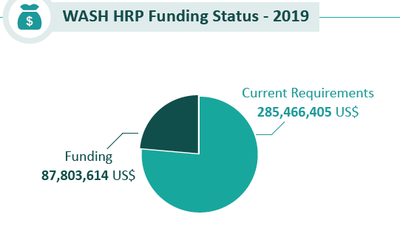
WASH overview for Yemen

Slide 6
WASH overview for Yemen
Yemen in Stats
Economic Decline; 50% since March 2015. Employment and income diminished, depreciation of YER in 2018 – Drastically Reduced HH’s purchasing power.
Fuel Crisis; 137-261 % Prices increase and scarcity: Low imports, currency crisis, supply chain, tax.
Cost of WASH: Increasing transport, water, sanitation services. Costs of truck water & bottled water doubled in 2018

Slide 7
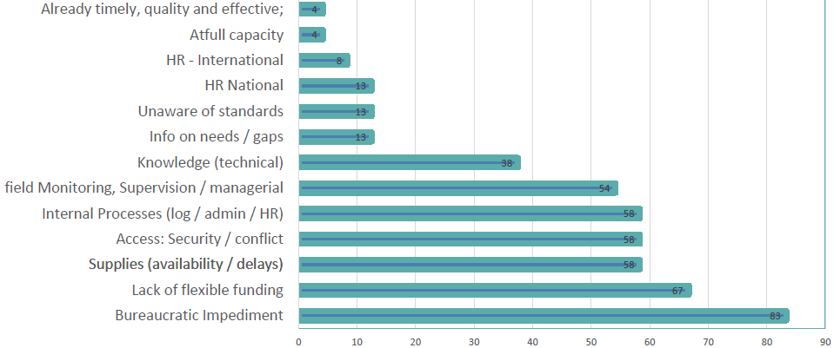
WASH overview for Yemen
Biggest bottleneck to timely, quality, effective WASH Response?

Slide 8
Key trends and messages
01. The need for further strategic priorities within the context of WASH especially linked with the WASH cluster. This entails further focus on: integrating WASH in Health care facilities and schools; WASH in Nutrition points and WASH in Food Security and Livelihoods. Also aspects of climate change- advocating the use of solar energy in MUS, and conducting studies on the impact of solarisation and strengthening ground water monitoring.
02. Further improving operational capabilities
03. Further balance of human resource skill mix at SC as the WASH work strengths
04. Increased influx in Internal Displacement People (IDP) settlements

Slide 9
05. WASH in disease outbreaks, epidemics and pandemics.
- National level cumulative figures from 1st January to 5th July 2019 ; 461, 542 suspected cholera cases , 713 associated deaths , under 5 years old represent 24% of total suspected cases
- Further support for flexible emergency modalities through enabling contingency funding
Need for long term developmental programming to address the root causes of cholera ( Preventive phase)
Enhancement of staff capacity building
- Request for further studies on the resurgence of Cholera in Yemen

Slide 10
Fit for purpose in Yemen
Based on the experiences of SC and developments in Yemen around WASH, we can say that we are on track for tomorrow’s emergencies.

Slide 11
Notes:
11

