Slide 1
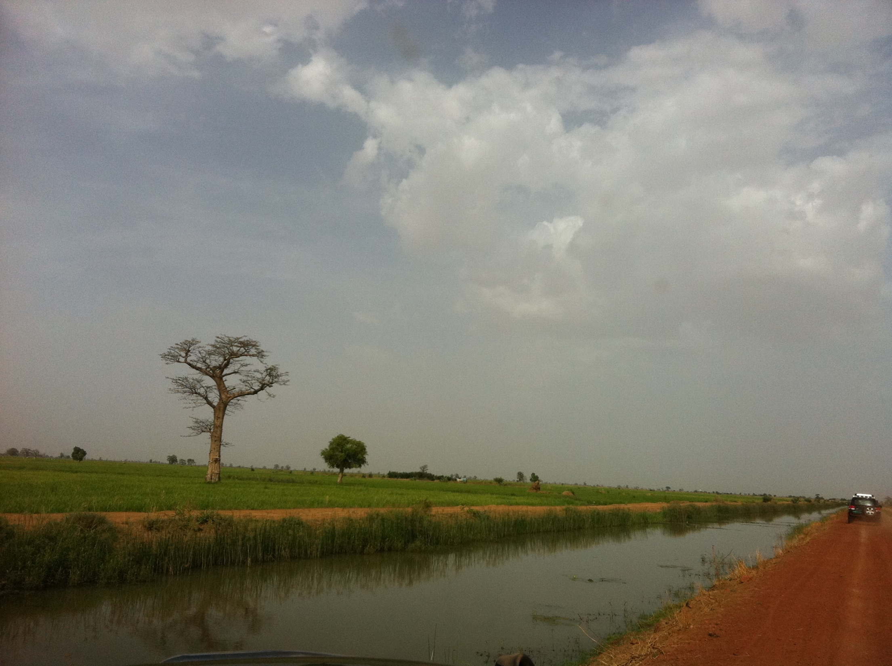
Climate Smart Agriculture
Achieving a greener green revolution
TOPS meeting: Maputo September 2011
Moffatt K. Ngugi
Climate Change Advisor
USAID Bureau for Food Security

Slide 2
Outline
What is Climate Smart Agriculture?
Examples of climate smart agriculture activities
Why climate smart?
Challenges & overcoming them

Slide 3
Climate Smart Agriculture
Approaches, Practices or Technologies that
  Increase yields: Production
  Conserves/maintains natural resources: resilience
  Minimizes or reverses emissions : mitigation
Notes:
Strengthens food security and delivers environmental benefits.
Climate-smart agriculture includes proven practical techniques— such as mulching, intercropping, conservation agriculture, crop rotation, integrated crop-livestock management, agroforestry, improved grazing, and improved water management — and innovative practices such as better weather forecasting, more resilient food crops and risk insurance.

Slide 4
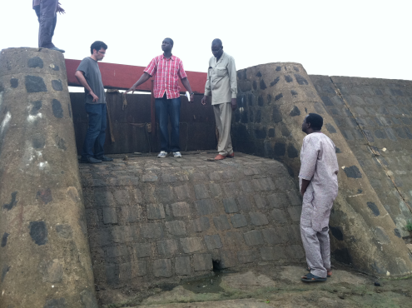
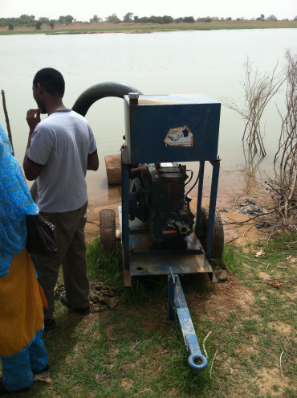
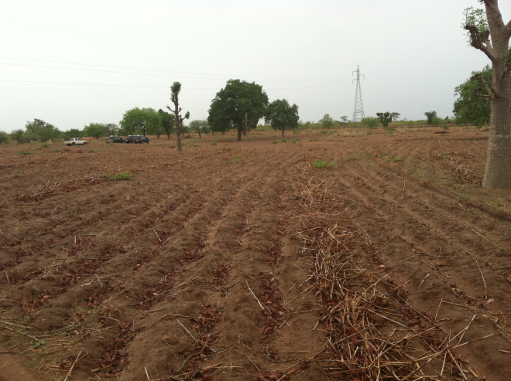
Example # 1: Water capture
Water management through rain water capture, storage and small scale river withdrawals
    Small dams
    River pumping
    Dryland water management
Notes:
Increases dry season horticulture production from one season to two or three seasons and increased area under horticulture production
Increase yields by an average of 400
Raised dry season wells to a maximum depth of 6m where wells had been previously been dry by April, and raised rainy season wells to 2m

Slide 5
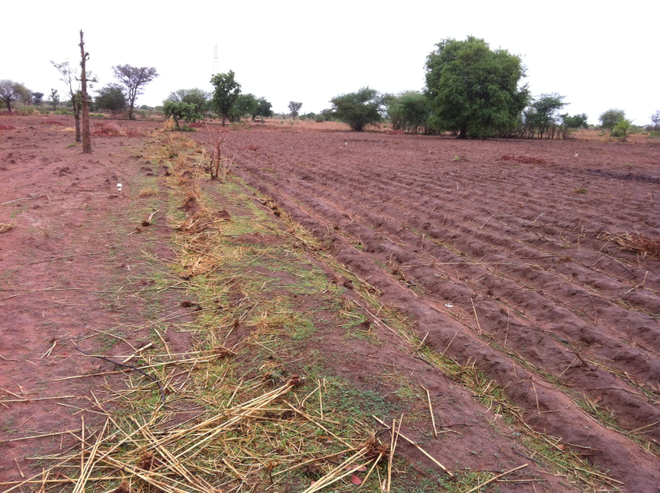
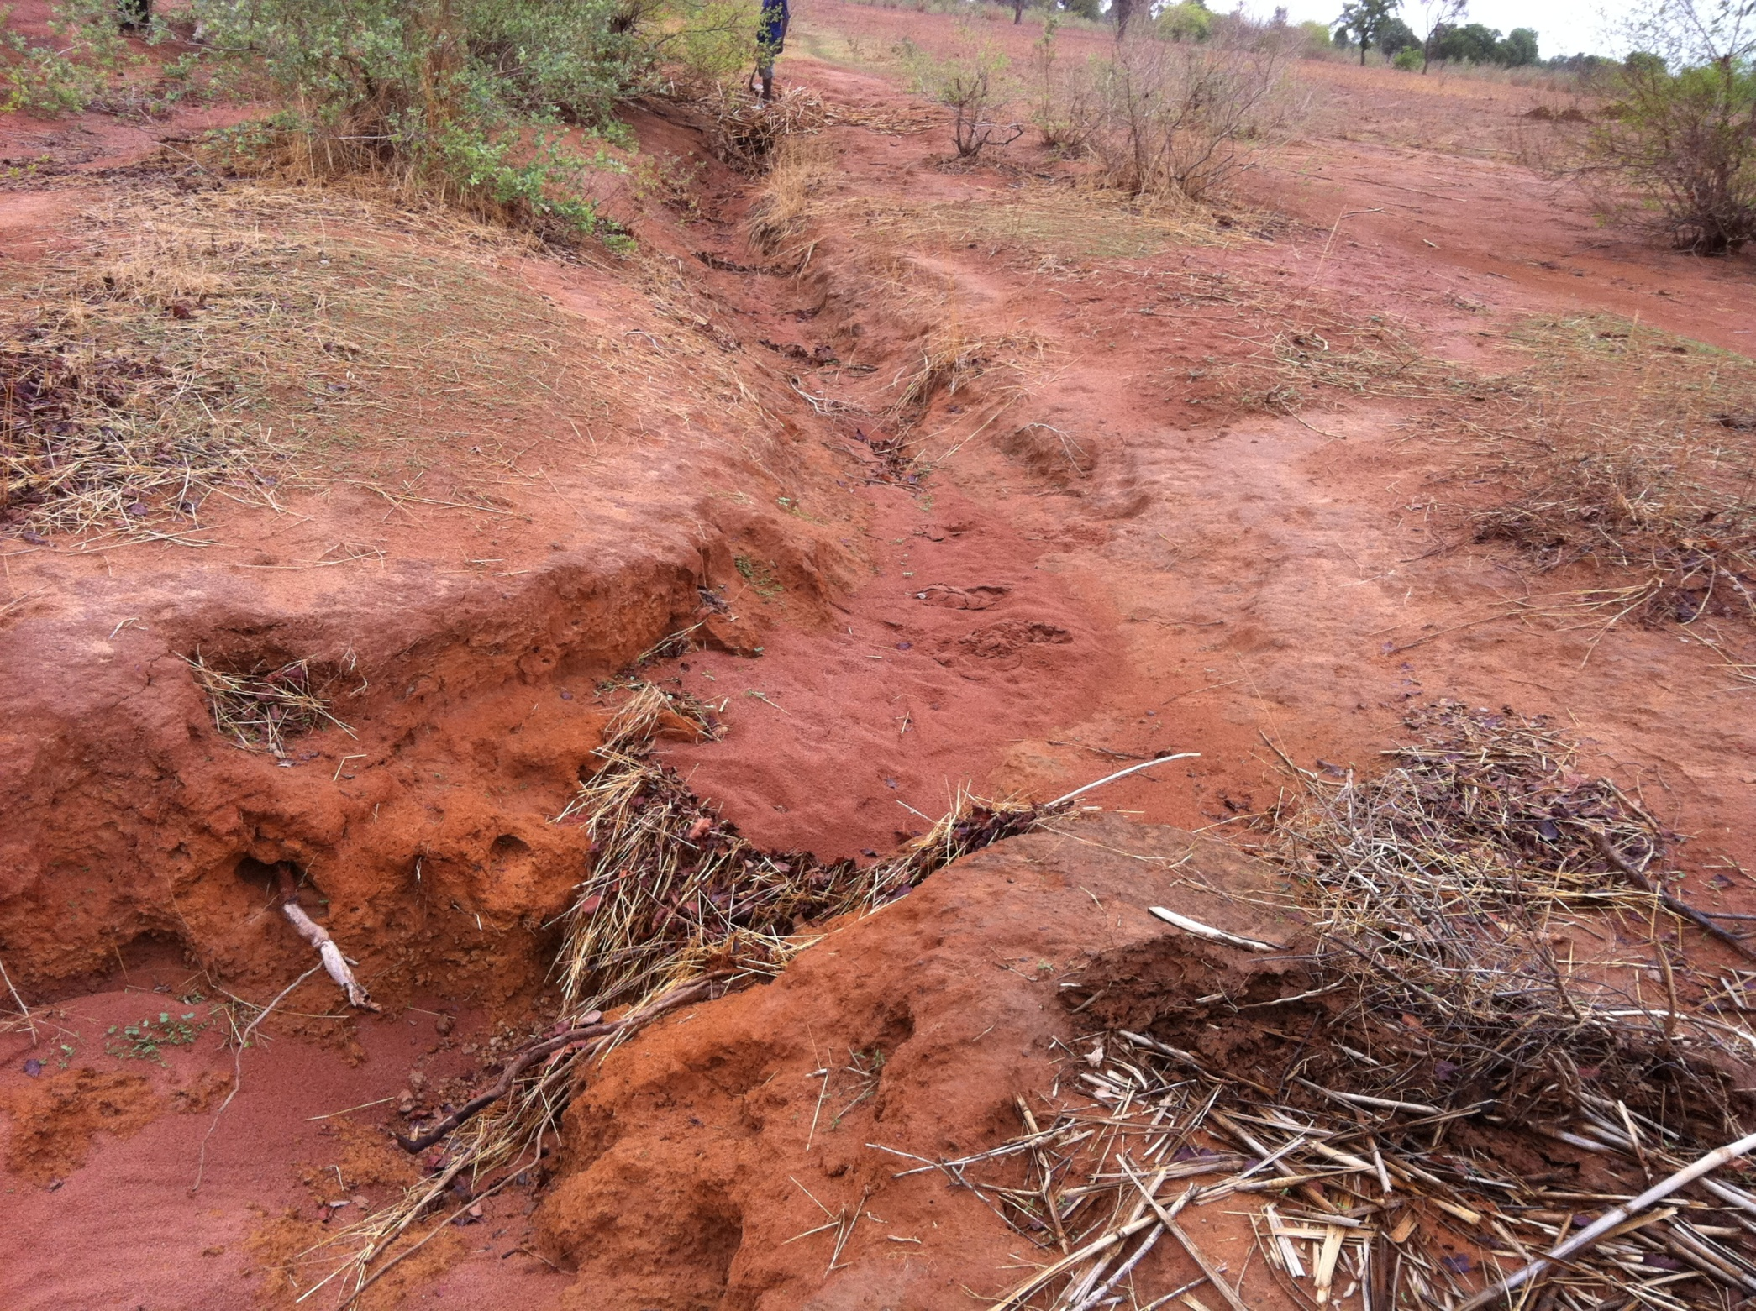
Example # 2: Soil & water management
    Soil Ridge Tilling/ACN
    Aménagement en Courbe de Niveau (ACN)
    Zai System
Notes:
soil and water Conservation Measures capture up to 90% of Rainfall and Allows it to enter the soil
20% increase in root zone of annual crops
40% increase in deep drainage
Impacts
Annual Crops: Early establishment → 30% to 50% Yield Increases
Increased use of inputs and improved seed
Dry Season Gardens provided new and additional revenues
Tree Crops (Shea, Néré, Baobab, Forage, and other women’s crops)
Adaptation: Gardens and tree crops less susceptible to rainfall variability

Slide 6
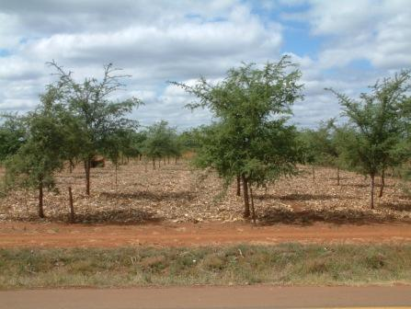
Example # 3: Plant management
Agroforestry
Notes:
‘Evergreen’ Agriculture: Fadherbia trees intercropped with sorghum
Provides nutrients, soil cover, rainfall interception, reduced evaporation, fodder

Slide 7
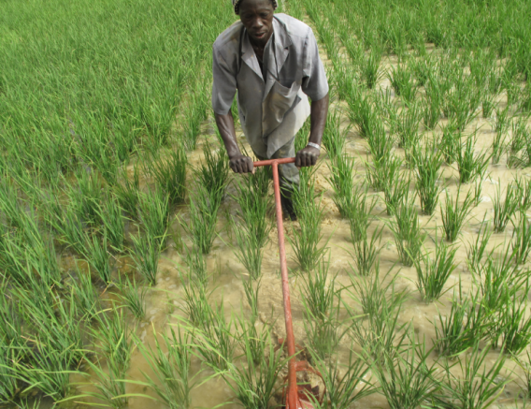
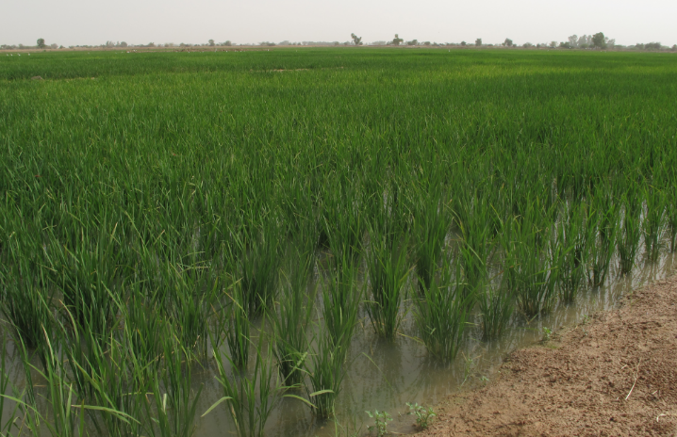
Example # 3: Plant management
SRI: System of Rice Intensification

Slide 8
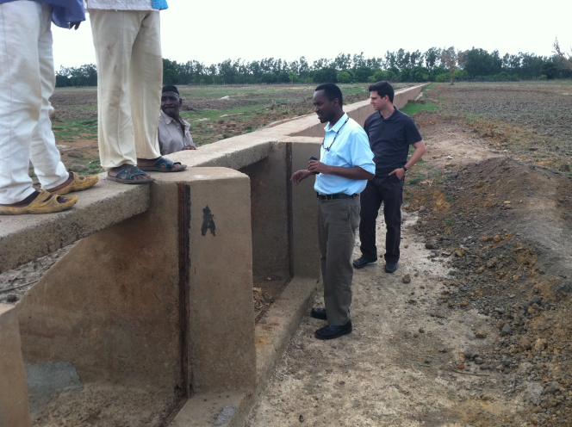
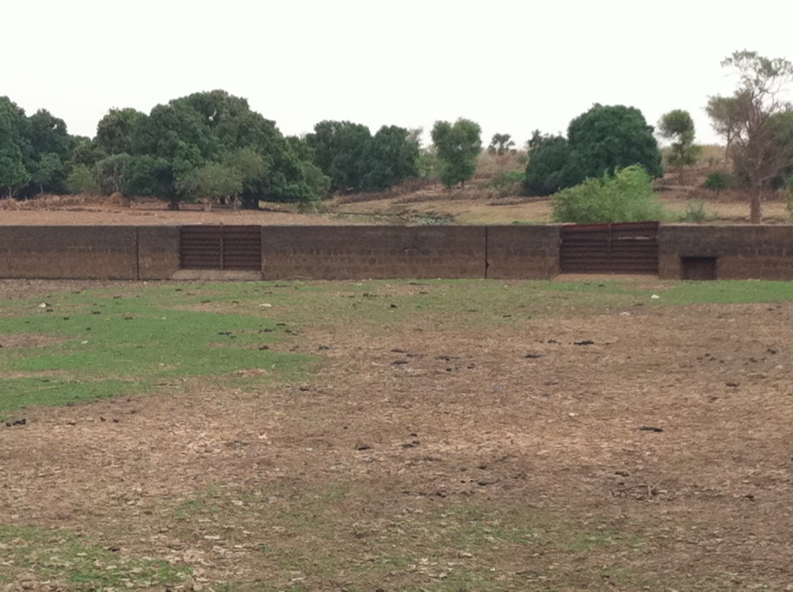
Why climate smart?
    Water harvesting techniques
    Promote infiltration of captured rainwater
    Store what is captured

Slide 9
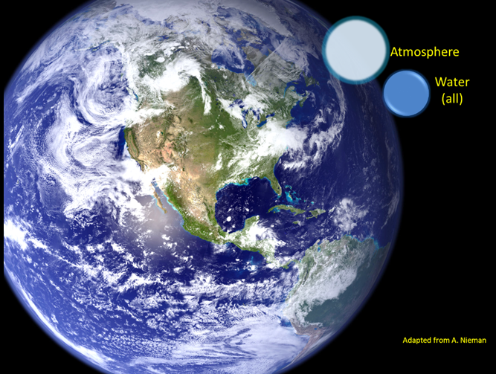

Slide 10
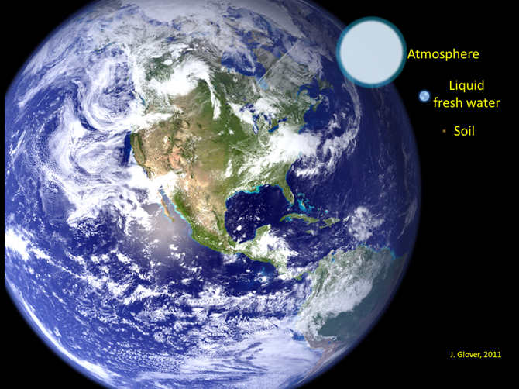

Slide 11

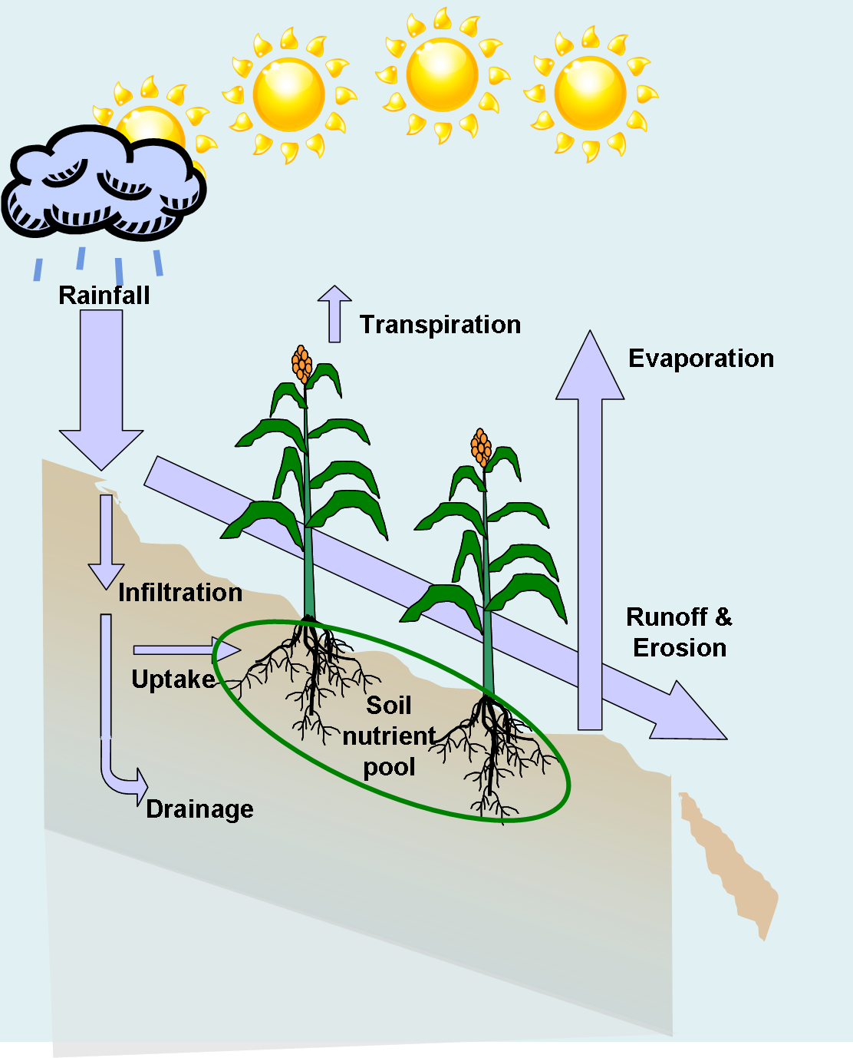
Low intensity cropping systems
Single crops, low diversity, low productivity = poor utilization of sunlight, soil, & water
Extended periods of unprotected soil = increased soil erosion
Poor water management: losses below root zones, high evaporation & runoff
African cropping systems often only use 10-30% of natural precipitation.

Slide 12


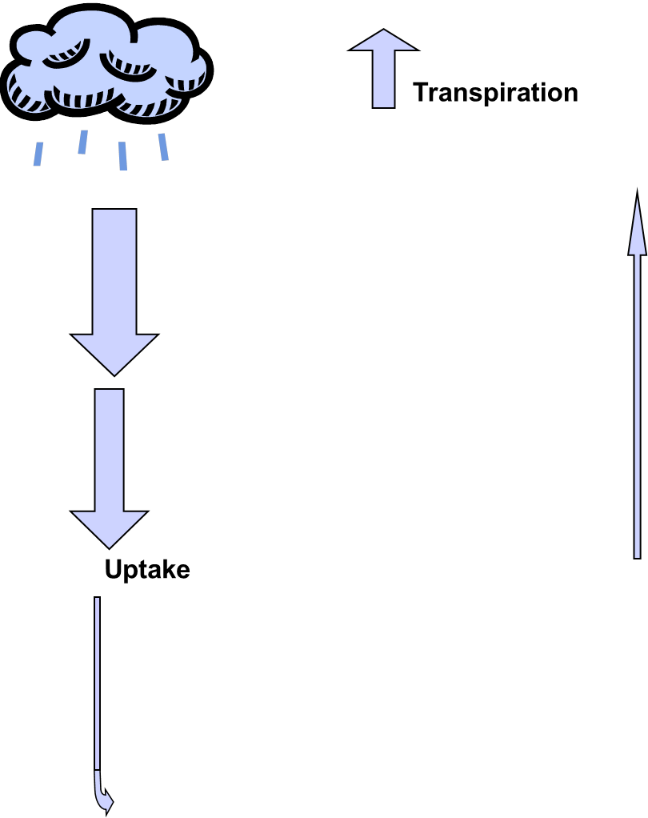
Greater residue retention protects soil & increases infiltration
Greater crop productivity increases use of natural precipitation (‘more crop per drop’)
Reduced runoff, surface evaporation, and soil erosion
Risk reduction, increased yield stability
May make additional crop investments more cost effective…
Evaporation
Infiltration
Uptake
Drainage
Notes:
Sustainable intensification using Conservation Agriculture (CA):
(1) minimal soil disturbance, (2) residue retention, (3) crop rotations

Slide 13
Climate change: benefits of CSA for adaptation & mitigation
Better water management increases availability to crop
Greater diversification can reduce risk
Reduced inputs per unit crop produced means fewer GHG emissions per unit production
Greater soil carbon and nitrogen levels offset GHG
Decreases pressures to convert wildlands to agriculture
Infiltration
Uptake
Drainage
Notes:
Systems-level Approaches
Integrated cropping system
e.g.
Rice, potato, onion
Generate synergies, added value
E.g. main season rice, other season potatoes, onion, tobacco, cross benefit of inputs added
Fish/aquaculture another opportunity
Incorporate Livestock systems

Slide 14
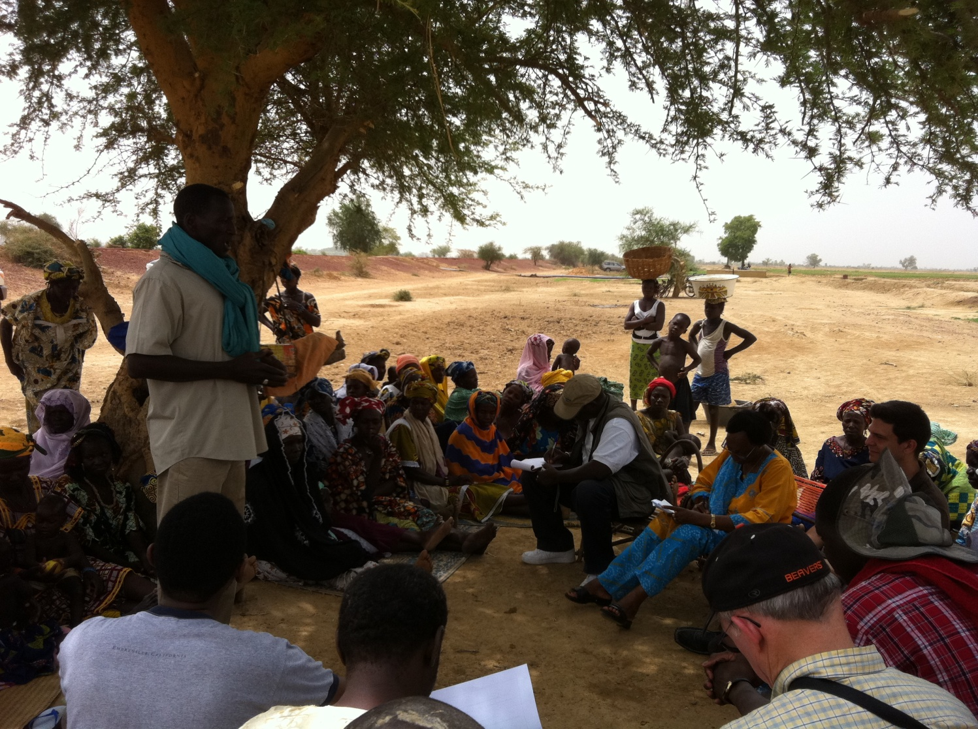
Challenges
  Access to infrastructure, equipment and water
  Lack of institutions
  Access to capital
    Inputs → Increased Productivity
    Invest in diversification
  Access to more favorable markets
    Lever markets by selling in quantity
    Store stock until prices more favorable
    Produce for premium markets

Slide 15
Overcoming challenges
Success Factors
  Training and follow-up for stakeholders
    Adult literacy and numeracy
    Technical (e.g., IWRM)
    Enterprise and organizational training (basic accounting, business planning, etc.)
  Smart Subsidies that allow training without distorting markets
    Infrastructure and equipment
    Intermediary support to bring PO’s and banks together

Slide 16
Overcoming challenges
Agricultural production through integrated natural resource managed
Think systematically to maximize benefits
Effective Institutions and governance are the most important factors in sustainable natural resources management
Notes:
Systems-level approaches
Incorporate livestock into irrigation planning and design
Organic matter benefits
Disease and malaria control
(schisto, guinea worm, oncho)

Slide 17
Diffusing what’s working
Extension is a challenge
Understand limits of different approaches
Understand impacts of different approaches in different contexts (robust M & E)
Options with integrated communications technology (ICT)

Slide 18
Questions & Discussion

Slide 19
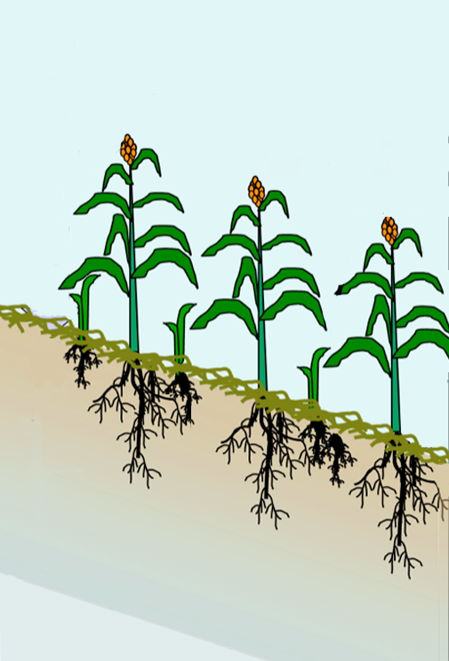

Integrating additional components:
Improved crop varieties
Tolerance to higher temperatures
Evaporation
Improved photosynthetic efficiency
(on the longer horizon)
Improved nutritional quality through biofortification of cereals/legumes (including as fodder)
Reduce tillage through biotech-enabled weed management
Uptake
Maintain productivity with less water, including tolerance to moderate drought
Drainage
More efficient usage of soil nitrogen
(both organic and synthetic)
Tolerant of more saline soils & brackish water (including removing salt from soils)

Slide 20
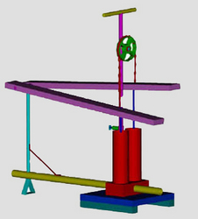
Integrating more complex practices: irrigation
Can extend growing seasons
Makes higher-value crops feasible
Reduces risk
Small-scale, distributed vs centralized large scale?
Intercropping with a legume
Infiltration
Nutrient recycling
Uptake
Drainage

