Slide 1
Land O’Lakes International Development Gender Task Force
Mara Russell
June 11, 2012
TOPS Learning and Sharing Meeting
Addis Ababa, Ethiopia

Slide 2
Overview
History
Purpose
Structure
Challenges

Slide 3
Diversity & Inclusion at Land O’Lakes
2009: Land O’Lakes commitment to diversity and inclusion:
“The Diversity and Inclusion Initiative is a key element in our Best Talent Strategic Imperative and recognizes that successful, world-class organizations are built on a foundation of a diverse and inclusive workforce and work environment – bringing individuals and teams together to blend a wide range of talents, experience and perspectives in pursuit of common goals and a shared purpose.”
Notes:
- How vulnerability is based on both economic and social disadvantages
- Land O'Lakes has addressed vulnerability through inclusive socially responsive approaches
- How these approaches have especially address gender inequalities

Slide 4
Gender & International Development
Gender Analysis for International Division:
Beth Miller, September 2009
Recommendations:
Need to review programs and get feedback on the extent to which we address gender considerations
Need to develop a vision and policy
Need for staff resources devoted to gender issues
Practice Expansion Initiative
Notes:
Need to review programs and get feedback on the extent to which we address gender
Need to develop a vision and policy
Need for staffing to address gender issues

Slide 5
History & Progress
2010
8 Members (7 women), Chair, Champion
Vision, policy
Gender qualification statement
Gender analysis (Sri Lanka)
Success stories
DevLink site
Project Management meeting: Demand for more men and international members
2011
Added 17 members from 10 countries: Regional Committees
Land O’Lakes high profile to gender
Link with Women Thrive: World Food Prize – Mary Rono from Kenya
GAAP, Mickey Leland Fellow
Increased technical focus in proposals and projects
Successes highlighted
2012
Departmental Business Plan – input from all
Finalize Gender Policy
Gender integration into practice areas, operations, new business
Get Regional Committees working
Identify successes and document
Identify and share best practices, scale up
Get on-board with new USAID policy, etc.

Slide 6
Purpose
The Gender Task Force, composed of staff from multiple departments and practice areas, provides strategic direction, technical support, and thought leadership in support of gender equality and female empowerment. Through its DevLink site, the Gender Task Force makes available technical resources and tools for project implementers, and shares news and developments in the gender arena. Through global task force meetings and regional committees, the Gender Task Force enables sharing of success stories and best practices within IDD.

Slide 7
Structure
Global Task Force:
SMT Champion
Global Task Force Chair
HQ Members
Regional Task Force Chairs: EA, SA, Asia
East Africa
Kenya
Ethiopia
Rwanda
Uganda
Tanzania
Southern Africa
Mozambique
Malawi
Madagascar
Zambia
Zimbabwe
Asia
Pakistan
Bangladesh
Sri Lanka
Philippines

Slide 8
Challenges
Ensuring inclusiveness and outreach at country and regional level
Awareness of best practices at organizational level
Bridging the gap between concepts and application
Supporting people in effective implementation
Resources to address the all of these challenges

Slide 9
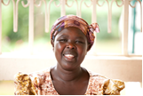
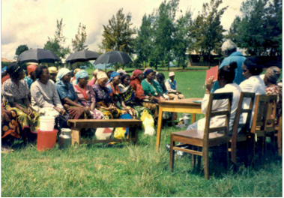
Questions

