Slide 1

FROM FOOD AID TO FEED THE FUTURE IN ETHIOPIA
John Graham
Senior Policy Advisor
USAID Ethiopia
June 2012

Slide 2
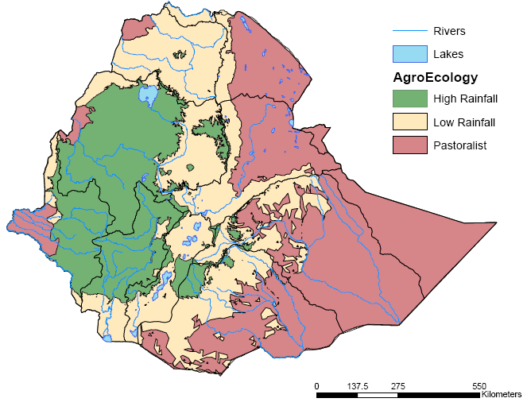
Context: Summary
Ethiopia is a poor, but rapidly growing country with distinct regional differences, with Productive Ethiopia showing high growth potential
Key challenges
Based on current trends, Ethiopia will achieve MDG goals
Humanitarian needs have not declined, with ~13m people receiving food aid,
Droughts, deforestation & soil degradation pose challenges for subsistence farmers
Sources of growth (e.g., extension system) of past decade less able to drive future growth
Tight government regulation on inputs, like fertilizer and seeds, limit growth
Notable opportunities
Strong Ag GDP official growth of 8% recently and increase in cereal production of ~40%
Abundant natural resources for improving productivity: irrigation potential, ‘high potential’ land; abundant labor force
Strong and coordinated donor initiatives such as the new Agricultural Growth Program could catalyze growth in the sector
Progressive and ambitious CAADP plans

Slide 3
Context:
Poor but Progress
Poor but growing: remarkable progress over the past decade, and ambitious plans to continue…
National Food Poverty Head Count (%)
Sustained economic growth:
11% official GDP growth (2006-11)
8% official Agricultural GDP growth (2006-11)
Fastest growing economy in Africa; among world’s 5 fastest past 2 years (Economist)
Progress towards MDG goals
Food aid declining
Preliminary GoE estimates indicate Food Poverty improved dramatically
2000
2006
2010
But is current growth sustainable???

Slide 4
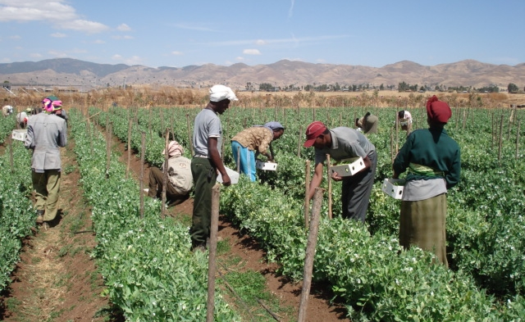
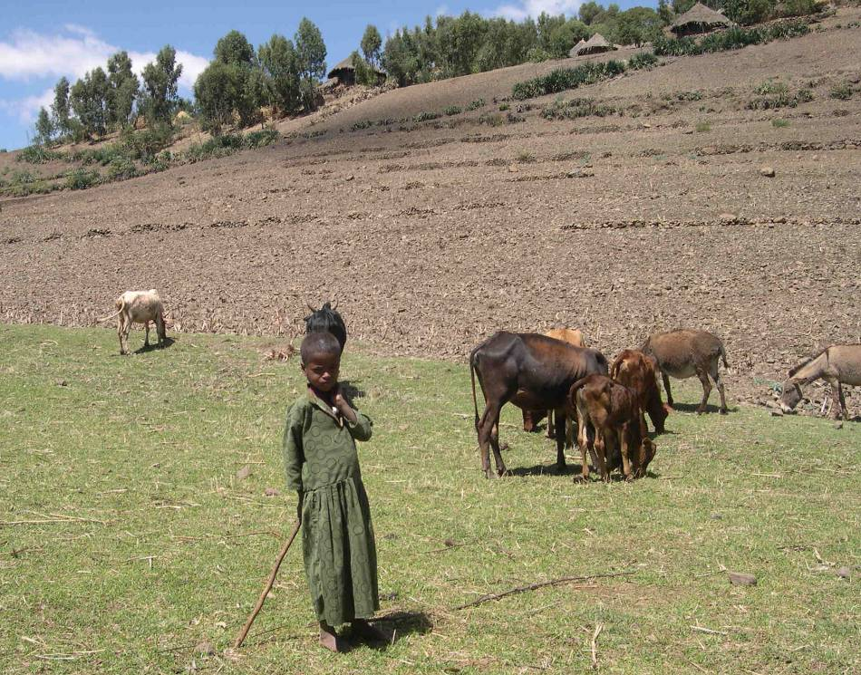
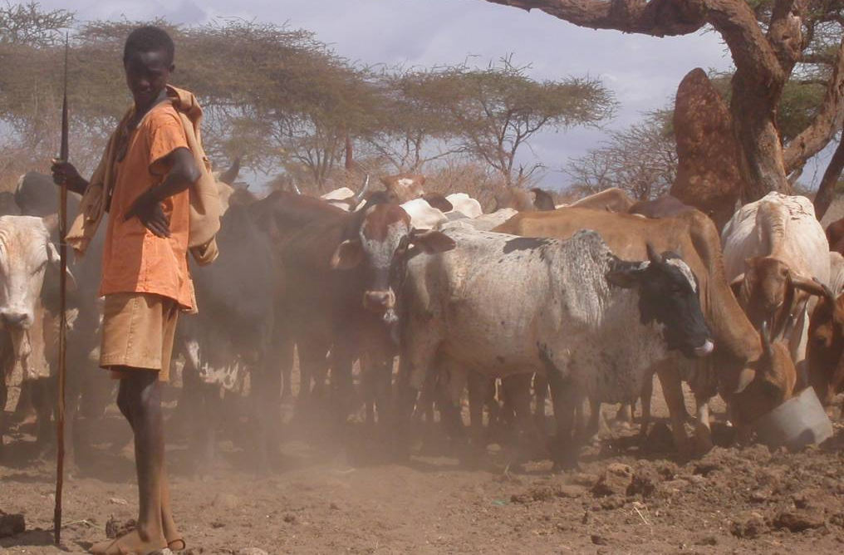
Context: “Three Ethiopias”
“Productive Ethiopia”
larger landholdings
predictable climate
fertile soils
45m
“Hungry Ethiopia”
irregular climate
degraded soils
small landholdings
“Pastoral
Ethiopia”
large grazing areas,
irregular climate
15-20m
12-14m

Slide 5
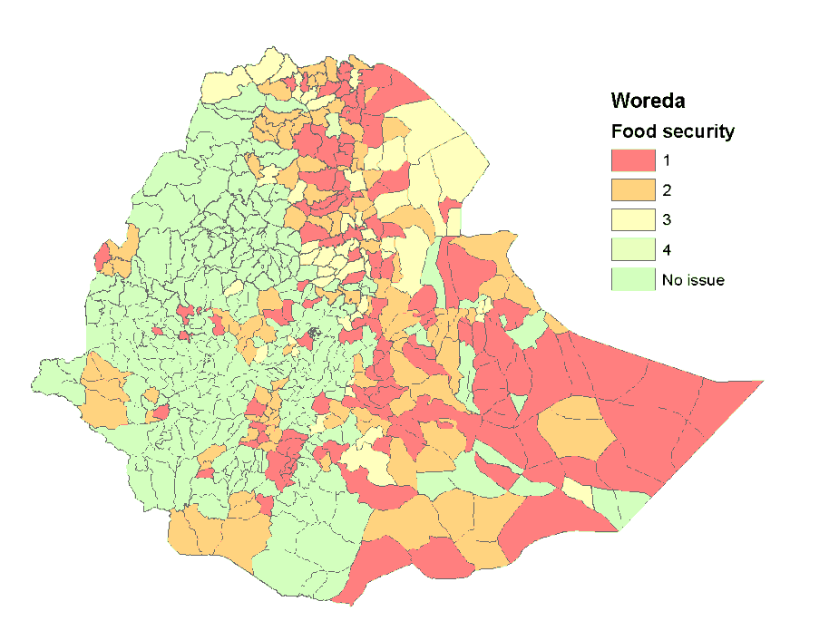

Context:
Food Insecure Focus
GoE and donor resources have traditionally focused on food insecure areas = “Hungry Ethiopia”
Share of population requiring food aid
Percent, 2009
year-round aid
part
year aid
USAID agriculture portfolio
$millions, FY09
6.5M
(8%)
6-7M
(~8%)
Hungry
Pastoral
Productive
The “Three Ethiopias”
USAID contribution to PSNP = $110M annually
100% = 85 million

Slide 6
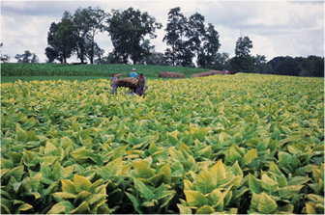
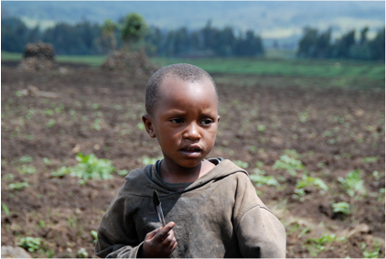

Strategic Choices: Summary
USAID/Ethiopia’s strategy will have three interlinked Focus Areas that will drive food security and nutrition objectives
System-wide transformer
Sustainable livelihoods for chronically vulnerable
A
Voice of the Poor
B
Agricultural
growth
65%
25%
(AGP) for Productive Ethiopia
Link vulnerable populations into “Productive Ethiopia”
Systems Change Initiative
Link vulnerable populations into economic opportunities
Policy development and Learning
Policy and Learning
C
10%

Slide 7
AGP: USAID Focus
System-wide transformer
A
Within AGP, USAID/Ethiopia will focus investment
on Marketing & Agribusiness component
65%
AGP components
Agricultural production
and commercialization
Small scale rural infra development and mgmt
Program management/M&E
1
2
3
Develop and strengthen institutional capacity
Scale up best practices;
Strengthen marketing and agribusiness development of key value chain commodities thru private sector engagement
Small scale agricultural water development and management
Small scale market infrastructure development and management
Support effective management and coordination of AGP
Establish effective M&E system and create learning environment
Support baseline assessment of AGP population
Rationale for focusing on Marketing & Agribusiness:
  Leverage private sector to drive change
  Capitalize on USAID comparative advantage
  Leverage GoE/donor dollars for maximum impact
USAID is the only
donor currently providing significant direct support to marketing and agribusiness
development

Slide 8
Systems Change Initiative
System-wide transformer
A
In addition to AGP, the Mission will also support a Systems Change Initiative
65%
Systems Change Initiative
Objective: Catalyze systemic and policy change through targeted investments with high rates of return
Criteria for initiative investments
Potential Investments:
Support to Agricultural Transformation Agency
Transformative ag input reforms (Gates recommendations)
Biotechnology
Land administration
The Mission will use set criteria to choose investments, e.g., does the investment:
    Directly benefits at least 50,000 smallholder farmers or pastoralists?
    Innovative (is anyone else already doing it)?
    Incorporates performance metrics which ensure a transition to stand alone sustainability in 3 years?
    Clear critical path from a small investment to large systemic change within 3 years?
8

Slide 9

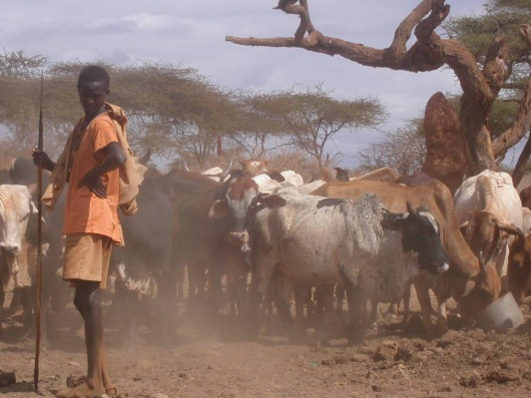
Focus Area B:
“Voice of the Poor”
3
Voice of the Poor
B
Model for change
Link vulnerable populations to opportunities for economic growth through “push” model:
  Graduate 50,000 households “Hungry” Ethiopia/PSNP
    Provide “push” through asset transfers, TA, capability building, credit access, nutrition education
    Link PSNP-GRADS to AGP by prioritizing PSNP woredas adjacent to AGP areas and prioritizing assets and value chains promoted in AGP woredas
  Improve livelihoods in “Pastoral Ethiopia” through linkages to target AGP area
    Provide “push” through TA on animal health, emergency de-stocking, NRM, nutrition education
    Link PLI to AGP through cost-sharing incentives for private sector to facilitate market linkages
  Strengthen GoE efforts to scale “push” model thru capacity building for PSNP & HABP
25%

Slide 10
Focus Area C:
“Policy and Learning”
Policy and Learning
USAID/Ethiopia will drive policy change and project design to address top-binding constraints
C
10%
Production
…and then will address these through 4 interventions:
first identify key constraints in agriculture…
Marketing & Agribusiness
Knowledge, Learning and Policy Program
  Impact assessments on FTF activities
  Research, develop, institutionalize best relief-development practices
  Engage stakeholders and MoARD to guide policy development
Demand
Capacity Building Program
  Train change agents to drive reforms
  Build GoE capacity to undertake new strategic approach
…and determinants of malnutrition
Strategic Research
  Demand-driven policy research through multi-donor ESSP (IFPRI)
Stunting (<2 years)
Nutrition Assessments
  Impact assessments to understand effectiveness of FTF interventions
  Design ENGINE and other project interventions to incorporate nutrition impact
Underweight (<5 years)
Cross cutting

Slide 11
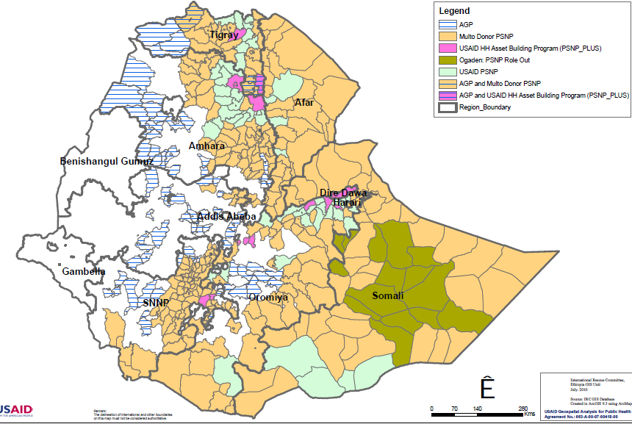
Linking the “Three Ethiopias”
Voice of the Poor
B
USAID/Ethiopia will invest deep in a subset of AGP woredas within Oromia to create linkages between growth in Productive Ethiopia and Hungry/Pastoral Ethiopia
25%
See next slide
Illustrative livestock flows
from Pastoralist areas
Potential target area for
deep FTF intervention
Existing Pastoral Livelihood
Initiative Activities
USAID/Ethiopia will increase scale of investment in three value chains in ~10 woredas in Oromia Region to test its “push” and “pull” hypothesis
Deeper USAID investment would raise total investment/woreda in target AGP woreda subset to ~$1.1M per woreda

Slide 12
Food Insecurity – three pronged response
- Support food secure areas to increase production and provide economic opportunities for food insecure areas
- Continue Productive Safety Net Program in food insecure cropping areas, and increase support for income diversification
- In Pastoral areas, support strengthening of livestock sector and assist those transitioning out of pastoralism

Slide 13
NEVER WASTE A CRISIS!!!!
Results from previous droughts
- 1999-2000 drought – Somali region centered
- good early warning system, dispersed food distribution, improved vaccination campaigns, and better therapeutic feeding
- 2002-03 drought – widespread
- Productive Safety Net Program
- Pastoralist areas early livelihoods interventions (PLI)
- 2006 and 2008 – Malnutrition crises in Southern Region
- Improved therapeutic feeding response
- 2011 – Mainly southern Pastoralist areas
- JPC linked to FtF

Slide 14
JPC – FURTHER SUPPORT FOR DROUGHT RECOVERY AND RESILIENCE THROUGH FTF
- 2011 drought affects over 13 million people in Horn, mainly in pastoralist areas
- USAID forms Joint Planning Cell involving Washington departments and Regional, Kenya and Ethiopia missions
- Joint analysis and program with additional funds approved for implementation starting now
- Multi donor mechanisms set up for donor coordination with IGAD

Slide 15
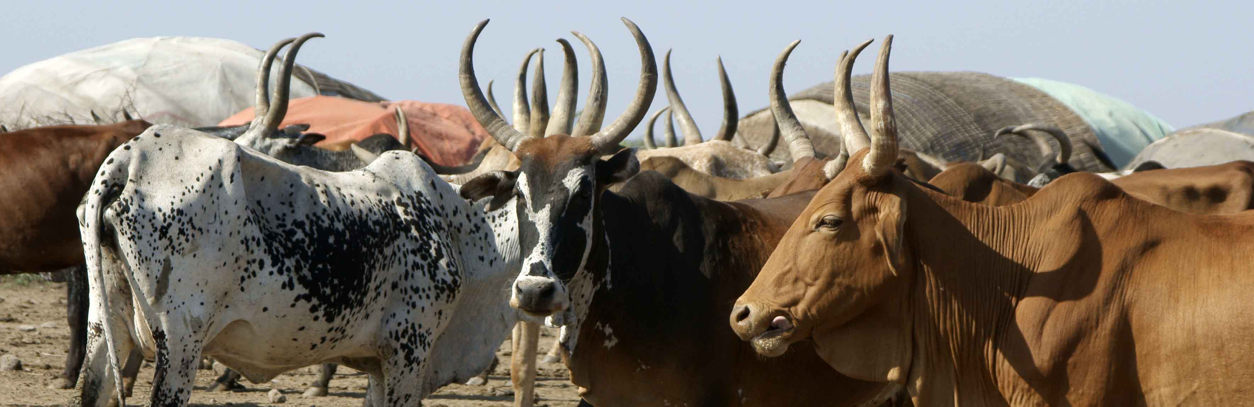
PASTORALIST AREAS PROGRAM
– ANALYSIS AND ACTION
TWO NARRATIVES:
“PASTORALISM IS A PRIMITIVE AND DYING LIVELIHOOD. THESE PEOPLE SHOULD CONVERT TO FARMING AS A STEP TOWARDS CIVILIZATION”
“PASTORALISM IS A THRIVING LIVELIHOOD WHICH EFFICIENTLY USES DRYLANDS TO PRODUCE LIVESTOCK FOR GROWING MARKETS”

Slide 16
Trend in wealth group over 60 years (1944-2004), Shinile zone, Somali Region, Ethiopia
(Source: adapted from Kassahun et al., 2008)

Slide 17
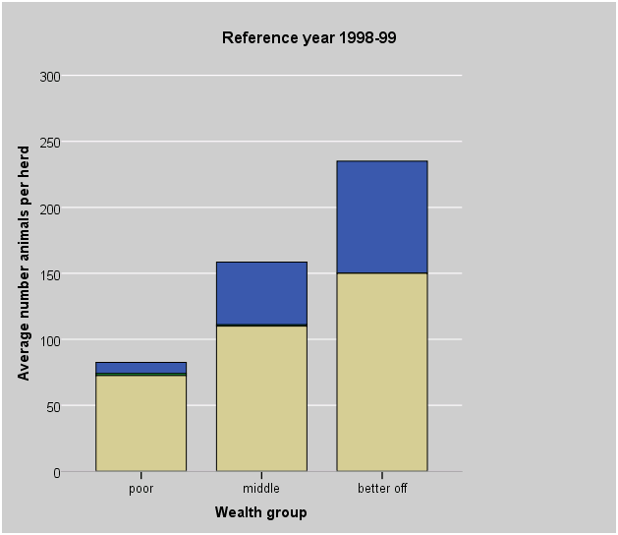
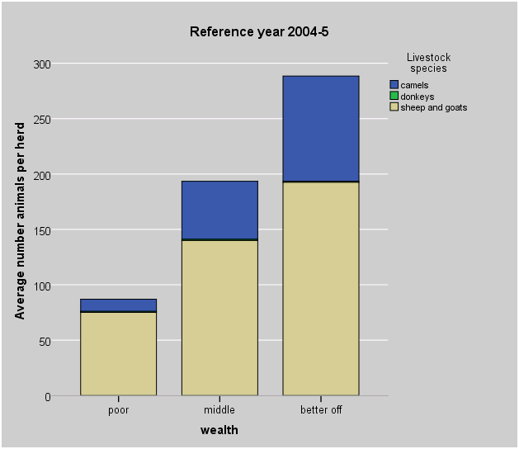
Short-term trends in livestock ownership,
Short-term trends in livestock ownership, lowland Hawd, Somali Region, Ethiopia Region, Ethiopia
(Source: adapted from SCUK, 1998 ; 2005)

Slide 18
OTHER DATA
Proportional wealth group data from Somali Region ‘livelihoods baselines’ indicates, over 8 years:
  5% increase in proportion of ‘poor’ households
  5% decrease in proportion of ‘middle wealth’ households
  No change in proportion of ‘better off’ households
But, apply a 2.5% annual population growth to this data and absolute trends can be estimated:
  4.1% annual increase in number of poor households
  0.8% annual increase in number of middle-wealth households
  2.5% annual increase in number of wealthy households
  Livestock exports from Ethiopia
  Formal trade increases from less than $2m/year in 2002 to $211m in 2011
  87% increase in formal trade in 2011 alone
  Evidence of increased informal trade – Sudan, Somaliland, Puntland

Slide 19
Trends: 1922-2010, Somali region Ethiopia
Other data – Somaliland, 1920-2009
Data sources: Kenya Office; Ethiopia Meteorological Office; SWALIM; Hunt (1940); Lewi
Notes:
Let’s look at a few trends of our key drivers.
This data represents a time series from Somali region Ethiopia of 3 key variables, plotted as a deviation from mean values.
Can you guess what they represent? First, blue xxx; Second, green xxx; Third, red xxx
While demographic pressure clear, the assumption that rainfall is declining and commercial export sales on an ever upward path not clear. Much more complexity in the data.
Take rainfall…

Slide 20
Commercialization, ‘Moving Up and Moving Out’
Moving Up
Positive feedback loops – increasing assets, increasing influence and capacities
Wealthy
Livestock holdings/person +++++
Number of people
+
Commercialization
Capacity to respond to increasing market demand for livestock
Purchasing power
Capacity to access, control or sell decreasing grazing and water resources
Capacity to withstand drought and rebuild herds
Medium wealth
Livestock holdings/person +++
Number of people
++
Poor
Livestock holdings/person
+
Number of people
++++
Destitute
Livestock holdings/person
-
Number of people
+++
Long term ‘constants’
Rainfall variability and drought
Conflict
Moving Out
Negative feedback loops – decreasing assets, decreasing influence and capacities

Slide 21
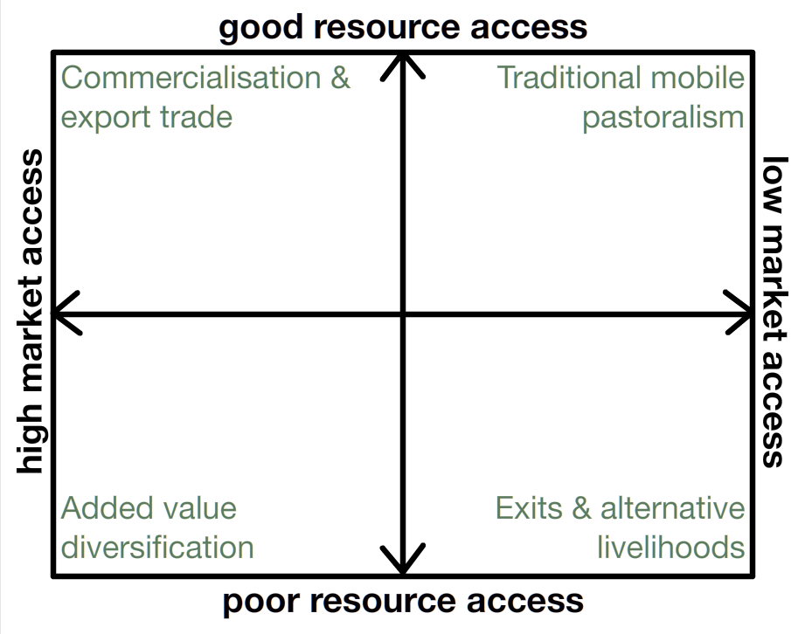
Notes:
To focus debate, we propose a set of potential scenarios, emerging from two key drivers.
Diag adapted from Ethiopia workshop, and result of intensive deliberation by Ethiopian policy makers and practitioners.
Two key drivers:
Resource access (xxx rainfall/primary prod and demography (population increases), but also enclosures, land grabbing and of course climate change)
Market access (xxx trade, formal, informal, export, not)

Slide 22
Regional Dynamics
Resource degradation, reduced access to and competition over rangeland resources, climatic shocks
Commercialization &
herd consolidation
Marginalization & underinvestment
Change
Transitioning out of pastoralism (TOPs)
STEP UP
STEP OUT
MOVE OUT
Commercial thriving
Vulnerable but viable
Vulnerable and exiting
Exited
Enhanced efficiency of livestock value chain
Diversification of livelihood opportunities
Thriving Drylands Economy
Notes:
Commercial Thriving – Ethiopia export; Kenya domestic

Slide 23
Programs are designed to achieve the following:
Strategic Approach
Response
Facilitating the Process of Transition out of Pastoralism
Increasing the Sustainable Profitability of Livestock Value Chain
Ensuring Access to Fundamental Services
Ensuring Sustainability
Developing Alternative Sources of Income
Increasing Profitability
Facilitating Migration
Effectively Implemented, Evidence-based Policy
Governance
Knowledge Management
Notes:
The Ethiopian development philosophy is based upon the effective implementation of evidence-based policy…..
…..dependant upon the key elements of good governance and knowledge management, and….
…..implemented through the twin pillars of :
Facilitating the process of transition
Increasing the sustainable profitability of pastoralist production,
each of which has a subset of key interventions.

Slide 24
Framework for Change in HoAfor A
Social Stability and Economic Growth in Dryland Areas
1:Increase Economic Opportunities
2: Strengthen Institutions, Governance, & Social Accountability
3: Improve Security Conditions & Conflict Management Capacity
4: Improve Physical Infrastructure
5: Sustainable Natural Resource Management
1.1 Diversified Livelihood Opportunities
2.1 Expand Access to Social and Economic Services
3.1: Community & County-Level Conflict Resolution Capacities Strengthening
4.1: Improve Productive Infrastructure
5.1: Improve Use & Conservation of Land, Water and Vegetation
1.2 Improve Livestock Value Chains
2.2 Enhance Capacity/Efficiency of Public & Private Institutions
3.2: Improve Community & Local Security Force Relations, Coordination and Collaboration
4.2: Improve Marketing Infrastructure
5.2: Rehabilitation, Reclamation & Improvement of Land, Vegetation and Water Resources
2.3 Improve Advocacy, Accountability, & Transparency
3.3: State Institutions Produce Confidence in the Rule of Law
5.3: Sustainable Exploitation of Other Natural Resources for Economic Benefit
INNOVATION & KNOWLEDGE MANAGEMENT

Slide 25
Relief & Development Nexus
  Linking risk, resilience, growth and governance efforts through strategic integration of HA & DA
Humanitarian
Assistance
Development
Assistance
HoA JPC
Protect lives and livelihoods, stabilize nutritional status, and create a platform for recovery and resilience
Manage risk to sustain and accelerate recovery, enhance resilience and support economic growth
Ensure sustainable natural resource base and support competitive and profitable livestock sector
Risk – Resilience – Growth
Emergency food/
Non-Food Assistance
Management/Mitigation of Conflict & Disaster
Financial Services
Livestock Production & Marketing
Cash/Food for Assets
Diversified
Livelihood
Opportunities
Community Management
of Acute Malnutrition
NRM/ Water
Nutritional Rehabilitation
Regional Trade
Animal Health & Fodder
Institutional Capacity Building
Emergency Destocking

Slide 26
LIVESTOCK TRADE IN ETHIOPIA
- Increase in formal trade from Ethiopia of livestock and meat from $2 million/yr in 2001 to $211 million in 2011
- 87% increase from 2010 to 2011 alone, during drought year
- Evidence that informal trade has also grown
- camels and other livestock to Sudan
- live sheep and goats for Haj in Saudi Arabia
- Protect and Strengthen Livestock production and trade
- Policies – Mobility - land, enclosures, access to rivers
- Programs – markets, fattening, animal health, SPS

Slide 27
TRANSITIONING OUT OF PASTORALISM (TOPS)
- Evidence base – what not to do
- large irrigation schemes
- cost benefit and labor absorption
- small cooperatives also dubious
- Migration from rural to urban areas a natural process
- Build on what people are doing
- savings and credit
- skills for migration

Slide 28
Leveraging USAID Ethiopia Programs
Budget and Potential Impact
Resources
New JPC Funds:
Economic Opportunities $39.5
Strengthen Institutions $ 7.0
Conflict Management $ 7.0
Natural Resource Mgmt $15.5
Learning/Innovation $11.0
TOTAL $ 80.0
Estimated USAID Leveraged Funding: $177 M
PSNP (safety net) programs | 75.0
OFDA DRR programs | 19.0
Health | 10.0
Livelihoods/Youth | 30.0
Livestock | 25.0
Water | 13.0
Knowledge Management | 5.0
Other Donor Leveraging
Coordinating planning and implementation with:
DFID - $120 million program for Pastoralist Peace and Development
EU - $130 million program for drylands development
World Bank - $4-500 million Pastoral Areas program
JICA - $20 million + on water programs in pastoral areas
Total Ethiopia Drylands Package:
$257 Million

Slide 29
Strategic Approach
Knowledge and Learning
LEARNING AND APPLICATION IN DRYLANDS AREA
Over 15 impact assessments already conducted (2006-11)
improved real time implementation
Crisis Modifier developed, reviewed and institutionalized
Basis for Livestock Emergency Guidelines developed with stakeholders
Commercial de-stocking success (44:1 benefit cost) catalyzes expanded markets for Pastoralist livestock
Women’s empowerment promoted through access to capital (see next slide)
2011 drought response – reached over 500,000 affected pastoralists with livelihood protection support (out of 3 million pastoralists affected)
Underway
- Nutrition study (Milk Matters funded by OFDA) to combat malnutrition in dry season and droughts
- Water guidelines – stakeholder process to improve borehole management, rangeland management, reduce water trucking, assess cost benefit of irrigation programs
Crisis Modifier
In Phase I of the Pastoralist Livelihoods Initiative a crisis modifier was designed into the program to allow partners to re-organize budgets to respond to emergencies with quick livelihoods interventions (de-stocking, animal health, fodder and water provision).
This program was evaluated and praised as an innovative and effective approach to early response
In Phase II of the PLI and in the newly developed PRIME program, OFDA provides funds to support the crisis modifier
Notes:
Capacity Building Helps Pastoral Women Transform Impoverished Communities in Ethiopia: D. Layne Coppock, Solomon Desta, Seyoum Tezera, Getachew Gebru. Science Vol 334, 9 December 2011 AAAS
The paper details how USAID used an action oriented approach to build capacity among thousands of pastoralists to diversify livelihoods, improve living standards and enhance livestock marketing. The process included collective action, microfinance and participatory education.
The assessment showed that through these interventions, poor women became leaders and rapidly changed their communities. Survey-based comparisons with ex-post controls indicated that USAID interventions led to major improvements in trends for quality of life, wealth accumulation, hunger reduction and risk management.

Slide 30
HOA REGIONAL PLANS
1. COMMON ANALYSIS
2. REGIONAL PLATFORM WITH IGAD
3. BUILD ON POLICY – AU, COMESA
4. FOCUS ON CROSS BORDER ISSUES
5. KNOWLEDGE AND LEARNING AGENDA

Slide 31
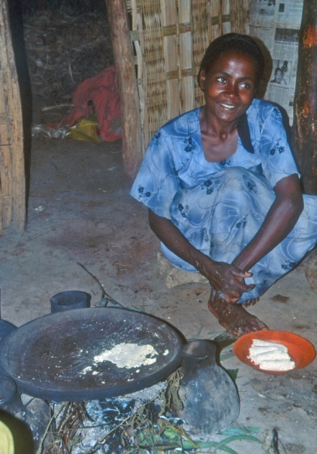
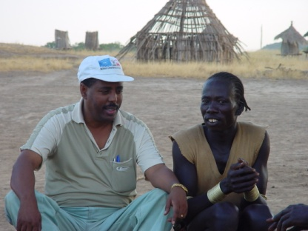
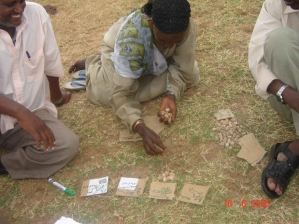
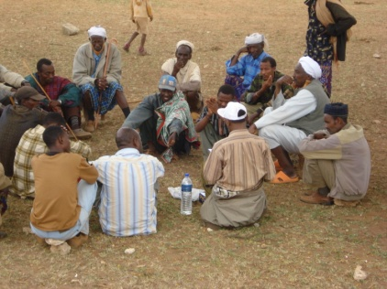
Overview of K&L experience
Adaptation and use of ‘Participatory Impact Assessment’ and conventional surveys and assessments from the late 90s
Initial focus on veterinary projects, then expanded to cover livestock more broadly
By early 2011 in Ethiopia included:
Livestock – veterinary, feed, destocking, restocking
Human health
Education
Financial services & value chain links (PSNP Plus)
Small-scale irrigation
Cash-for-work and food-for-work
Income generating groups
Urban gardens

Slide 32
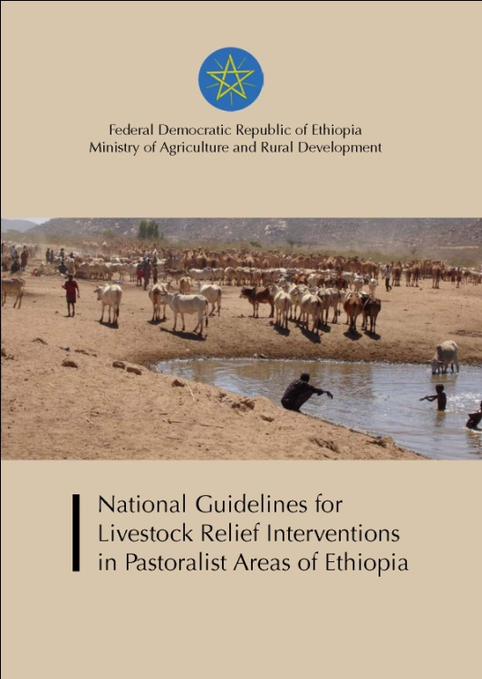
Ethiopia examples
Community-based animal health workers
  Legislative recognition of CAHWs
  National MoA Minimum Standards and Guidelines
Livelihoods-based drought responses, pastoralist areas
  MoA national guidelines
  Revised veterinary approaches e.g. voucher schemes with private sector
  Commercial destocking
  Livestock feed

Slide 33
THANK YOU!

