Slide 1


The Partnership Defined Quality
Video Project
Beth Outterson, Capacity Building Advisor
Andrew Hoskins, Liberia Country Director
Medical Teams International

Slide 2
Agenda
What is Partnership Defined Quality?
Description of PDQ Video Project
Discussion of Learning Tool Questions
Next Steps
Questions

Slide 3
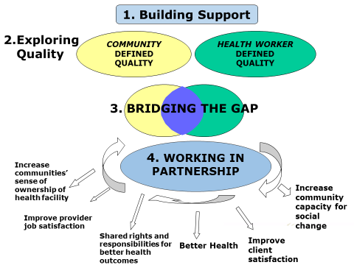
What is Partnership Defined Quality (PDQ)?
Four-phase methodology
improves quality and accessibility of services by engaging community members in defining, implementing and monitoring the quality of service delivery.
empowers providers and community members to develop solutions together.
most often used in health sector.
developed by Save the Children
implemented in more than 15 countries.
Save the Children, 2003
Notes:
PDQ has 4 phases.
It is a methodology that improved quality and accessibility of services by engaging community members in defining , implementing and monitoring the quality of service delivery. It empowers providers together with community members to develop solutions together.
It is has been used mostly in the health sector but there have been applications in education, and HIV/AIDS and other sectors.
It was developed by Save the Children in the early 2000’s and has been implemented in more than 15 countries.
It works best when it is part of the quality improvement component of larger projects.

Slide 4
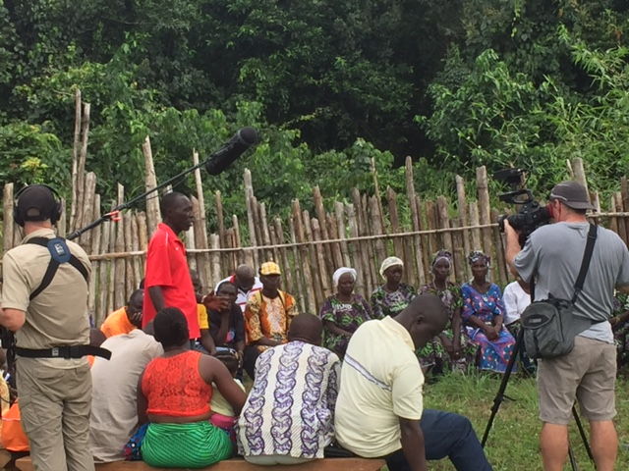
What is the PDQ Video Project?
MTI received a TOPS Small Grant to produce a video of the PDQ process it was implementing in Liberia.
Purpose: to increase awareness and use of PDQ
Process:
  Storyboarding and draft script
  Planning with video team for scenes of different phases in 4 communities
  Manage logistics at community level
  One week of shooting
  Narrative finalized
  Editing and translation
The video team shoots QIT meeting in Bambalah
Notes:
MTI received a TOPS Small Grant to produce this video. We wanted to capture the PDQ process to show how it was being implemented in Liberia.
The purpose of the Video project was to increase awareness and use of PDQ. PDQ has been around for many years, but its use has not been widespread. Developing a video is a great way to help facilitate the training we are doing, but also sort of re-introduce the methodology to others who may be seeking community based approaches to improving health and development indicators.
We only had 3 months to implement the project so a lot of detailed planning and coordination was needed between HQ and in country staff AND the video team to plan the storyboarding, the script, notify the communities and shoot the footage in 1 week in 4 communities in order to get adequate footage of the phases. In cases where we couldn’t explain a concept with video, we described it in the narrative or with interview excerpts.

Slide 5
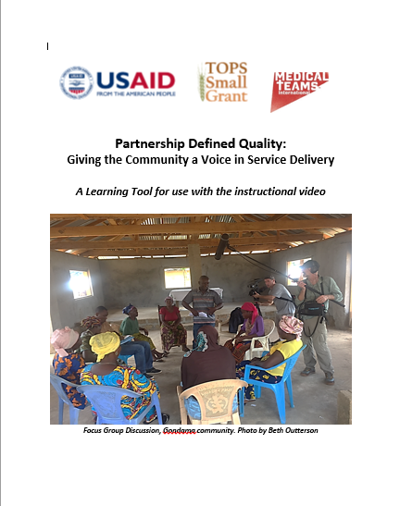
What is the PDQ Video Learning Tool?
A guide that helps to enhance a group’s learning about PDQ after viewing the video.
The Learning Tool includes:
  Frequently Asked Questions (FAQs)
  Discussion Questions
  PDQ resources
  Narrative script
Notes:
The Learning Tool accompanies the video. It helps facilitate learning after viewing the video.
The Learning Tool has 4 sections: Frequently asked Questions, Discussion Questions, PDQ Resources, and the narrative script from the video.
In this webinar we will focus on the two areas in red: the FAQs and the Discussion Questions.

Slide 6
Frequently Asked Questions (FAQs)
How long does it take to implement PDQ? How many staff?
  MTI: Phases 1-3; follow up QIT 3-4 weeks with 1 staff at 100% and 1 staff at 50% and 1 at 25% LOE; QIT follow-up should take 6 months.
How can low-literacy QIT members be equipped to mobilize their communities for social change?
  MTI: pairs of literate/non-literate QIT members conduct exit interviews; create pictorial images to share problems.
How will QIT be managed once the implementing NGO departs?
  MTI staff monitor QITs for 6 months, while training QIT in community mobilization, data collection, leadership, and advocacy. In Liberia, PDQ is endorsed by MOH, so QITs will be integrated into local government structures.
How can PDQ be taken to scale, given intensity of work and time needed?
  This has been an issue in some countries. Depends on minimal sustained funding, and manpower for monitoring and support. More feasible as a component within larger projects, and with prioritization by government. In Liberia, we are experimenting in Sinoe with a schedule of 2 teams each adding one new health facility each month and continuing QIT mentorship.
Notes:
The Frequently Asked Questions section answers some questions that were not included in the video that viewers may ask. Most of them related to the logistics and feasibility of PDQ.
Go through each question, read the answer from MTI’s experience

Slide 7
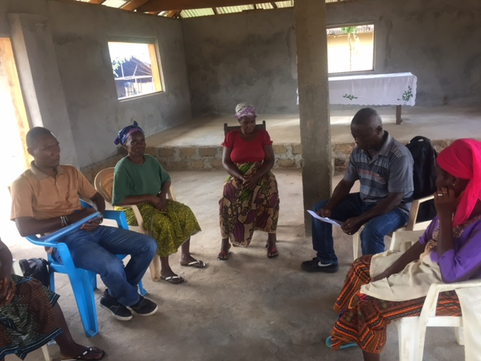
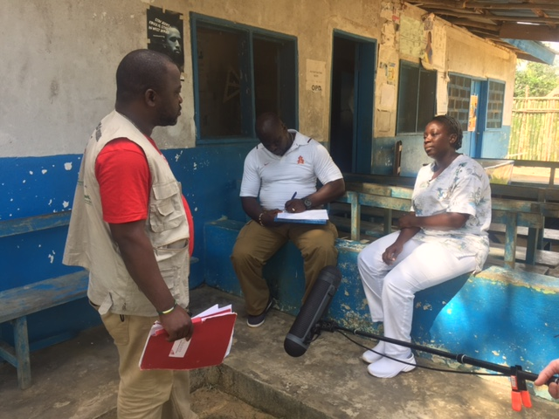
Discussion Question 1
Have you implemented the PDQ process before in any sector?
What are your experiences?
Who were the “partners” in the partnership within your context or in your sector?
Focus groups with community members and discussions with providers in Karnga community.
Notes:
The next section is the Discussion Questions which draw on the experience of the viewers and are meant to enhance discussion either in plenary or in small groups.
There are 12 Discussion Questions included in the Learning Tool. The facilitator can pick and choose which questions make the most sense for the audience.
I will go through 6 of them quickly with you just to give you a taste of the tool.
The first question is Have you implemented the PDQ process before in ANY sector?
And if so, what were your experiences? Can you talk about those who would be perceived as the 2 partners in the partnership?

Slide 8
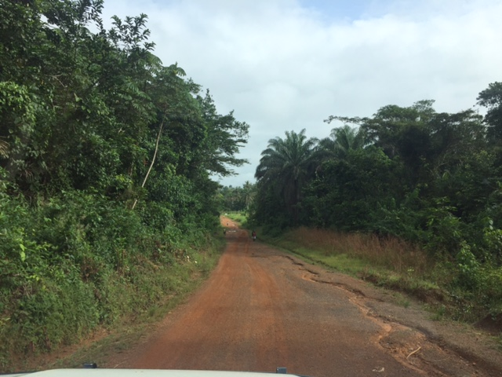
Discussion Question 2
PDQ attempts to address issues and barriers that the community has tried to overcome but has not had success. Most are social barriers that keep people from accessing services.
What were some of the barriers mentioned in the video?
What other barriers do you see in the communities you work in?
Rural road in Grand Cape Mount County
Notes:
The second question talks about social barriers. PDQ attempts to address issues and barriers that the community has tried to overcome but has not had success. Most of these are social barriers – things basically outside the health system that keep people from using services. They could be infrastructural, environmental, etc.
Addressing these barriers as social barriers is unique about PDQ, and focuses in on the viewpoint of the community members’ and the providers’ daily struggles to achieve good health care in the community.
So there are two questions:
What were some of the barriers mention in the video? (no place to deliver baby, clinic is in bad shape, leaking roof, no respect between provider and client, poor relationships that keep people from coming to the clinic, etc.)
What other barriers do you see in the communities you work in?

Slide 9
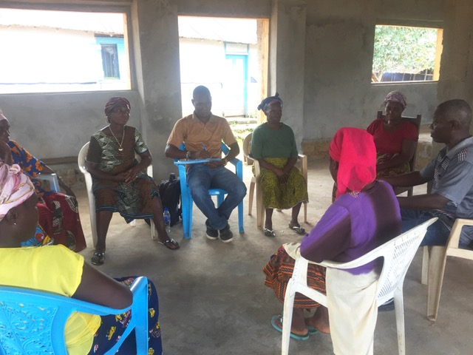
Discussion Question 3
During Phase 2, Exploring Quality, the facilitator starts the focus group discussion with a story about buying cassava in the local market. Much time is spent helping community members think through how they select who they will buy from.
Why do you think that understanding the meaning of quality is important?
Focus group discussion, Karnga community
Notes:
The next question has to do with Phase 2: Exploring Quality. As you recall, Phase 2 is when the implementing NGO conducts FGDs with the community members and providers. In the warm up to the FGD questions, the facilitator tells the story about buying cassava in the market. This is often a long and drawn out story that people enjoy.
Question: why do you think that understanding the meaning of quality is important?
(it gets people to think about the right they have to choose the best cassava in the market, and how that relates to their right to good (quality) health care when they go to the clinic.)

Slide 10
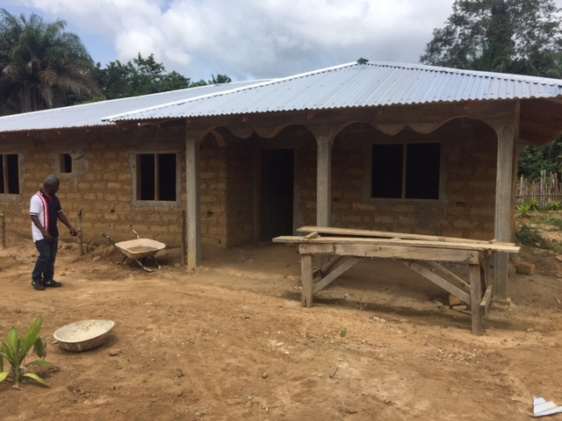
Discussion Question 4
PDQ can work in a variety of settings, as long as there are cohesive communities within a catchment area and providers that are responsible to provide a service.
PDQ is based on social barriers to services (health, educational agricultural, etc.).
used most often where there is strong motivation for change.
more difficult where there is NGO saturation, since there may be less willingness to volunteer.
What are some country or program contexts where you think PDQ may work well?
The Bambalah QIT is building this staff housing next to the health facility. It will also serve as a maternal waiting home.
Notes:
As we stated, PDQ can work in a variety of sectors. Of course we mostly have examples in the health sector. But the most important thing is that there are cohesive communities within a catchment area that pertain to a provider or group of providers (when we say providers we refer to clinic staff, which includes some clinical and some non-clinical). PDQ works best when there is a strong motivation for change. It is more difficult where there is NGO saturation which could create an expectation of perdiems etc.

Slide 11
Discussion Question 5
The PDQ process allows for adaptations to the local culture:
In Liberia, exit interviews were conducted by teams of QIT members (one literate, one non-literate)
In Pakistan, a different team building game was used since it is not appropriate for men and women to have physical contact. QITs were separate for men and women.
What kinds of adaptations do you foresee would be needed to conduct PDQ process in the communities you are working in?

Slide 12
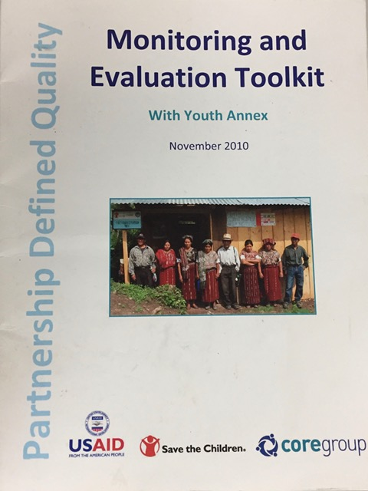
Discussion Question 6
Some standardized tools exist for measuring progress in PDQ.
What were the tools mentioned in the video to measure quality improvement?
What tools do you know of to measure “quality”?
What challenges do you face in measuring “quality”?
Save the Children’s PDQ M and E Toolkit

Slide 13
Next Steps for MTI
January 20: Haiti launching event with NGO network
January 31: Liberia launching event and meetings with development partners and donor agencies
Ongoing: Dissemination of Video and Learning Tool through website, social media and conferences.
Ongoing: Promotion of PDQ within other country projects
Notes:
These are MTI’s next steps for rolling out the PDQ video and Learning Tool.

Slide 14
What are your Questions?
The video Partnership Defined Quality: Giving the Community a Voice in Service Delivery and accompanying Learning Tool were made possible by a grant from The Technical and Operational Performance Support (TOPS) Program. The TOPS Micro Grants Program is made possible by the generous support and contribution of the American people through the U.S. Agency for International Development (USAID). The contents of the materials produced through the Micro Grants do not necessarily reflect the views of TOPS, USAID, or the U.S. Government.
Notes:
Before we go to questions, I would like to thank the TOPS Small Grants Program, which funded this project. The TOPS program is administered by Save the Children, and funded by USAID. Thanks very much for your support in making this project possible.

